Slide 2
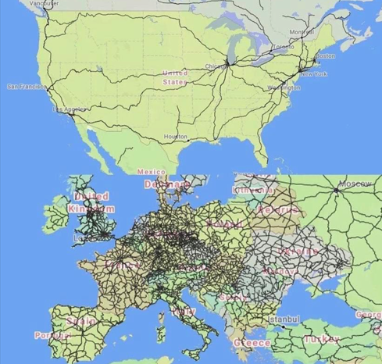
Flows in relation between home and society - comfort, economy and sustainability
Gunnar Persson
Expert Housing and Planning

Slide 3
Flows to and from home
Water, hot and cold Sewage Water, Heat,
Gas Heat
Electricity Power, Light, Heat
IT Information
Goods Recycling Products, Waste
People Family, Social Interaction

Slide 4
Quality Outcomes
On the agenda Start
Social Interaction 1940
Safety 1970
Environment 1970
Sustainability 1980
Climate 2010
Security 2020
Resiliens 2020

Slide 5
Tools for flow
Now Development
Tubes (water, sewage, heat)
Wires (electricity)
Fiber (IT) Dematerialization to
Electromagnetic Wawes
Vehicles (car, public transport, bicycle etc) Drons, Automatic cars
Walking (by foot) Electrical kick bike

Slide 6
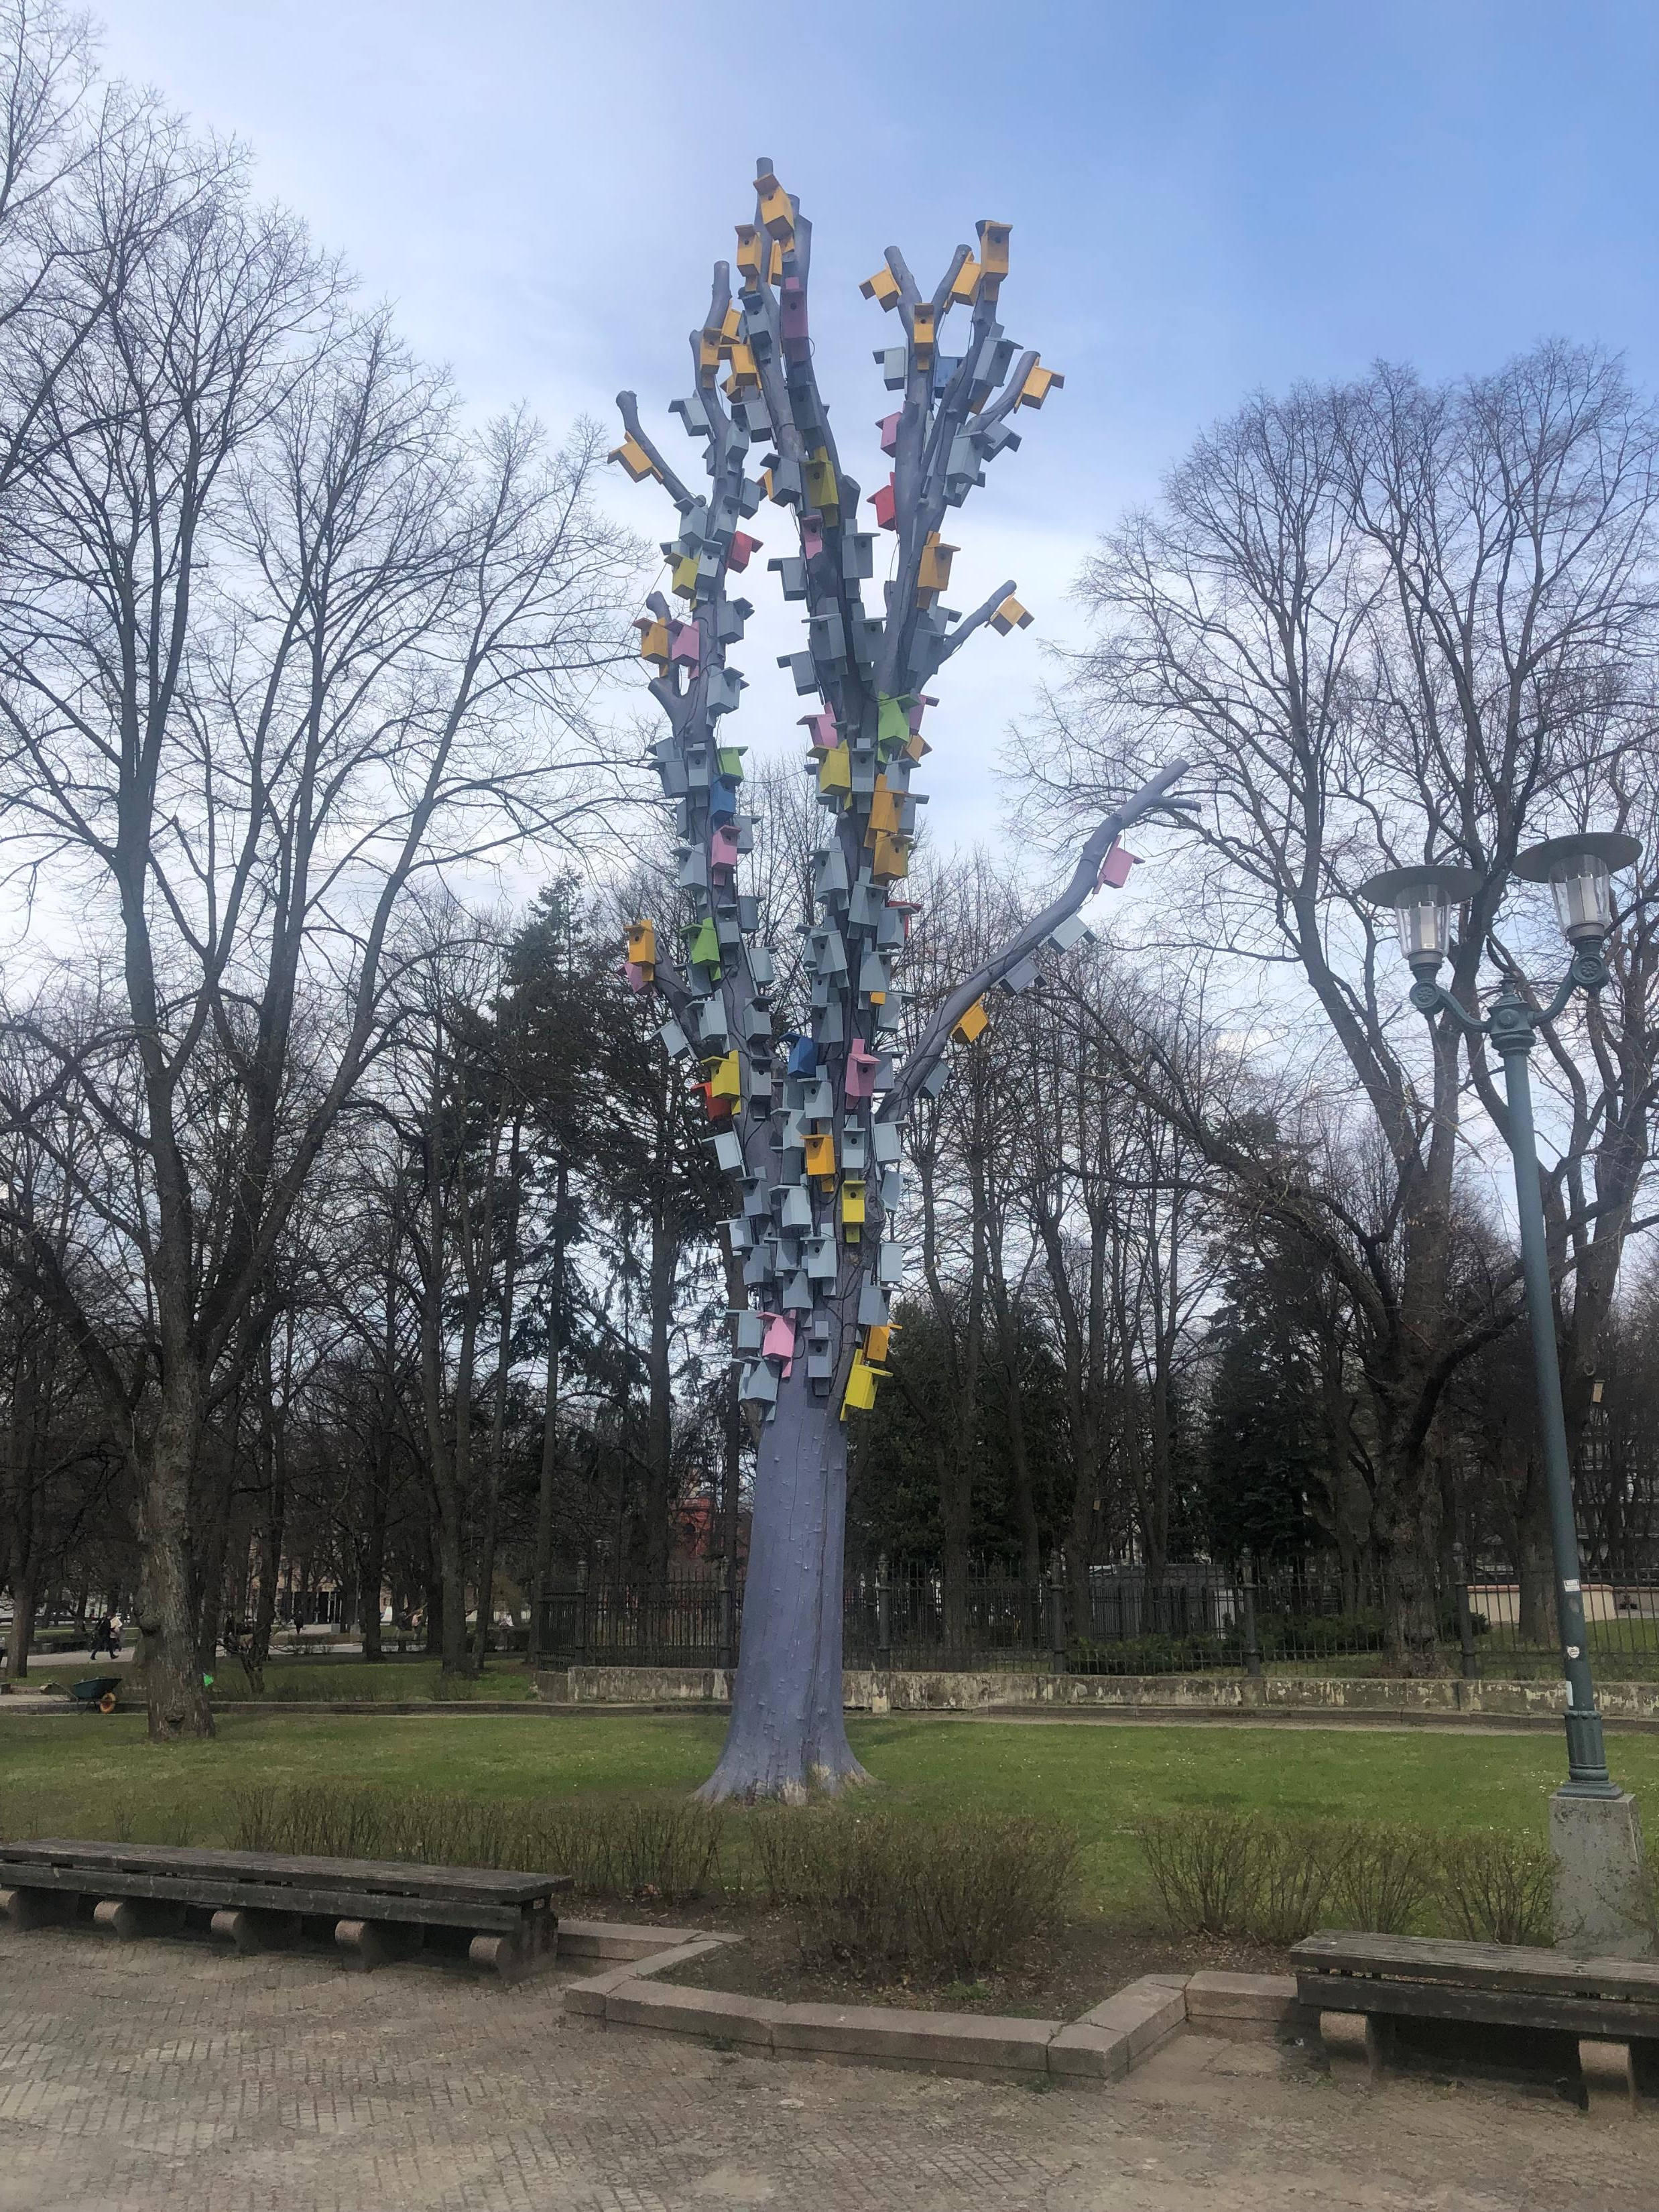
Flows of People - where in everyday life?
Home
Work/School
Commerse
Leisure, (sport, health, library)
Other services
Friends, relatives

Slide 7
FAMILY
Two parents, two children
Moving pattern in everyday life
Work 1
School 2
0,5 km
School I
Sport 1
7 km
2 km
Work 2
3 km
9 km
Vehicle
Distance
Experiences
Sustainability
Time
Comfort
Economy
HOME
2 km
1 km
4 km
6 km
Sport 2
Commerce
5-15 minute city

Slide 8
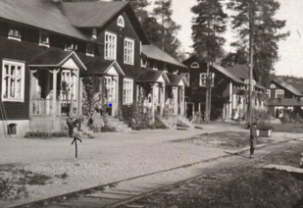
Tools for peoples flow - modal split
Cars
Public Transport
Bicyle/Electric bicycle
Motorbike/Mopeds
Walking
Electronic kick bikes

Slide 9
New ways to activate
New life styles
Staying home
IT instead of buying newspapers, records, books. films
Receiving different goods and services at home instead of going somewhere
Working at home
Work out at home
Travelling at home (travel stories)
Facebook instead of meeting each other
Watching sport at home

Slide 10
Framtiden and mobility
Situated in Gothenburg
Municipality owned housing company
76 000 flats and 150 000 people in Gothenburg
39 000 parking places (cars)
1000 new flats every year.
Framtiden

Slide 11
Framtiden and mobility
76 000 flats and 150 000 people in Gothenburg
More comfort time saving, healthy, safe, funny, beautiful, trustful, secure, safe, short, just
More cost effective cheaper
More sustainable less contamination, more climate friendly
Framtiden and mobility

Slide 12
Tools
New housing in the optimal place
good access to public transport, service, greenery, good local climate
Car parking get more expensive,
Car parking less comfortable comparing to other vehicles,
Permit parking instead of Your own,
Parking car pay its own costs not included in the cost for flat
Car sharing
Better possibilities for delievering goods (package hubs)
Bicycle sharing
Travel Pass for a period to change habits
Waste and recycling possiblities close to home
Possiblities to work home or in local coop working areas
Short and safe roads to schools
Cultivating in the neighbourhood
Mobility Hubs
Tools

Slide 13
Different approaches
Flexibility
Recycling
Function
Business model
General
Sustainability

Slide 14
Functions in a Mobility Hub
Energy
Storage
Parking
Mobility Services
Logistic Services Goods
Facility Management
Recycling, Waste
Dialogue, Meeting points
Trade
Service
Sharing Services

Slide 15
Conclusions
Flows are essential for our lifes
Digitalisation means less need of transport to physical places
To where and how we move matters on sustainability
Moving patterns are changing and developing
Framtiden are activley working to change its tenants behaviour
New ways of collecting mobility needs in one place is developing

