Slide 1
LiiDi2 - Digital twins for mobility
International Federation of Municipal Engineering (IFME) World Congress
Helmi Tuori, Forum Virium Helsinki, Finland
18.4.2023 IFME World Congress, Birmingham, UK
Notes:
Hello, I´m Helmi Tuori from Forum Virium Helsinki,
project manager of the LiiDi2 project, and here to talk about the Digital Twin of Mobilityt

Slide 2
Digital twins in urban context
Notes:
Firstly some background information
I would like to discuss the concept of Digital twins, and how we understand them

Slide 3
A digital twin of a city
Digital
Social
In industry, the digital twin
reflects physical entities
in a digital form
City
The digital twin of the city
should also include urban
processesses and human
behaviour
Physical
Adapted from: Suomisto & Autio, Helsingin kaupunki
Notes:
Digital twins are known from the industry, where physical entities are decsribed in digital form as copies
In order to be able to monitor the functionality of them more easily and assess possibilities of optimatisation without tempering the actual facilities
As we talk about cities, urban spaces as operating environment, we need to add aditional data to the equation, such as the behavior of people

Slide 4
Digitally first
The Urban digital twin: an entity of co-operating datasets and systems.
Awareness of data sources allows the combination and further processing.
City model
Geospatial data
Registers
Sensor data, simulations & plans
Digitally first:
Plan the full life cycle before building
Simulated impacts before changes are made
Better understanding → Better decisions→ Better city→ Quality of life
Notes:
That is why we do not talk of digital twins as one entity, but in plural: we have different sources of data that when combined together
Helps us undestand the interactions and dependencies better
In order to accomplish that we need information on infrastructure, conditions, processes and feedback
That way we are able to not only better understand but alsoi to simulate and test scenarios and hence make better decisions regarding the complex entity of a city

Slide 5
Mobility scope
…some of these data sources may also be of interest to the mobility…
Urban
Digital
Twin
Mobility
Digital
Twin
… but some can also be mobility specific and not become a part of the urban digital twin…
Urban digital twin integrates several data sources…
… because of this, it might be easier to discuss a Mobility Digital Twin more specifically.
Working paper available at:
https://mobilitylab.hel.fi/app/uploads/2022/09/Digital-Twin-for-Mobilty.-Working-paper-version-9-September-2022.pdf
Notes:
That is also the reson we need to set focus points, such as digital twins for mobility
There are certain charasterisctics regarding the data that describes mobility, traffic and their standards

Slide 6
LiiDi2 - Digital Twin for Mobility project

Slide 7
LiiDi2 project
LiiDi2 - Digital twin for mobility as an enabler of services
The project is run from August 1, 2021 - August 31, 2023
The project is implemented by Forum Virium Helsinki (project coordinator) and Stara, Helsinki City Construction Services
The project is funded by the European Regional Development Fund (ERDF), and the project is financed by the Union of Uusimaa as part of the measures implemented by the European Union due to the covid-19 pandemic (REACT-EU)
Notes:
LiiDi2 project. -Digital twin for mobility as an enabler of services
Is a two year project implemented by Forum Virium and the Helsinki city construction services Stara
We are funded by the Euorpean Regional Develoment Fund, and the covid 19 inspired REACT-EU money
So we have a background in enhancing cities resilience and ability to address timely the accelerated change in mobility

Slide 8
Forum Virium Helsinki
An innovation company established in 2005, which co-creates urban futures together with city units, companies and research units
A non-profit limited liability company fully owned by the City of Helsinki
Three main focus areas: smart city, smart mobility and data & IoT
Employs 60 top experts
The company operations are funded by the City of Helsinki and different EU projects with about EUR 8–10 million project portfolio a year
Notes:
Now I would like to introduce us, the project partners,
first Forum Virium Helsinki
We are a non-profit, fullly cityowned company of the City of Helsinki
We cocreate urban futures together with city units, companies and eresearch units and residents
We act as an agile operator, sort of a bridge between the city of Helsinki and the companies
Our operations are funded mainly by EU funding instruments – our project portfolio is about EUR 8–10 Miljon Euro

Slide 9
Forum Virium Helsinki as partner
Companies' new solutions and business models
Experiments, pilots and innovation competitions
The city as a test bed for new services and technologies
Living labs and resident cooperation
In Digital Twins context:
The digital twin of mobility
Using data in planning
Opening up data as a basis for companies' innovations
Notes:
Here some examples of the possibilitiues we offer as partner:
We offer the access to the city as a test bed and have experties in topics such as smart city, smart mobility and data

Slide 10
Stara, Helsinki City Construction Services
Stara verkossa:
https://stara.hel.fi/en/
An independent producer organization founded in 2009, which soon started using the name Stara
Six units: Urban engineering construction, Urban engineering maintenance, Construction engineering, Environmental management, Logistics and Administration.
Approx 1 400 employees
Turnover in 2021 was 228.9 million euros
Image: Veikko Somerpuro
Notes:
As our partner in this project we have Stara, Helsinki City Construction services
Stara is a producer organisation founded in 2009,
Stara builds Helsinki’s streets, parks and municipal engineering services – everything that a City’s infrastructure needs
With an yearly turnover of over 200 million euros

Slide 11
Stara as partner in building the digital of mobility
Stara builds streets, parks and municipal engineering services – everything that a City’s infrastructure needs. In addition to this, Stara is in charge of approximately 70% of the public areas in Helsinki.
Received snow loads 155,361 pcs
Managed street areas 1,116 hectare (ha)*
281 ha of street greenery to be maintained
Managed park areas 876 ha
*) hectare: a metric unit of square measure, equal to 100 ares (2.471 acres or 10,000 square meters).

Slide 12
LiiDi2 project’s scope
LiiDi2 project 8/21-8/23
https://fvh.io/liidi2_en/
The LiiDi2 project creates a model for the digital twin of mobility and develops new methods for collecting and making data available
The digital twin of mobility describes urban traffic, the traffic environment and conditions virtually
The digital twin for mobility brings together different data sources and, through their combination, opens up opportunities for the development of new services and a better functioning, liveable city
Notes:
LiiDi2 projects aim is to create a model for the digital twin of mobility together with companies and city units
We pilot methods for collecting and making data available
Our challenge is to recognise all relevant data and show what benefits the combining of those could bring for the city and companies alike

Slide 13
Digital Twin of Mobility
Infrastructure
Infrastructure & traffic environment
E.g. street structures, traffic signs, infrastructure condition
Traffic and movement
E.g. public and private vehicle traffic, number of vehicles, light traffic: cyclists, scooters, pedestrians, quantities, flow
Circumstances & context
E.g. weather conditions, air quality, road works, events, residents' feedback
Digital Twin of Mobility
Traffic
Conditions
Notes:
In our understanding The digital twin of mobility describes urban traffic, the traffic environment and conditions virtually
The data dimensions we use are
infrastructure & traffic environment (street structures, traffic signs
Traffic (public and private vehicle traffic, pedestrians)
Traffic conditions (weather, air quality,resident feedback)

Slide 14
The Digital Twin - a set of interoperable systems
Mapper /
Data producer
Files
Data processor service
Digital twin
Contract
Contractor /
Data producer
Contract
API
API
Contract
Official /
Process owner
Operations planning
Analysis tool
API
Data storage service
Contract
Operations planning
Official /
Data owner
Operator /
Data user
API
API
Contract
Operator /
Data producer & user
API
Data market
2022 J-P Virtanen (Forum Virium Helsinki)
Notes:
Here you see a nice picture of a digital twin, that is in realtiy a set of interoperable ssystems and data

Slide 15
The Digital Twin - a set of interoperable systems
Mapper /
Data producer
Files
Data processor service
Digital twin
Contract
Contractor /
Data producer
Contract
API
API
Contract
Official /
Process owner
Operations planning
Analysis tool
API
Data storage service
Contract
Operations planning
Official /
Data owner
Operator /
Data user
API
API
Contract
Operator /
Data producer & user
API
Data market
2022 J-P Virtanen (FVH), orange circles added for 18.4.2023 by Tuori
Notes:
Our interest is to figure out:
Who are the data producers,
where does the ownership lie and
how we can make sure, that Companies and city units can cooperate, create better services and new business by sharing mobility related data

Slide 16
LiiDi2 project focus points
Current state &
needs
4-10/2022
Data sources 8-12/2022
Data collecting
12/2022-05/2023
Definition work &
modelling
02/2023 - 06/2023
Mapping the needs of the businessesand city units, identifying potential data sources
Designing challenges based on Stara's production data and supplementary data sources and mentoring implementation at the hackathon
Stara's mobile fleet as an IoT platform & urban environment as an IoT platform
What is the digital twin of movement, and what is required for its development
Key goals
Key goals
Key goals
Key goals
Current state
Needs mapping
Building a network of actors
Combining data sources
Making data available
Metadata model
Innovative use cases
IoT platform solutions
Standardized installation models
Data sharing mechanisms
New innovative products and services
Compilation of observations collected in previous work phases together with the business network
A model of the digital twin of mobility (DTM)
Support for innovative procurement
Requirements for the DTM data ecosystem
Design by PresentationGO.com
Notes:
Our project has four focus points:
The mapping of needs related to the digital twin of mobility
Recognising potential data sources and use cases
Piloting ways for data collecting and modelling new data sharing mechanisms
Defining the shape of a digital twin of mobility: the requirements, data sources, ecosystemic way to enhance the use of it

Slide 17
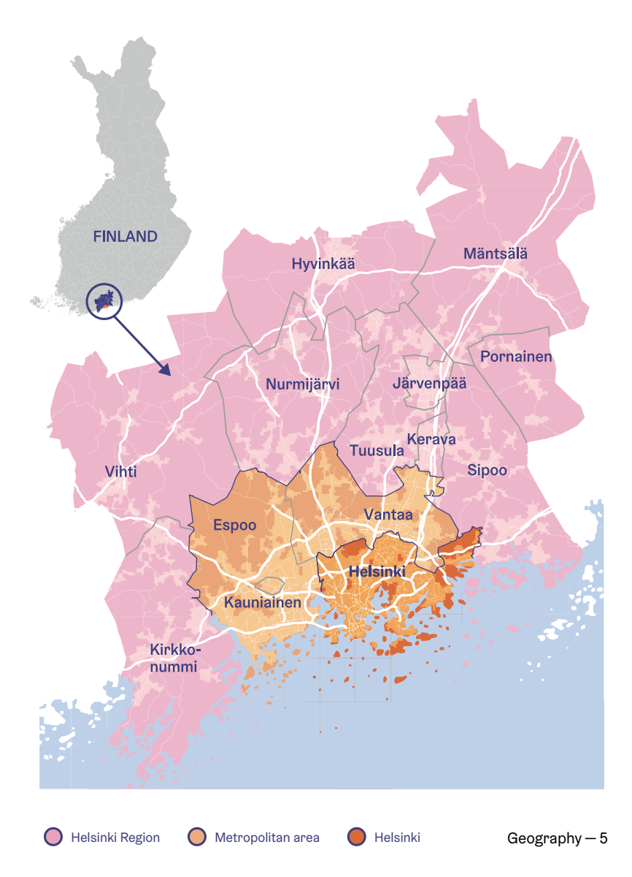
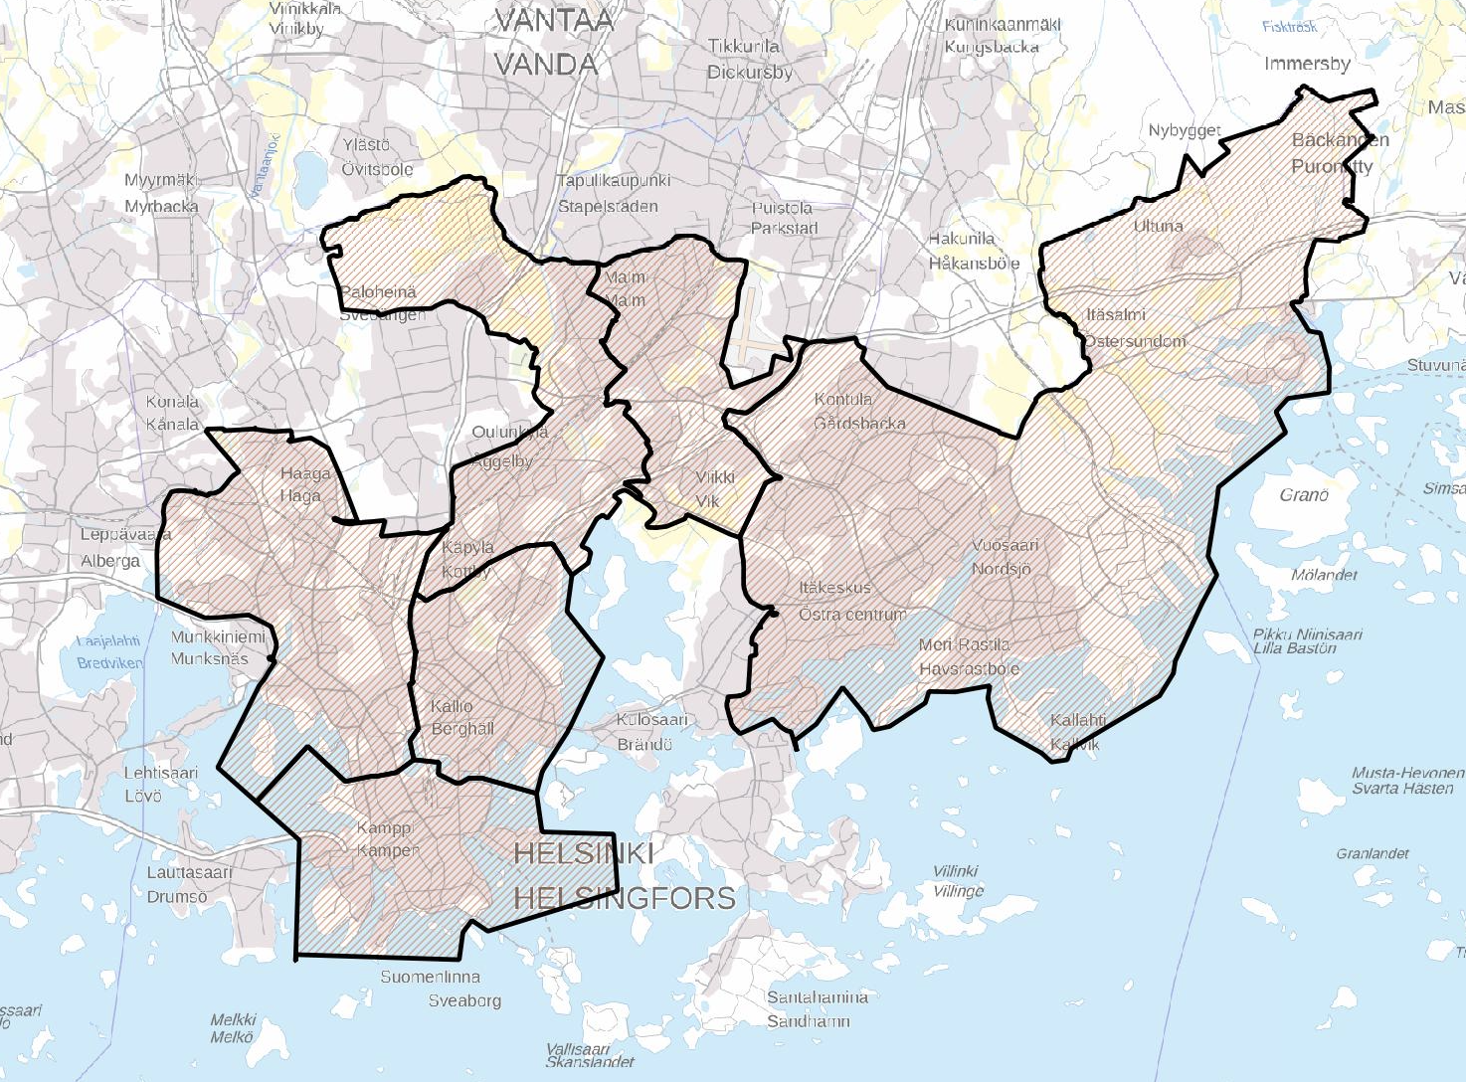
Helsinki, the capitol city of Finland. In 2021 total 658,457 habitants.
Stara builds Helsinki’s streets, parks and municipal engineering services – everything that a City’s infrastructure needs. In addition to this, Stara is in charge of approximately 70% of the public areas in Helsinki.
Stara manages a fleet of approximately 1,240 pieces of machinery, of which 450 are used by other City divisions on the basis of leasing agreements.
Stara’s city engineering maintenance department has approximately 550 vehicles in its fleet.
Notes:
Now, as we approach the concrete doings I want to show you the potential of Stara, why we are partnered in this project.
Stara operates as stated before in Helsinki, the capital city of Finland. Helsinki has a population of over 600 000 persons.
Stara is in charge of approx 70 % of the public areas in Helsinki
And Stara´s maintenance fleet consists of over one thousand two hundred vehicles
Stara´s city engineering department has approx 500 vehicles in its fleet.
So, as we talk about this mobile fleet as potential plat form and data source, you get the hang of it.

Slide 18
LiiDi2 project organised together with the Metropolia University of Applied Sciences a Digital Twins - Building sustainable futures within the most functional city -hackathon 11/2022
Forum Virium Helsinki & Helsinki City Construction Services Stara offered two challenges:
Challenge 1: Overcome winter conditions to improve equal urban mobility
Challenge 2: Reboot logistics: Optimizing for sustainable supply chains
For the hackathon a metadata model was developed for describing data in a standard form as well as a data catalog as a pilot of take-in-use of data sources
The hackathon verified the usability of city’s maintenance and logistics production data
The hackathon brought also first new use cases for Digital twin for mobility in form of new product innovation
Data sources 8-12/2022
Designing challenges based on Stara's production data and supplementary data sources and mentoring implementation at the hackathon
Key goals
Combining data sources
Making data available
Metadata model
Innovative use cases
Notes:
In autumn last year we organised a Digital Twins hackathon with these two challenges, the idea was to offer
Stara´s maintenance and logistics production data.as one of the data sources
and in addition data from all the other Digital Twin for mobility angles: conditions, infrastructure
We were able to pilot the metadata format and ways of offering the data to users with a data catalog pilot
Most importantly we got new innovative use cases for the production data

Slide 19
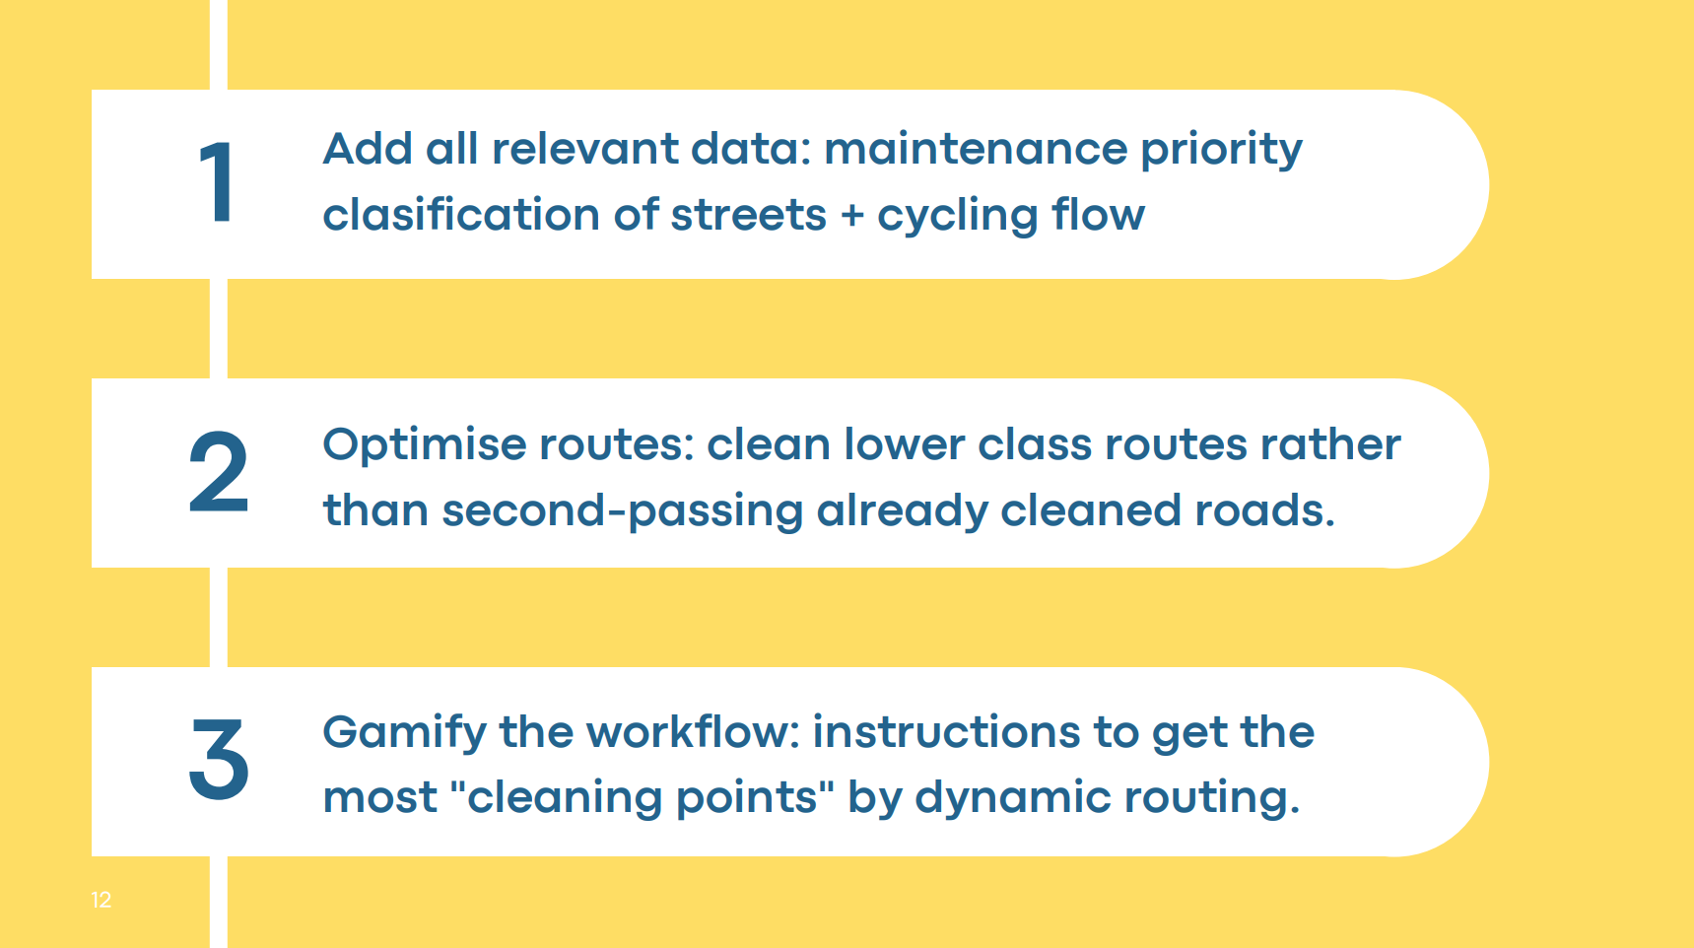
The application guides the employee based on the data.
In addition to the traditional care classification and work plan, the need for maintenance is identified with the help of data.
As the technical limit values change, so does the priority and weighting of the streets to be maintained.
Recommended routes are presented to employees with a React Native Android application.
The goal of the worker is to reach as many prioritized streets as possible in a limited time window.
End users:
The goal is to present the recommended routes to the city residents from the maintained roads to the public interface and to gamify the use of said routes also from the point of view of end users.
Data sources 8-12/2022
Designing challenges based on Stara's production data and supplementary data sources and mentoring implementation at the hackathon
Key goals
Combining data sources
Making data available
Metadata model
Innovative use cases
Notes:
Altogether 9 teams chose our challenges and here we have one example of the results: Winterpac
The Winterpac team wants to promote the city of Helsinki's year-round maintenance and cycling goals from the perspective of gamification.
The Helsinki Pacman game collects relevant dynamic data sets instead of traditional maintenance classifications and work plans, which brings a significant change and reform to previous practices.
Based on traffic flows, the goal is to understand the degree of usability of different lanes at different times of the day, which helps to achieve more timely implementation of maintenance measures, as well as effectiveness.

Slide 20
The concept of agile pilots
At the heart of the agile pilots is the opportunity for learning and dialogue between the city and companies
The client of the agile pilots formulates a challenge for which the companies propose innovative solutions
goals are set for the pilot both on the part of the client and the implementer (company)
the selected companies will receive a subsidized opportunity to carry out the pilot in the city environment, as well as a moderate amount of money to cover the immediate costs of the pilot, such as equipment
the companies carry out their pilot as planned, and discuss the results and lessons learned with the client
the companies also present the pilots: goals and final results at an open event organized by the client at the end of the trial period
Notes:
Then I move on to the data collecting efforts:
We were looking for innovative IoT solutions with both Stara´s mobile fleet as platform as well as the urban environment, that is stationary infra as platform
We opened two agile pilot tendering processes
In agile pilots we formulate a challenge, to which companies then offer solutions
The companies get the opportunity to use city of helsinki as a testbed
And they discuss and report their findings as they demo the actual pilot

Slide 21
Data collecting
12/2022-05/2023
The LiiDi2 agile pilots will be carried out in the period 03-05.2023
Two agile pilots with the focus of the digital twin of movement:
Stara's mobile fleet as an IoT platform
The urban environment as an IoT platform
In the pilot, the company gives a trial run on:
data collection method,
shows the combinability of several data qualities through visualizations as well as
demonstrates installation models related to the IoT platform with its own solution
The goal is to learn:
how to standardize a city-level IoT installation
understanding of the benefits of combining data in operational development
how to innovate with data as the basis for new products and business
Stara's mobile fleet as an IoT platform & urban environment as an IoT platform
Key goals
IoT platform solutions
Standardized installation models
Data sharing mechanisms
New innovative products and services
Notes:
We wanted the companies to figure out
new data collecting methods
To show the data and analyse it
The goal was to get the companies not only collect data, but to combine it with other data in order to achieve better insight
In LiiDi2 project we not only wanted to get innovative pilots, but also learn from the implementation:
Could we standardise the installation models somehow
How could we implement data sharing mechanisms, that would foster data collecting and sharing between companies and the city units

Slide 22
Agile pilot 1: Stara´s mobile fleet as IoT platform
In the current state, route information is collected from the mobile fleet of Stara's urban technology maintenance with the help of telemetry devices installed in the vehicles.
From the point of view of Stara's operational development and city-level data management, data collection potential has been identified in addition to route information:
in the vehicle on-board computer data (FMS) as well as
in additional maintenance equipment connected to the vehicle, such as plows and sandblasters (data collection and transmission protocol EN-15430-1)
Notes:
In the first pilot we asked the piloting companies to make use of
the FMS data of the mobile fleet vehicles
As well as data from the additional maintenance equipment connected to the vehicle

Slide 23
Agile pilot 2: Urban environment as IoT platform
In terms of the development of the urban environment, in addition to driveways, key mobility related data could also be generated by, for example, public transport stops on light traffic routes or smart waste bins
In terms of the digital twin of mobility, the data available from light traffic routes would complement, for example, the knowledge base of the urban environment industry to support the quality control of maintenance measures and street and traffic planning
Notes:
In the second pilot, the focus was wider and gave more room for innovations:
We were seeking for innovative solutions that would gather data as attached to the stationary infra of the city
In terms of the digital twin of mobility, the data available from light traffic routes would complement the knowledge base of the urban environment function to support the quality control of maintenance measures and street and traffic planning

Slide 24
Sensor-based air quality data from mobile equipment and a fixed measuring point
Maintenance fleet here: utilization of truck FMS and accessories EN-15430-1 data collection and transmission protocols
Sensor-based, local microclimate data
Conditions
Digital Twin of Mobility
Traffic calculation based on machine vision and artificial intelligence
Data analysis of EN-15430-1 data collection and transmission protocols for truck FMS and additional equipment
Traffic
Infrastructure
Analyses & impact
Traffic flows: quantities, directions, types, lead times. Based on data analysis:
→ examination of the impact of maintenance measures in an urban environment
→ support for traffic planning purposes
→ simulation of the changing traffic environment, anticipation
Monitoring and analysis of the performance and action data produced by the maintenance fleet:
→ analysis and optimization of the performed procedures
→ equipment consumption in relation to the maintenance work done on the equipment and the perceived effectiveness, life cycle management, partial optimization of ways of doing things, new ways of doing things
Microclimate data: temperature, humidity, dew point.
→ real-time situational data
→ forecast modeling
→ analyzes based on the desired weightings as a basis for situational assessments of maintenance work, for work planning and prioritization
The real-time effect of maintenance measures on local air quality, as well as reference values for fixed measuring points in the area.
→ utilization of mobile fleet for data collection at city level
→ identifying and monitoring factors affecting air quality
→ optimization of measures and processes
Notes:
This is what we got:
The company wapice offered traffic calculation based on machine vision (camera) and artificial intelligent
Kaltio Technologies installed micro weather sensors to street sections knows as difficult
Swarco Finland installed air quality sensors both to the mobile fleet and a fixed measuring point in a traffic light pole
GSGroup was interested in the maintenance vehicle’s FMS data in combination with its EN data
Oinride focuses on the analysing of the data retrieved from the vehichle
VAIHDA KALVO

Slide 25
Sensor-based air quality data from mobile equipment and a fixed measuring point
Maintenance fleet here: utilization of truck FMS and accessories EN-15430-1 data collection and transmission protocols
Sensor-based, local microclimate data
Conditions
Digital Twin of Mobility
Traffic calculation based on machine vision and artificial intelligence
Data analysis of EN-15430-1 data collection and transmission protocols for truck FMS and additional equipment
Traffic
Infrastructure
Analyses & impact
Traffic flows: quantities, directions, types, lead times. Based on data analysis:
→ examination of the impact of maintenance measures in an urban environment
→ support for traffic planning purposes
→ simulation of the changing traffic environment, anticipation
Monitoring and analysis of the performance and action data produced by the maintenance fleet:
→ analysis and optimization of the performed procedures
→ equipment consumption in relation to the maintenance work done on the equipment and the perceived effectiveness, life cycle management, partial optimization of ways of doing things, new ways of doing things
Microclimate data: temperature, humidity, dew point.
→ real-time situational data
→ forecast modeling
→ analyzes based on the desired weightings as a basis for situational assessments of maintenance work, for work planning and prioritization
The real-time effect of maintenance measures on local air quality, as well as reference values for fixed measuring points in the area.
→ utilization of mobile fleet for data collection at city level
→ identifying and monitoring factors affecting air quality
→ optimization of measures and processes
Notes:
You see that we have data collecting pilots that touch all angles of the Digital Twin for mobility
I use the Swarco pilot as example of the impact potential with this kind of data collecting and analyses
With this kind of sensoring (air quality) we can see how the removal of sand from the lanes after the winter affects the situational air quslity during the temoval process and how it affects the overall air quality after the removal when measured from a fixed measure point
→ identifying and monitoring factors affecting air quality
→ optimization of measures and processes

Slide 26
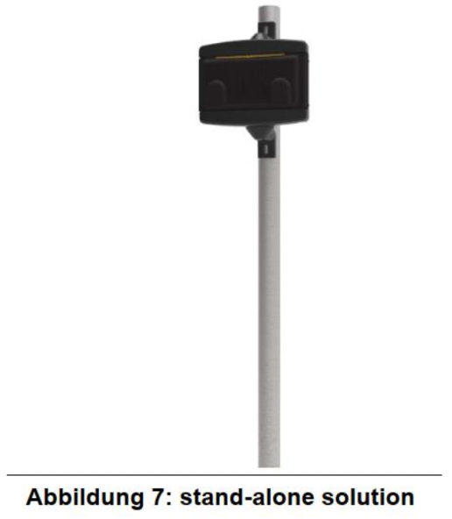
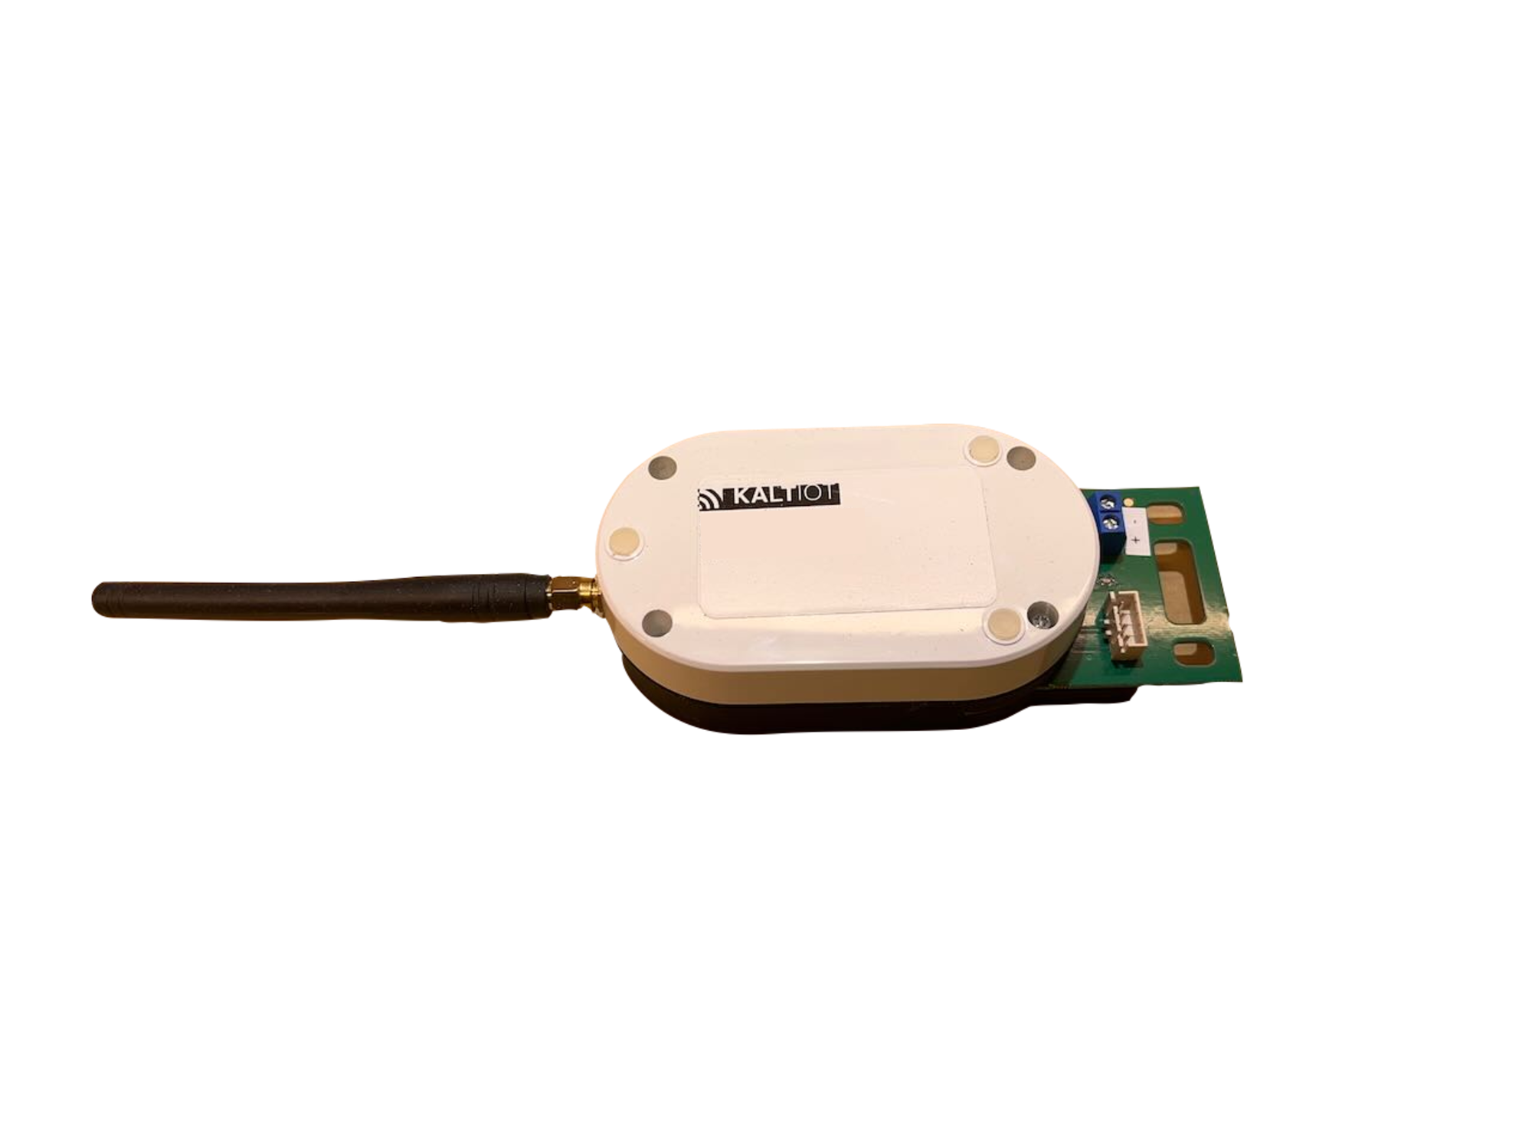
LiiDi2 kokeilut: Staran liikkuva kalusto & kaupunkiympäristö IoT-alustana
LiiDi2 kokeiluiden avoin demo 16.5.2023,
tervetuloa!
Sensoripohjainen ilmanlaatudata liikkuvasta kalustosta sekä kiinteästä mittauspisteestä
Kunnossapitokaluston tässä: kuorma-autojen FMS- ja lisälaitteiden EN-15430-1 tiedonkeruun ja -siirron protokollien hyödyntäminen
Sensoripohjainen, paikallinen mikroilmastodata
Olosuhteet
Liikkumisen digitaalinen kaksonen
Konenäköön ja tekoälyyn perustuva liikennelaskenta
Kuorma-autojen FMS- ja lisälaitteiden EN-15430-1 tiedonkeruun ja -siirron protokollien datan analysointi
Liikenne & liikkuminen
Infra
Analyysi & vaikuttavuus
Mikroilmastodata: lämpötila, kosteus, kosteuspiste. → reaaliaikaista tilannedataa
→ ennustemallinnuksia
→ analyysejä haluttujen painotusten pohjalta kunnossapitotyön tilannearvioiden pohjaksi, työnsuunnitteluun ja priorisointiin
Kunnossapitotoimenpiteiden reaaliaikainen vaikutus paikalliseen ilmanlaatuun sekä alueen kiinteiden mittauspisteiden vertailuarvot. → liikkuvan kaluston hyödyntöminen datankeruuseen kaupunkitasoisesti
→ ilmanlaatuun vaikuttavien tekijöiden tunnistaminen ja seuraaminen
→ toimenpiteiden ja prosessiosuuksien optimointi
Kunnossapitokaluston tuottaman suoritus- ja toimenpidedatan seuranta - ja analyysi:
→ suoritettujen toimenpiteiden analyysi ja optiminti
→ kaluston kulutus suhteessa kalustolla tehtyihin kunnossapitotöihin sekä havaittuun vaikuttavuuteen, elinkaarenhallinta, tekemisen tapojen osaoptimointi, uudet tekemisen tavat
Liikennevirrat: määrät, suunnat, lajit, läpimenoajat. Data-analyysin perusteella:
→ kunnossapitotoimenpiteiden vaikuttavuuden tarkastelu kaupunki- ympäristössä
→ liikennesuunnittelun tarpeet
→ muuttuvan liikenneympäristön simulointi, ennakointi
Notes:
auttaa yllä- ja kunnossapitotyön tietopohjan laajentamista toimien tuotannolle päätöksenteon tukena.

Slide 27
Why are Digital Twins so intriguing?
Better, combined data → Better understanding → Better decisions → Better city → Quality of life
Better, high quality, comprehensive and updating data on our urban operating environment gives us tools for knowledge based analyses, trend spotting and eventually decision making
Together with human processing capacity and insight this data serves for more accurate operations, optimised workflows and proactive proceedings
Better functioning and perceived services, new business
Better everyday for the citizens in a more liveable city
Notes:
To conlcude: why do we bother?
Better, high quality, comprehensive and updating data on our urban operating environment gives us tools for knowledge based analyses, trend spotting and eventually decision making
Together with human processing capacity and insight this data serves for more accurate operations, optimised workflows and proactive proceedings
Better functioning and perceived services, new business
Better everyday for the citizens in a more liveable city

Slide 28
Thank you!
Helmi Tuori, PM, FVH Tel. +358 40 617 5333 helmi.tuori@forumvirium.fi
Toni Liikamaa, PM, Stara Tel. +358 40 506 9704 toni.liikamaa@hel.fi
LiiDi2 project on web: https://fvh.io/liidi2_en/
Notes:
I thank you for your interest!
Together with me there is my co-project manager from Stara, Toni Liikamaa, and the Head of Unit of Stara logistics, Sami Aherva

Slide 30
Wapice Ltd.
Liikennelaskentakamera
Kiinteässä infrassa
Asennuspaikka Itä-Pasila, Ratapihantie 13 risteys
Kamera kiinnitetään keskikorokkeen liikennevalaisimeen
Kamerasuunta: etelä
Analysoi kokeilualueella kulkevat liikennevirrat: ajoneuvot yhteensä neljällä kaistalla sekä kevyen liikenteen virrat länsi- ja itäpuolella
tarkastelussa määrät, suunnat ja läpimenonopeudet

Slide 31
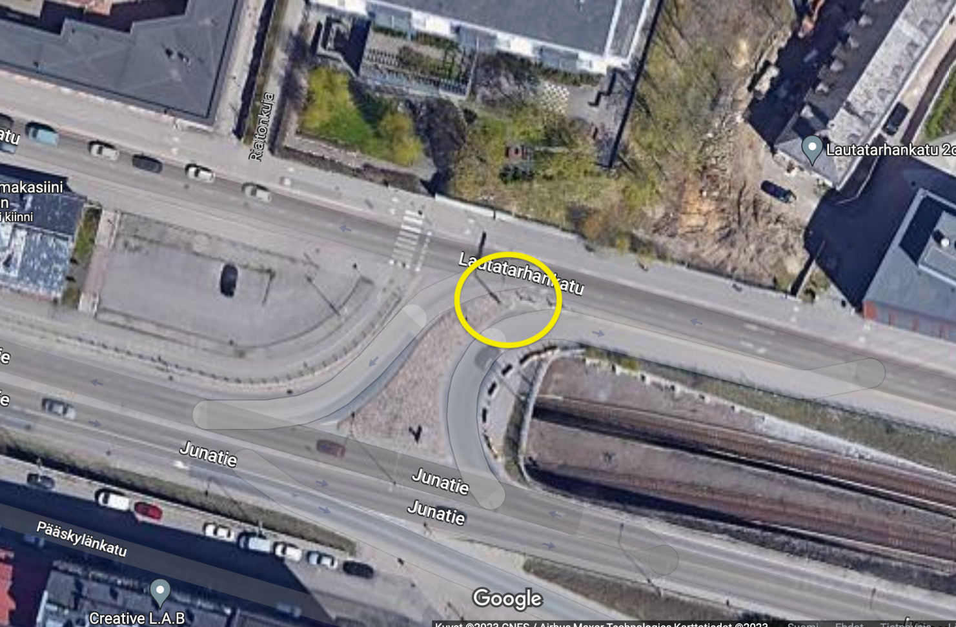
Kaltio Technologies Oy
Mikroilmastosensorit
Kiinteässä infrassa
Asennuspaikkoina:
Hakamäentien laskeutuva ramppi kohti Ratapihan- tietä Pasilassa
Lautatarhankatu, ennen haarautumista Junatielle
Mittaa ja analysoi kokeilualueella vallitsevan mikro- eli paikallisilmaston: tienpinnan lämpötilan, kosteuden

Slide 32
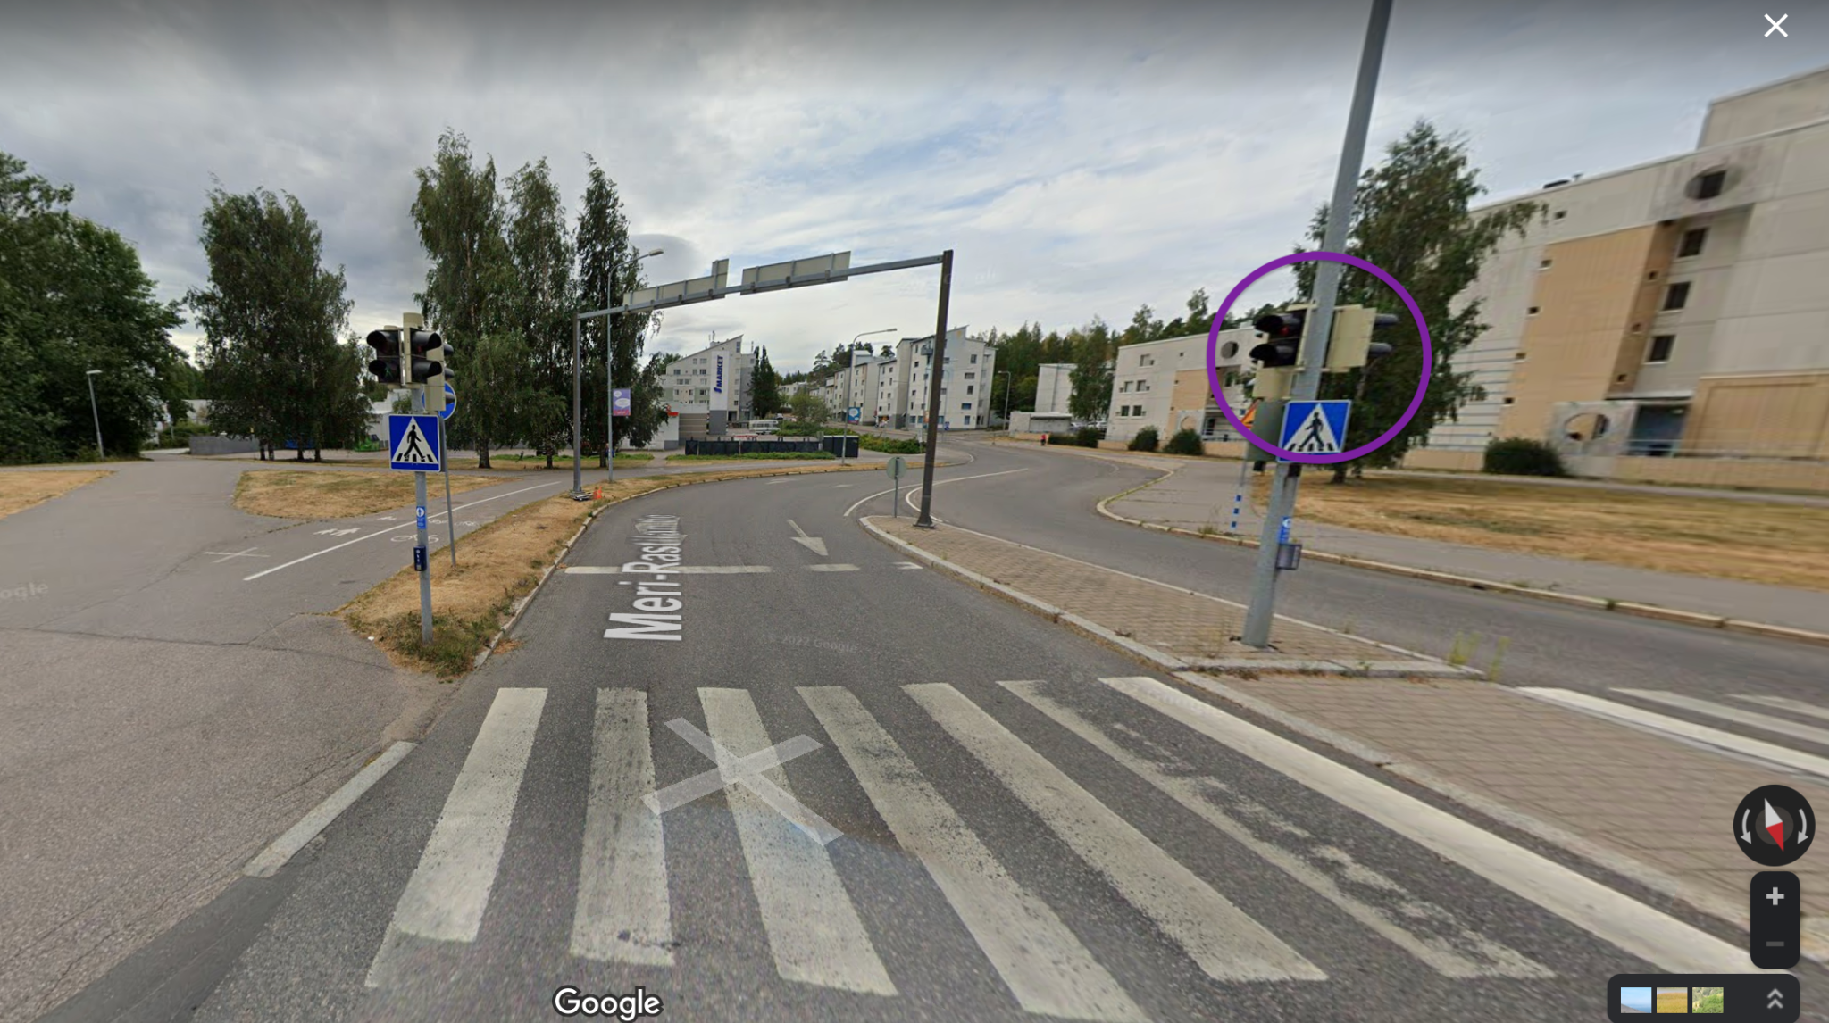
Swarco Finland Oy
Ilmanlaatusensorit
Liikkuvassa kalustossa ja kiinteässä infrassa
Asennuspaikkoina:
Hiekannostoletkan autoista: Volvo ja Harja-Wille Vuosaaressa
Meri-Rastilan tien ja Vuotien risteyksen liikennevalaisin
Mittaa ja analysoi kokeilualueella vallitsevan ilmanlaadun sekä kiinteästä mittauspisteestä että liikkuvan, hiekannostoa suorittavan ajoneuvon sensoreista

Slide 33
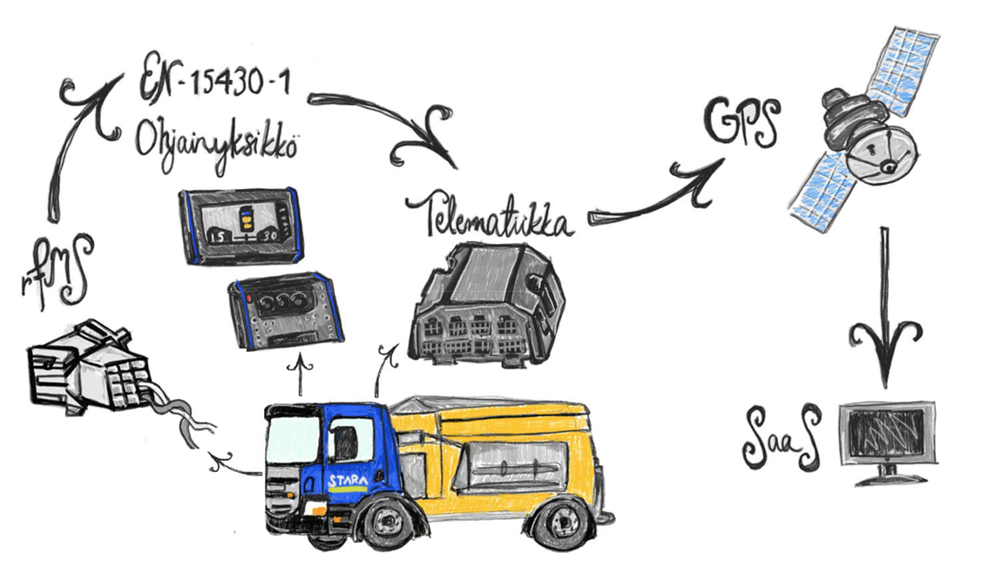
GSGroup Finland Oy
Scania kuorma-auton FMS -standardin mukainen datan tiedonkeruu ja -siirto.
Sähköllä ja hydrauliikalla toimivien lisälaitteiden EN-15430-1 -standardin mukainen datan tiedonkeruu ja -siirto.
Tiedonkeruu ja -siirtostandardien avulla pystytään keräämään, tutkimaan ja analysoimaan ajotietokoneen, sekä ohjainlaitteen dataan perustuvia tapahtumia.
Tavoitteena on mallintaa liikkuvan kaluston datasta erilaisia kunnossapidon toimenpiteitä, jotka synnyttävät uusia liikkumisen digitaalisen kaksosen mallin mukaisia käyttötapauksia sujuvamman kaupunkiympäristössä liikkumisen tueksi.

Slide 34
Oinride Oy
Volvo kuorma-auton FMS -standardin mukainen datan tiedonkeruu ja -siirto.
Sähköllä ja hydrauliikalla toimivien lisälaitteiden EN-15430-1 -standardin mukainen datan tiedonkeruu ja -siirto.
Tiedonkeruu ja -siirtostandardien avulla pystytään keräämään, tutkimaan ja analysoimaan ajotietokoneen, sekä ohjainlaitteen dataan perustuvia tapahtumia.
Tavoitteena on mallintaa liikkuvan kaluston käyttöä ja kalustolla tehtävien toimenpiteiden vaikuttavuutta elinkaarenhallinnan näkökulmasta, joka mahdollistaa monipuolisemman kaluston hyödyntämisen osana käyttöasteiden kasvattamista.

Slide 35
Data
Kaikissa kokeiluissa tavoitteena, että data ei jää pelkästään kokeilijan tarjoaman dashboardin taakse, vaan saadaan myös “sopivan raakana” omaan datavarastoomme
Tällä toivotaan helpompaa yhdistettävyyttä muiden tuottamaan dataan
Eri datalähteitä yhdistämällä syntyy liikkumisen digitaalinen kaksonen

