Slide 1
What’s Your Why: Decarbonisation
Priyani de Silva-Currie
IPWEA NZ President & Technical Director Asset Advisory Beca

Slide 2
Notes:
Imagine a future New Zealand, or a Future England – what does it look like? What would climate change do to this vision?
Only you will know if this is important to you. The balance of our korero is based on the assumption that you might care enough to take some action, and that you want to learn how to do your bit to protect what you have and the life and freedoms you enjoy.

Slide 3
What is your Why?
Notes:
What Is Your “Why”?
Your “Why” is a statement of purpose that describes why you do the work you do and why you live the lifestyle you do. It is the core source of motivation for you and a reference point for all your decisions and actions, your conviction and perhaps your calling.
The story I will tell you today will hopefully help you to think about your Why, why you are here at this forum in particular, and what climate change means for you, I hope you find this interesting and give you food for thought:

Slide 4
Let’s start our journey with a story from just the other day…
Notes:
Every good Why starts with a story. This story is not about carbon, its about motivation that brings about change, its real recent, and very human

Slide 5
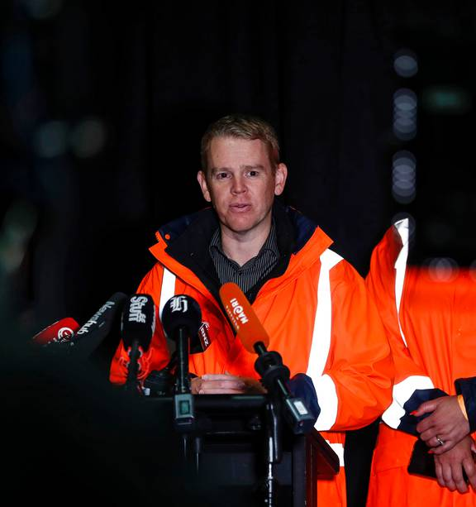
National State of Emergency
Notes:
Cyclone Gabrielle Hits New Zealand, National State of Emergency declared in February 14th 2023 by Prime Minister Chris Hipkins. Only the third time in history this has occurred. Two times in two weeks New Zealand was hit by two Category 3 Storms which created each occasion 1/100 year floods.
This story starts with my husband Rob who was deployed to be the national emergency response controller for Waka Kotahi (the New Zealand Transport Agency) working with other national utility and services providers to complete the initial response and emergency management. They started on shifts with teams rolling in and out every 48 hours. Little did I know at the time, this was to last 7 weeks of being a national emergency response controller for my husband and testing times ahead….

Slide 6
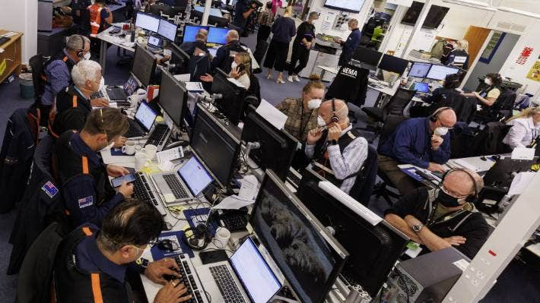
Notes:
This is the NZ Government Beehive Bunker – National Civil Defence HQ during the Emergency Response, politics and emergency provision all interacting together

Slide 7
Notes:
Until an emergency occurs we don’t tend to think about how to know where everyone is. The Unaccounted people, started at 11,000 and by day three just six people unaccounted for, by day 6 all people accounted for, Tragically 11 people confirmed dead. I recall Rob telling me, Priyani we just don’t know how many people there are out there dead or alive, they are searching all the rivers and shorelines for bodies…

Slide 8
Notes:
We all take for granted that we can go anywhere in this country. Network resilience – highways and communities isolated for days and weeks, some communities only just now receiving access via alternative route or baily bridges. Risk and hazard mapping by central and local government is not mature enough to deal with widespread destruction across multiple utilities and geographies. Each day Rob was making decisions on which areas required what level of intervention, how lifelines would be opened and how and when communities would be made accessible.

Slide 9
Notes:
Two sides of the same coin, major tracts of our commercial forestry destroyed – our carbon sinks and primary industry – interesting that it was forestry offcuts that created much of the damage down stream.

Slide 10
Notes:
Our whole country now knows about “slash” the terrible effects of timber debris coming off hills and accumulating on and then smashing bridges, structures, waterways, and beaches. Creating flooding and destroying communities, A young child died in Hawkes Bay when loose slash on a beach rolled onto him.

Slide 11
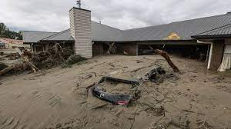
Notes:
Silt – a silent killer, carrying contaminant matter, hazardous to breathe, and invasive through all materials. Complete areas of New Zealand have now been “red zoned” where silt has taken over and cannot be removed. An impact on all arable land and areas of orcharding and irrigation zones. National plans have been developed for Silt Management – who knew that was going to be a thing!

Slide 12
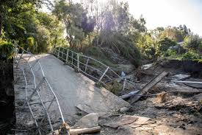
Notes:
The value of bridges to connect communities cannot be understated and a learning for New Zealand is the supply and provision of temporary structures to create access and lifelines. Some communities had to be serviced by Boat for fuel and supplies, some by air. But those provisions are temporary and soon residents face a reality of having to find their own way to negotiate across rivers and creeks on a daily basis to get to family, the school, the shops or get to the doctor.

Slide 13
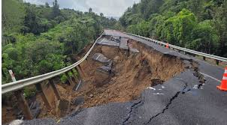
Notes:
Matters keeping Rob and others up at night, is evaluating the total cost of remedial recovery and potential new critical and lifeline route alternatives. This is an exercise that the New Zealand Transport Agency Waka Kotahi is now undertaking. This is billions of dollars of capital investment over a lifetime to improve resilience, but will it be enough? Are we just waiting for the next climate event?

Slide 14
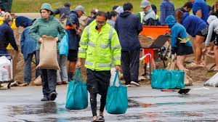
Notes:
Displaced people and communities. Homes, lives and work all affected. Insurance alone will not cover the cost of remediation or repair, that provision in New Zealand is a mix of central government and private insurance and international reinsurance. As found with the Christchurch earthquakes of 2011/2012 the cost and time to deal with recovery rolls on to this day.
Electricity connections gone, people were relying on generators and gas supplies. Stealing generators became popular. Internet and Phone Lines down, a lack of communications, people not knowing for up to a week where there loved ones were Civil Defence Emergency Management Teams had Starlinks (sat phones, these too were stolen from ‘non secure’ facilities. Cash was king again for essential transactions as EFTPOS was not available, people lurking near money machines to steal from those who withdrew cash. Ques for fuel to leave town, this was shortlived as tankers couldn’t supply these communities, people became stranded without the ability to leave. Crime and looting and generally just poor behaviour, severe events bring out the best and the worst in people.
For me this was personal, my Rob, our friends and family were in the midst of these devasted communities, and created much of my WHY around resilience planning and decarbonsiation.

Slide 15
Notes:
Now Let us Go back to thinking about NZ and change tack. I live in this beautiful country, it is known internationally as clean and green, a large part of why I live here is because of New Zealands principals of Kaitiakitanga (guardianship), sustainability and environmental protections.
NZ signed up to the Paris Agreement climate change target, in 2016, a little late to the party. Emissions must reduce by 7.6 percent per year from 2020 to 2030 to keep temperatures from exceeding1.5°C or 2.7% per year to stay below 2.0°C increase in temperature over that period. To put this into context, NZ emissions account for 0.17% of the worlds gross carbon emissions. But just because we are insignificant in emissions, we are adversely affected as much as the rest of world by the effects of global emissions. We are not doing that well, we are over the carbon budget in 2020 reporting, 1.03% higher than our annual carbon budget.
Take a look at our glacial retreat and you will see we just aren’t meeting the pace of climate change. Our glaciers are a stark signal of a warming planet.
While we can reduce damage to our environment by reducing emissions and reducing global warming by 1.5°C, we can not eliminate it all. New Zealand has a history of solving challenges through innovation, resourcefulness and determination. Adapting to climate change is no different.

Slide 16
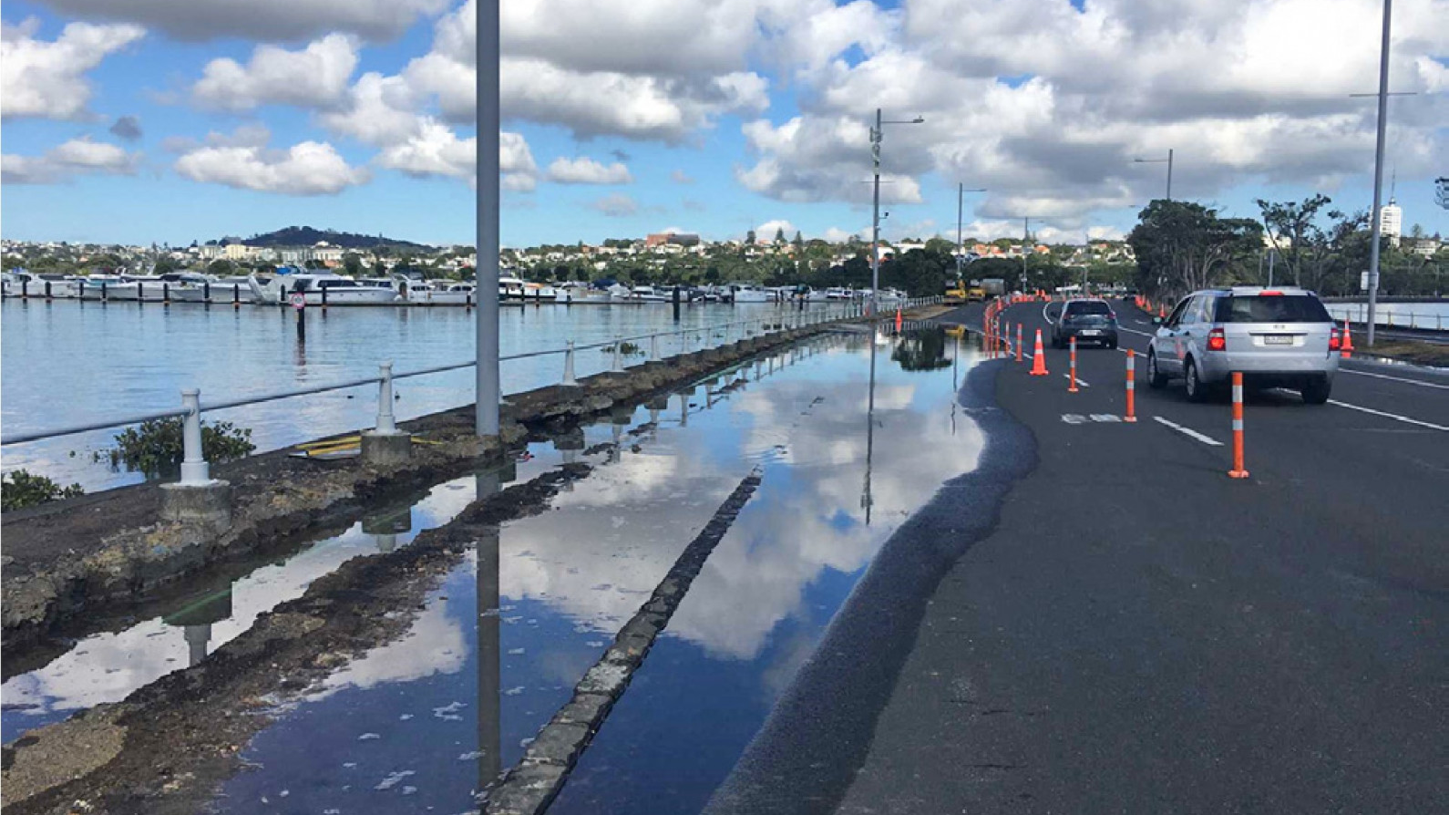
What is Climate Related Risk?
Notes:
Let’s think about some other risks directly affecting NZ. sea level rise, and increased weather events. In New Zealand, our relative sea level has risen by an average of 1.81 millilitres per year since we began keeping records 100 years ago. We live on as island surrounded by water, strong air and sea currents, a temperate, but increasingly warmer and wetter climate on the west and drier climate on the east. This is called Climate Related Risk.
This is a picture of a king tide at Mission Bay in Auckland. Rising sea levels will make many coastal communities and infrastructure vulnerable to floods, tsunamis and other natural disasters. For all you roading engineers in the audience this is not just a blocked culvert.
Latest International Panel for Climate Change report released: IPCC Climate Change 2022: Impacts, Adaptation and Vulnerability
The report, agreed to by 195 countries assesses the impacts of climate change, looking at ecosystems, biodiversity, and human communities at global and regional levels. It also reviews vulnerabilities and the capacities and limits of the natural world and human societies to adapt to climate change. It recognises Specific impacts for Aotearoa New Zealand:
more rain
clean ice glacier retreat
more droughts and extreme fire weather
increased rainfall intensity
more severe cyclones.

Slide 17
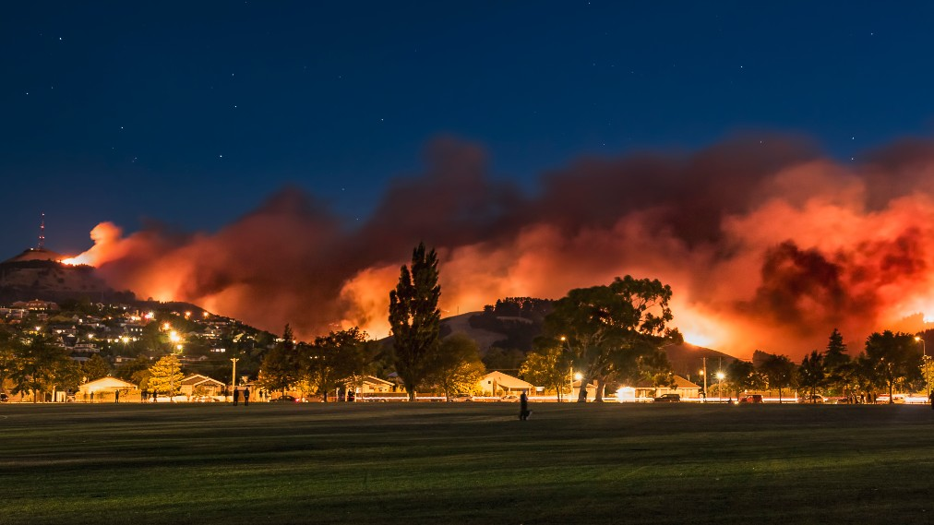
What is Climate Related Risk?
Notes:
This is a picture of the Christchurch Port Hills Fires in February 2017. This wildfire is directly attributable to increasingly warmer drier climates in the east of our country.
Climate change increases the risk of natural disasters
Extreme rain, drought and wildfire risk are expected to increase in many places. Areas that rely on rainwater for drinking and pasture will be especially hard-hit by droughts.

Slide 18
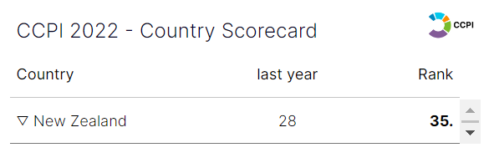
How is NZ Performing in Climate Change Actions?
Notes:
Some key facts you need to know, Climate Change Performance Index, This is our international score card:
By dropping seven spots from the previous year’s CCPI, to 35th, New Zealand moves among the low-performing countries. Ist Denmark, Loser (59th) Australia
New Zealand continues to rate low in the GHG Emissions category, agriculture accounts for about 48% of national GHG emissions and transport 17%. Most of our emissions which creates atmospheric warming come from Cows and Cars. Cows methane and nitrous oxide are dangerous but do not linger in our atmosphere, Cars and Co2 also dangerous persists in our atmosphere for 1000s of years.
New Zealand has adopted a legally binding net zero emissions target (excluding biogenic methane Cows) for 2050, through its Climate Change Response (Zero Carbon) Amendment Act 2019, The Act introduced no policies for cutting emissions, but instead set a framework. And no appropriate measures to fully reach this 2050 goal.
The country relies on reforestation to accomplish its goals. The country’s main instrument for reducing greenhouse gas emissions is an emissions trading scheme. Experts criticise the price ceiling as unreasonably low and criticise the agriculture sector’s exclusion.
An existing pledge for 100% renewable electricity by 2035 is likely to be met. reliance on coal for electricity generation has grown over recent years and the share of renewables has barely changed, no incentives for renewables.
New Zealand should proactively support indigenous people’s rights in international and national climate policy and I will discuss this further later in the presentation.

Slide 19
New Legislation, Plans and Guides, Mandatory TCFD Reporting
Resilience is Reducing, Not Increasing
Affects on Māori
Personal Changes you can make
Notes:
There are Four Key Areas to Take Away when thinking about Climate Change and Adaptation:
New Legislation, Plans and Guides and Mandatory TCFD Reporting
Resilience is Reducing not Increasing!
Affects on Māori
Personal Changes you can make
I will briefly touch on each of these now

Slide 20
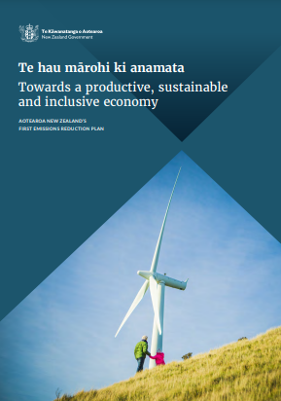
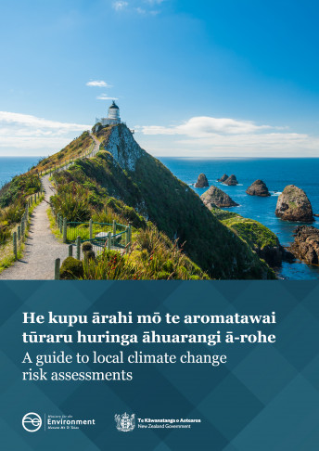
NZ has a Variety of Acts, Plans and Guides
Notes:
We Have Resources on hand! Policies Plans and Frameworks – Your first takeaway!
And we have taken previous steps we have already taken to address climate change, include:
passing the Climate Change Response (Zero Carbon) Amendment Act in 2019. This Act sets a target for all greenhouse gases except for biogenic methane – methane from agriculture and waste – to reach net zero by 2050.
major reforms to the New Zealand Emissions Trading Scheme
the end of new offshore fossil fuel exploration
putting the public sector on the path to carbon neutrality by 2025
sustainable finance reforms such as introducing a world-first climate reporting legislation, changing default KiwiSaver providers and establishing the New Zealand Green Investment Finance
major investment in public transport and rail, as well as programmes to encourage New Zealanders to buy cleaner vehicles (eg, Clean Vehicle Discount).
Draft National Adaptation Plan - useful
NZ has just finished consulting on a draft national plan to help Aotearoa New Zealand adapt to and minimise the harmful impacts of climate change.
This plan will build adaptation actions so that all sectors and communities. The consultation also outlines proposals for flood insurance and managed retreat policies.
The Resource Management Act 1991 (RMA) will be repealed and replaced with new laws this parliamentary term, These Acts are:
Natural and Built Environments Act (NBA) to provide for land use and environmental regulation (this would be the primary replacement for the RMA)
Strategic Planning Act (SPA) to integrate with other legislation relevant to development, and require long-term regional spatial strategies
Climate Change Adaptation Act (CAA) to address complex issues associated with managed retreat and funding and financing adaptation.
The guide to local climate change risk assessments - useful
sets out a framework for local government and community use, which is broadly consistent with the National Climate Change Risk Assessment Framework. The guide outlines the context for risk assessments within adaptation planning
Emissions Reduction Plan
The Government has released Aotearoa New Zealand’s first Emissions Reduction Plan, which outlines the actions to be taken across sectors to reduce our emissions. This is one of the steps to meet our 2050 net-zero greenhouse gas (GHG) emissions goal. The plan contains strategies, policies and actions for achieving our first emissions budget and contributing to global efforts to limit global temperature rise to 1.5˚C above pre-industrial levels.
The emissions reduction plan sets out targets on how Aotearoa New Zealand will reduce our impact on the climate
By 2050:
Long-lived greenhouse gas emissions are net zero
Biogenic methane emissions are 24–47% below 2017 levels.
The emissions reduction plan puts Aotearoa New Zealand on a path to achieve our longterm targets and contribute to global efforts to limit temperature rise to 1.5˚C above pre-industrial levels. The actions in this plan enable us to meet our first emissions budget. This requires Aotearoa to reduce our emissions by an extra 11.5 megatonnes of carbon dioxide equivalent (Mt CO₂-e) between 2022 and 2025. This is the emissions equivalent of approximately 4.3 to 5.5 million petrol-based cars driving 10,000 kilometres a year.
2022 Emissions Budget
Climate Change Minister James Shaw in May 2022 announced New Zealand’s first three emissions budgets, another milestone on of the journey toward a zero-carbon future.
He said: “these budgets will help to create new industries and high-value jobs; lower household energy bills; a more climate-friendly agriculture sector; warmer, drier homes; exciting new technologies; the protection of native species and eco-systems; cost savings for businesses; and greater resilience in the face of increasing global uncertainty,”
These budgets set out the total amount of emissions New Zealand must cut over the next 14 years. The Zero Carbon Act requires that emissions budgets are met through domestic action alone.
Rather than setting a target for emissions to reach a certain level in a single year, an emissions budget represents a multi-year target. The budget-based approach the Government established through the Zero Carbon Act is better for the climate, as it is not only emissions in a single year that impact climate outcomes.
New Zealand ratified the Paris Agreement on 4 October 2016 (New York time). The Paris Agreement entered into force on 4 November 2016 and took effect in 2020. This means New Zealand's commitments to reduce greenhouse gas emissions apply from 2021.
New Zealand’s first Nationally Determined Contribution (NDC1) was updated on 31 October 2021. The new NDC sets a headline target of a 50 per cent reduction of net emissions below our gross 2005 level by 2030. Our NDC covers the period 2021-2030.
New Zealand’s Nationally Determined Contribution (NDC) under the Paris Agreement, which is also managed as a multi-year emissions budget (from 2021 to 2030). The Paris Agreement, recognises that while countries need to take action at home, they can also work with other nations to cut emissions. That is why New Zealand’s new NDC goes beyond the domestic emissions budgets above.
Further Emissions Budget Information
Cabinet has agreed that the first three emissions budgets will be:
Emissions Budget 1 (2022–2025): 290 megatonnes of carbon dioxide equivalent greenhouse gasses (72.4 megatonnes per year)
Emissions Budget 2 (2026–2030): 305 megatones (averages 61 megatonnes per year) [in principle]
Emissions Budget 3 (2031–2035): 240 megatonnes (48 megatonnes per year) [in principle]
Emissions budget 1 averages out at 72.4 megatonnes per year. That equates to two megatonnes per year less than the five-year average leading up to this point (2017-2021), and 3.1 megatonnes less than projected emissions for 2022 to 2025.
Emissions budget 2 averages out at 61 megatonnes per year. That equates to an average of 13.4 megattones per annum, nearly twenty percent below average annual emissions from 2017 to 2021.
Emissions budget 3 averages out at 48 megatonnes per year, which equates to an average of 26.4 megatonnes per annum, or about thirty-five per cent, less than the average annual emissions from 2017 to 2021.

Slide 21
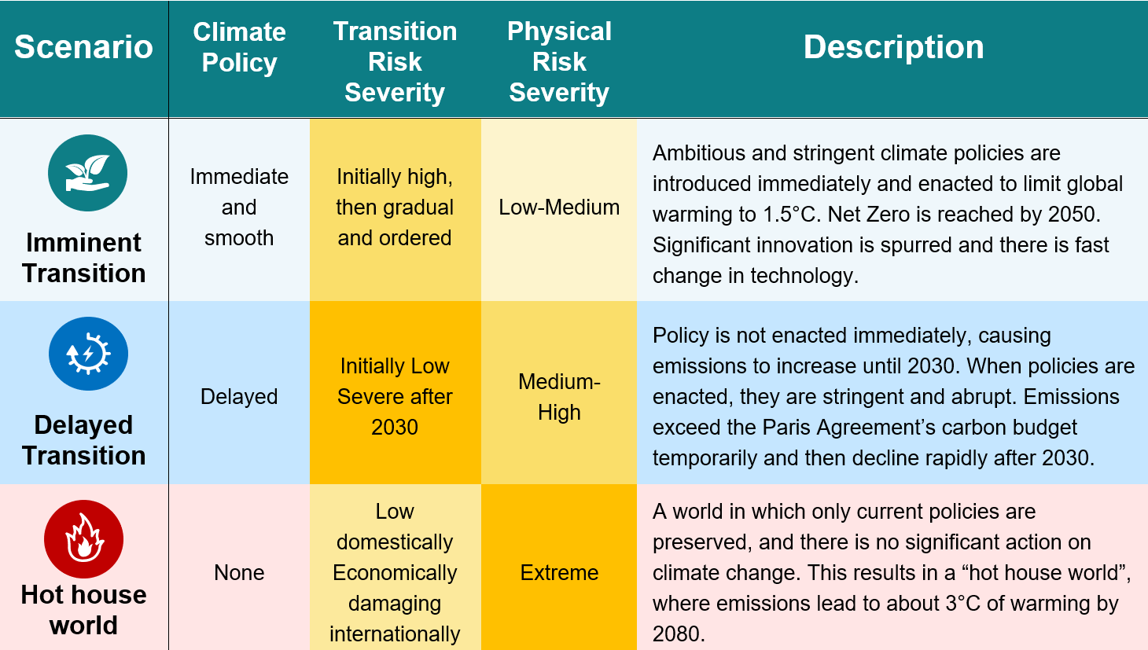
Climate Scenarios
Notes:
You might be familiar with these climate scenarios. These scenarios are developed by the Network for Greening the Financial Sector (NGFS), which are among the most widely used scenarios in the world. The key takeaways here are imminent transition, delayed transition and a Hot House World

Slide 22
Climate Change Reporting in Aotearoa – First in the World
Mandatory climate-related disclosures
Climate Change Response (Zero Carbon) Act
adopts
aligned with
Task Force on Climate-Related Financial Disclosures (TCFD) framework
Notes:
This is the 2nd thing I would like you to takeaway in your notes:
The Zero Carbon Act of 2019 already includes a reporting obligation for all public sector organisations in New Zealand – as well as for lifeline utilities in transport, water, power and other sectors. Last year, NZ Parliament passed legislation mandating climate-related disclosures for banks, insurers, and larger companies listed on the New Zealand stock exchange. Those requirements kick in in this year.
Aotearoa New Zealand has become the first country in the world to introduce a law that requires the financial sector to disclose the impacts of climate change on their business and explain how they will manage climate-related risks and opportunities. The Financial Sector (Climate-related Disclosure and Other Matters) Amendment Bill has just been past by Parliament
What does this mean? This mandatory requirement will put a spotlight on government and business. There are activities and assets that these businesses are involved in that will not hold their value in a low carbon world, simply because they emit too much climate pollution and contribute to the climate crisis. Similarly, there are technologies and activities that will cut emissions and become hugely valuable to the low carbon economy of the future.
Future Information
There are four main elements to the Bill:
It introduces mandatory climate-related disclosures for most listed issuers, along with large registered banks, licensed insurers and registered managers of investment schemes.
It requires the disclosures to be made in accordance with climate standards that will be issued by the External Reporting Board, or XRB.
The Financial Markets Authority will be responsible for the independent monitoring and enforcement of the relevant reporting entities’ compliance with the new reporting standards.
The XRB will be able to issue guidance material on environmental, social and governance reporting and other wider aspects of non-financial reporting.
More information available at: https://www.mbie.govt.nz/business-and-employment/business/regulating-entities/mandatory-climate-related-financial-disclosures
Climate Change Commission’s advice is as a warning that high-carbon investments will be increasingly risky as we get closer to meeting the Government’s climate targets of net-zero carbon emissions by 2050. This law will bring climate risks and resilience into the heart of financial and business decision making.
Reporting is based on the Task Force on Climate-related Financial Disclosures (TCFD) framework, which is widely acknowledged as international best practice.

Slide 23
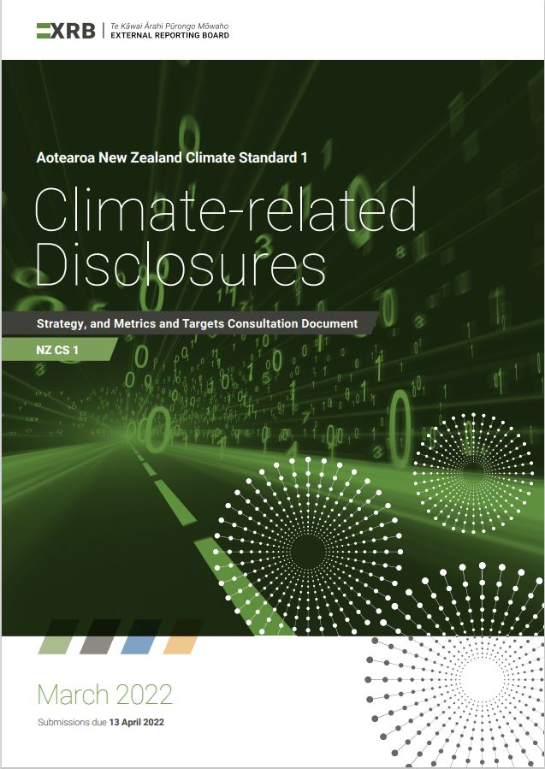
The TCFD Framework
Matt.Raeburn@wsp.com
Notes:
TCFD is the newest process used to assess climate risks You will need to know this:
At this point want to acknowledge my colleague Mr Matt Reaburn, who is the guru in this area, formerly a Ministry for the Environment leader, now at WSP, Matt developed and implemented climate-related disclosures in Aotearoa NZ, Matt is working with many government organisations on TCFD reporting and has examples he can share with you. Climate risk-related reporting is already changing NZ, and we believe it will drive economic transformation in this country.
The Task Force on Climate-Related Financial Disclosures framework (or TCFD framework) is the internationally recognised framework for climate related reporting.
the TCFD framework takes very complex areas of climate-related risks – with all of their inherent uncertainties – and attempts to simplify them. The TCFD framework uses sub-categories of transition risks, physical risks, and opportunities
Climate scenario analysis is a key aspect of the TCFD reporting process. Here’s what those three scenarios look like over time scales and with a Y axis showing whether the physical or transition risks from climate change are more of the focus. NZ – will be more ambitious, requiring companies to use at least one scenario aligned with 1.5 degrees of warming and one high warming scenario.
The reason this TCFD framework exists is to provide transparency – to inform investors, stakeholders, clients and customers about how an organisation is handling its risks and opportunities related to climate change – and particularly financial risks (that’s the F in TCFD).
Reporting using the TCFD framework is required for many New Zealand companies, and the TCFD framework is aligned with reporting requirements for public sector agencies under the Zero Carbon Act.

Slide 24
Our ‘Resilience’ is Reducing
We plan for Resilience but the reality is in New Zealand we just aren’t keeping up with Climate Change and Mother Nature
People are exhausted with dealing with Weather Events and Natural Hazards
The Frequency of 1 in 100 year or 1 in 50 year or even 1 in 5 year events has sped up.
Our Planning scenarios are not set to extreme, we are getting caught out repeatedly
Asset Lifecycles, lifelines and route security are not matching reality.
Notes:
We believe we are planning adequately for resilience, route security and lifelines, but each and every time we are caught out. Our planning scenarios are not extreme enough. The link is direct between global warming and increased severe weather events, increased rainfall or drought, temperature and sea rise.
Importantly the resulting effect on people is as devastating as the effect on our infrastructure. Repeated severe weather events and natural hazards takes a toll on everyone, the people who have lost their lives and homes and livelihood and those who are responsible for response and recovery and those people that support them. The entire nation is affected and that to me provides a very compelling WHY.

Slide 25
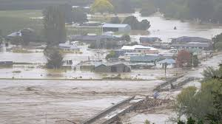
What is Your Why?
Notes:
The small community of Wairoa February 2023

Slide 26
This Photo by Unknown Author is licensed under CC BY-SA-NC
Notes:
Let us examine how Climate change affects Māori
Because of their close relationship with the environment and its resources, Māori people are among the first to be directly affected by climate change.
Māori face the loss of important cultural sites and taonga species. These changes would impact the spiritual, physical, intellectual and social values that are integral to the health and wellbeing of Māori identity.
e whenua (land), te wai (water), and taonga (treasured) species are being affected by climate change, which threatens traditional practices connected to Māori identity and wellbeing.
Culturally significant places are at risk
Numerous Māori cultural heritage sites – such as marae (meeting places) and urupā (burial grounds) – are situated in coastal low-lying areas.
These places are deeply connected with Māori identity and are especially exposed to impacts from climate change because of their location.
Hundreds of coastal urupā across the country are threatened by rising seas and more severe storms.
The loss of taonga (treasured) species
Taonga species such as tuna (eels), kōura (crayfish) and kākahi (mussels) are central to the identity and wellbeing of many Māori.
For generations these species have been the source of physical and spiritual sustenance for whānau, hapū, and iwi and have helped transfer customary practices and knowledge from one generation to the next.
Climate change is affecting our environment and the species that live here - many taonga species face extinction if things don't change.
The timing of tohu (environmental indicators) is changing
Alongside the loss of taonga species, climate change is also shifting tohu (environmental indicators) that Māori have observed and relied on for generations.
In the far north of the North Island one fisher noted, “I realised about two years ago things are changing. Things [plants] are blooming out of season. Fishing is all out of kilter. Mullet never came till winter and now you’ve got mullet coming any old time, sort of thing. It’s really changed.” (Te Hiku o te Ika Development Trust, 2018).
Mātauranga Māori (knowledge) may not be passed onto future generations
Mātauranga Māori is knowledge in its broadest sense. It is part of Māori culture, linked to Māori identity and is considered by some as a unique part of the identity of all New Zealanders.
Climate change can contribute to degradation in the mauri (life force) of ecosystems and taonga species and jeopardise the mātauranga associated with them. When a taonga species is lost the whakapapa (lineage or ties) between iwi, hapū, whenua (land) and taonga is severed.
The ability of tangata whenua to act as kaitiaki (guardians) over the taonga and engage in mahinga kai practices within their rohe (region) can also be degraded. Te reo me ngā tikanga (language and customs) and interactions between generations to share the mātauranga can also be reduced.
Ability to manaaki (hospitality) is threatened
Manaakitanga describes the responsibility of a host to care for whānau and manuhiri (visitors) through nurturing relationships and by providing shelter, food, and resources.
For Māori, manaakitanga is a way of life that can be shown in many ways. In homes, workplaces and everyday interactions, Māori people take great pride in caring for the wellbeing of others.
Tangata whenua usually do all they can to show generosity and kindness to their guests by sharing stories, singing waiata and treating them to the local delicacies for which their area is known. Climate change is likely to affect marae and customary harvesting grounds and cause major shifts in how whānau practice manaakitanga.

Slide 27
Conclusions
Mandatory TCFD reporting is a no-brainer
NZ has a lot of policy, framework and legislation with emissions budgets and targets
NZ has to address its Agricultural Sector
We haven’t achieved enough compared to other countries
NZ must partner with Māori to achieve these outcomes
This Photo by Unknown Author is licensed under CC BY-SA-NC
Notes:
Ensuring TCFD reporting is mandatory in NZ is a game changer. There are over 150 private sector organisations required to do TCFD reporting, over 600 public sector organisations incentivised to under the Zero Carbon Act. Without using a climate change lens to identify and manage risks – climate-related risks like these may be missed with potential for significant and material consequences to all New Zealanders, TCFD is a real evidence based assessment which highlights good and not so good practices.
We have a multitude of Acts, Policy, National Frameworks. But a general lack of tangible implementation actions as described in our official scorecard. For example although guides for local government and community urban development have been created recently. Its light on a nationalized approach, and open to interpretation by different sectors involved in urban form. Can we continue to build and settle communities in coastal areas with sea level rise? Can we manage retreat and is retreat an option for many existing towns and cities in New Zealand?
Clearly there is more work to be done on our Agricultural Sector – I don’t have the answer to that, we are a nation of primary producers. I see pockets of innovation in some production areas including 100% electrification and reducing or removing fossil fuel based operations. Balancing energy use and decarbonization is a fine balance. NZ has a head start there with embodied carbon from energy generation is lower than many other countries.
We have the Te Tiriti o Waitangi (Treaty of Waitangi) governs our Partnership with Maori to really achieve sustainable low carbon outcomes in New Zealand. A traditional and customary lens can be innovative. Maori have upheld sustainable and resilient practices for hundreds of years Te Ao Maori which acknowledges the interconnectedness and interrelationship of all living & non-living things. The Māori world view.
Further Information: How does New Zealand plan to meet its NDC
Our NDCs under the Paris Agreement drive our contribution to the global effort. NDCs are international targets that can be met through a combination of domestic action and additional international cooperation.
New Zealand’s first priority will be domestic climate action to help meet New Zealand’s climate change targets, including the NDC. This includes:
reductions in New Zealand’s domestic emissions, including all sectors and all GHGs, as reported under Paris Agreement following methodologies from the 2006 IPCC guidelines
removal of carbon dioxide by forests, using an accounting approach based on a long-term average carbon stock for plantation forests.
In addition to taking domestic action, New Zealand plans to use offshore mitigation with environmental integrity towards meeting our NDC. By cooperating with other countries to reduce emissions offshore, we can increase our contribution to global emissions reductions while managing the impacts on the New Zealand economy. Currently
New Zealand is exploring a range of potential options for sourcing offshore mitigation with environmental integrity and prioritising partnering with countries in the Asia-Pacific region in ways that promote sustainable development outcomes and resilience.
New Zealand is also exploring linking the New Zealand ETS to international markets with environmental integrity.

Slide 28
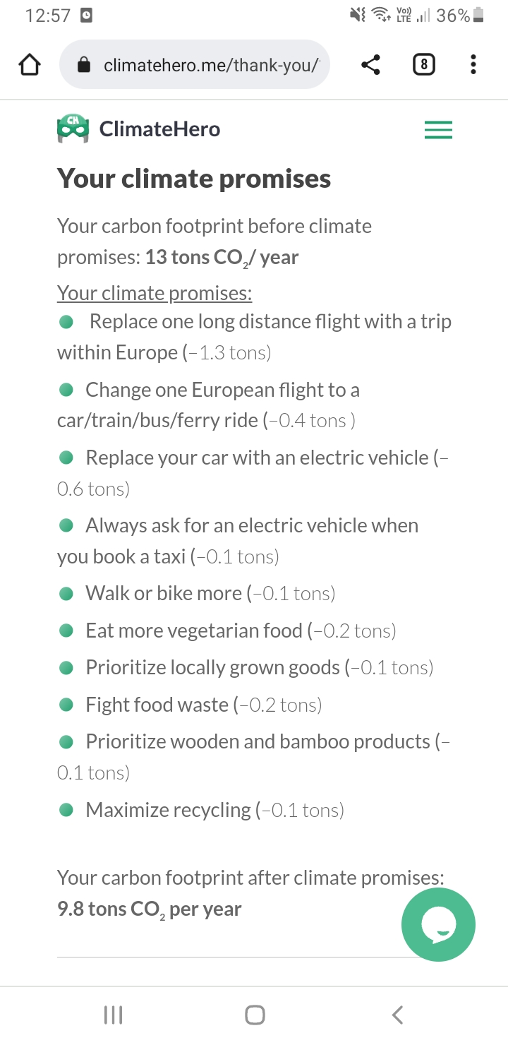
Climate Calculator - Climatehero.me
25% carbon footprint reduction through personal actions
Notes:
You will recall that NZ needed to save 7.6% carbon emissions every year between 2020 and 2030 to meet the goal of temperatures exceeding 1.5% degrees. If I can then please I encourage you to consider if a personal commitment to emission reduction is part of your Why. Check out this Climate Calculator climatehero.me. If I make a few small changes to my lifestyle – a 25% carbon reduction could be achieved.

Slide 29
New Legislation, Plans and Guides
New Mandatory TCFD Reporting
Resilience is Not Adequately Addressed
Affects on Māori
Personal Changes you can make
What is your Why?
Thank you
Notes:
Just to remind you of the story I have shared a few images of what climate change is doing to NZ

Slide 30
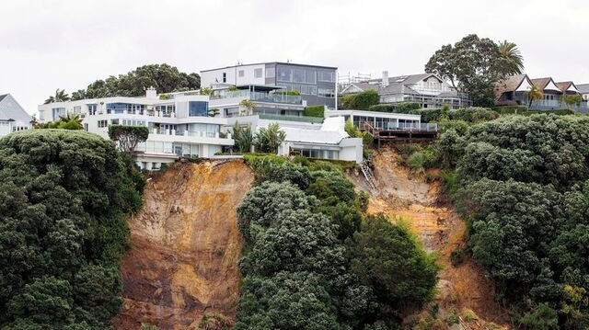
What is Your Why?

Slide 31
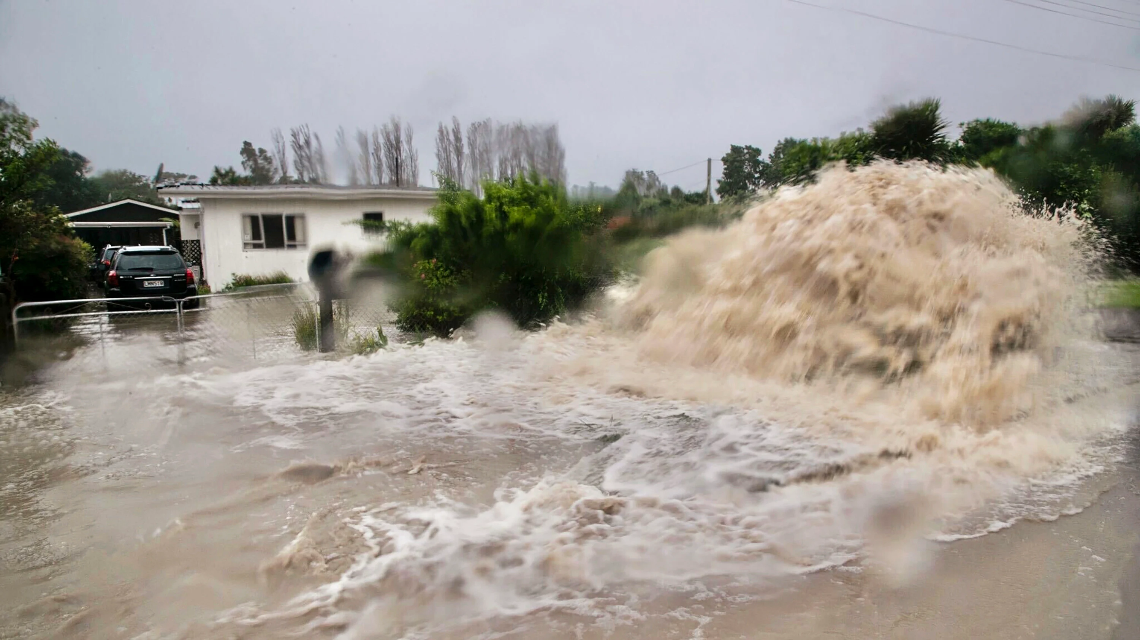
What is Your Why?

Slide 32
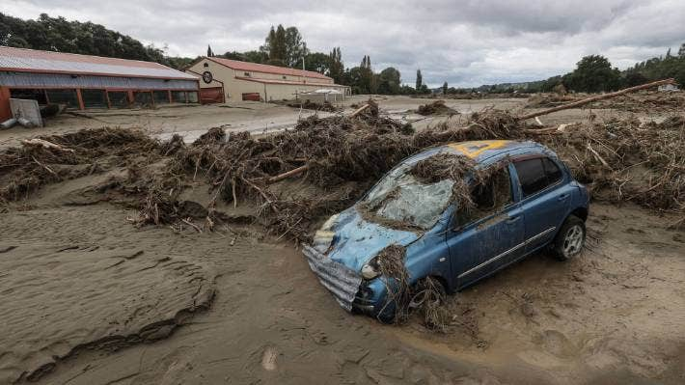
What is Your Why?

Slide 33
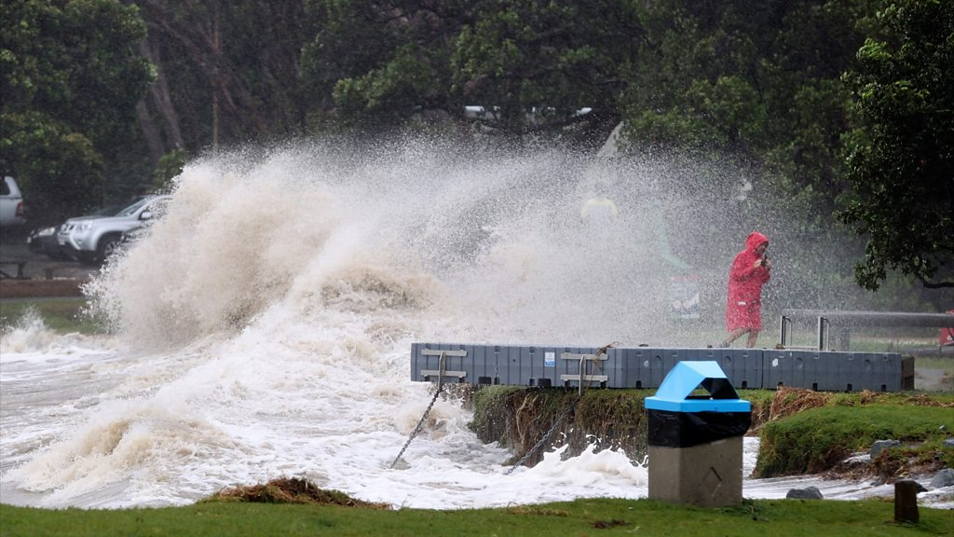
What is Your Why?

Slide 34
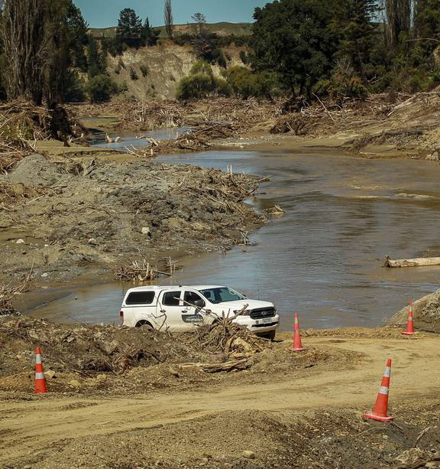
What is Your Why?

Slide 35
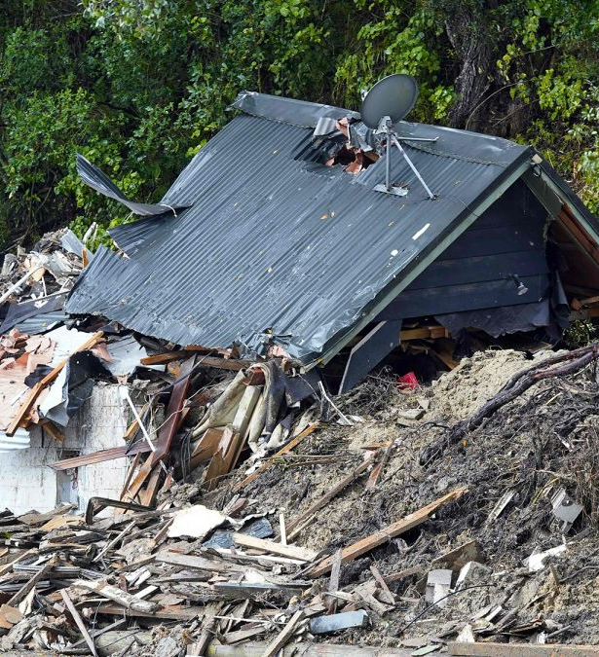
What is Your Why?

Slide 36
BLANK SLIDE

Slide 37
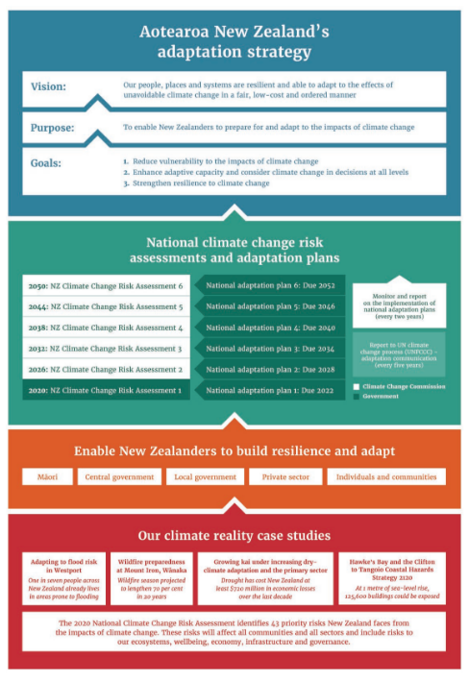
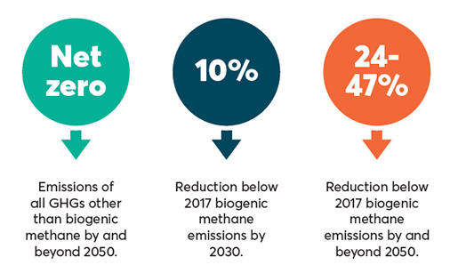
New Zealand Passed Climate Change Response (Zero Carbon) Amendment Act (2019)
New Zealand’s First National Adaptation Plan (Te mahere urutaunga ā-motu)
Notes:
Aotearoa New Zealand’s first national adaptation plan will enable New Zealanders to build resilience and adapt
Our climate reality: why we need to adapt to the impacts of climate change. This plan is the first step in a long-term adaptation strategy and process
Our first national adaptation plan will enable New Zealanders to build resilience and adapt
The actions in this plan are focused on addressing the 43 priority risks New Zealand faces from the impact of climate change from 2020–26.
The goals are consistent with the Global Goal on Adaptation that was established under the Paris Agreement.
New Zealand is also signatory to several international agreements that support action to reduce vulnerability and enhance resilience. These include the Sendai Framework for Disaster Risk Reduction and the 2030 Agenda for Sustainable Development, as well as agreements under the United Nations Framework Convention on Climate Change (UNFCCC) process, including the Paris Agreement.
New Zealand’s first national adaptation plan has three focus areas: Focus area one: Reform institutions to be fit for a changing climate Focus area two: Provide data, information, tools and guidance to allow everyone to assess and reduce their own climate risks
Focus area three: Embed climate resilience across government strategies and policies
New Zealand passed its Climate Change Response (Zero Carbon) Amendment Act in 2019, which sets a target for all greenhouse gases except for biogenic methane – methane from agriculture and waste – to reach net zero by 2050.
The target for emissions reduction (the 2050 target) requires that—
(a) net accounting emissions of greenhouse gases in a calendar year, other than biogenic methane, are zero by the calendar year beginning on 1 January 2050 and for each subsequent calendar year; and
(b) emissions of biogenic methane in a calendar year—
(i) are 10% less than 2017 emissions by the calendar year beginning on 1 January 2030; and
(ii) are 24% to 47% less than 2017 emissions by the calendar year beginning on 1 January 2050 and for each subsequent calendar year.

Slide 38
Climate Scenarios
Notes:
TCFD assesses these risks using climate scenario analysis
Climate scenario analysis is a tool for understanding the consequences – both positive and negative - of climate change for businesses and for encouraging longer term strategic thinking about risks and opportunities.
Climate scenario analysis is a key aspect of the TCFD reporting process. Here’s what those three scenarios look like over time scales and with a Y axis showing whether the physical or transition risks from climate change are more of the focus
The TCFD framework requires organisations to use at least one scenario aligned with the Paris Agreement’s agreement to limit global warming to well below 2 degrees Celsius above pre-industrial levels. The Paris Agreement also has an aspirational target of limiting global warming to 1.5 degrees above pre-industrial levels.
NZ – will be more ambitious, requiring companies to use at least one scenario aligned with 1.5 degrees of warming and one high warming scenario.
Imminent Transition scenario – Very high transition risks in this scenario. In this scenario, ambitious and stringent climate policies are introduced immediately and enacted to limit global warming to 1.5°C. Net Zero emissions is reached by 2050.
Under the Delayed Transition – Also a very high transition risk scenario. But in this scenario, policy is not enacted immediately, causing emissions to increase until 2030. When policies are enacted around 2030, they are stringent and abrupt. Emissions exceed the Paris Agreement’s carbon budget temporarily and then decline rapidly after 2030.
The hothouse scenario is exactly what you think it is and has very high physical risks from climate change

Slide 39
Notes:
To assess your climate-related risks, it helps to have a consistent framework. The Task Force for Climate-Related Financial Disclosures (TCFD) has developed an internationally adopted framework for disclosing climate-related risks. The U.S. just agreed to adopt this very recently.
the TCFD framework takes very complex areas of climate-related risks – with all of their inherent uncertainties – and attempts to simplify them.
The reason this TCFD framework exists is to provide transparency – to inform investors, stakeholders, clients and customers about how an organisation is handling its risks and opportunities related to climate change – and particularly financial risks (that’s the F in TCFD).

Slide 40
Notes:
The TCFD framework uses sub-categories of transition risks, physical risks, and opportunities. So what do those categories mean?
Physical risks: Risks posed to the organsiation by potential physical impacts of climate change (e.g., acute risks like extreme weather events, chronic risks like coastal erosion and sea level rise).
Transition risks: Risks posed to the organisation by transition to a net zero carbon economy (e.g., lawsuits, policy changes, whether technologies do or don’t appear, risks to a business’s markets and reputational risks.
Opportunities: The potential financial opportunities that climate change may present (e.g., for innovation and new services).

