Slide 1
Infrastructure boom! – People are the priority and root to success – it’s all about capacity and capability to deliver
David Jenkins IPWEA CEO

Slide 2
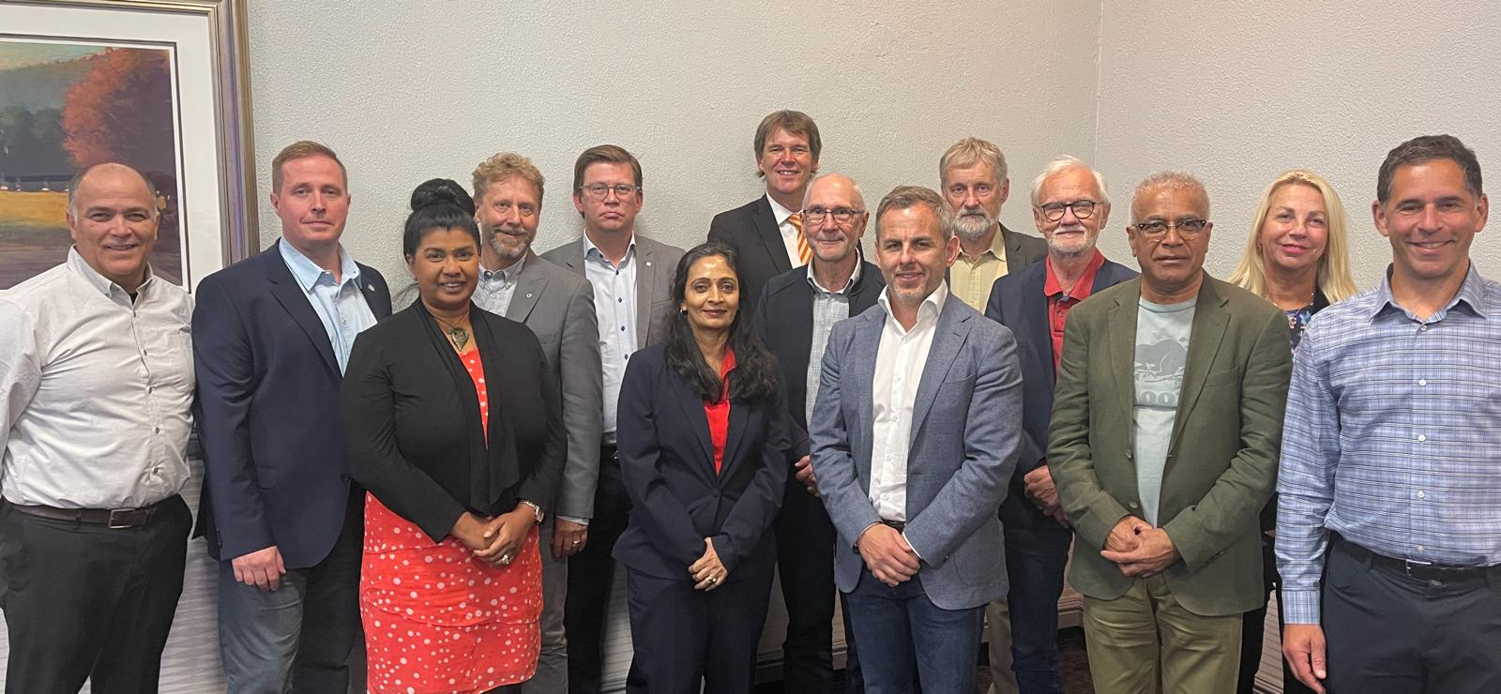
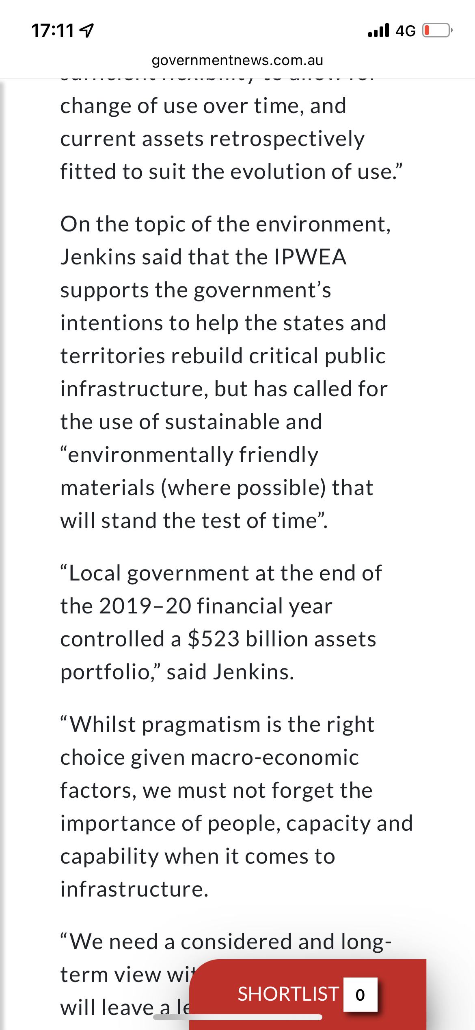
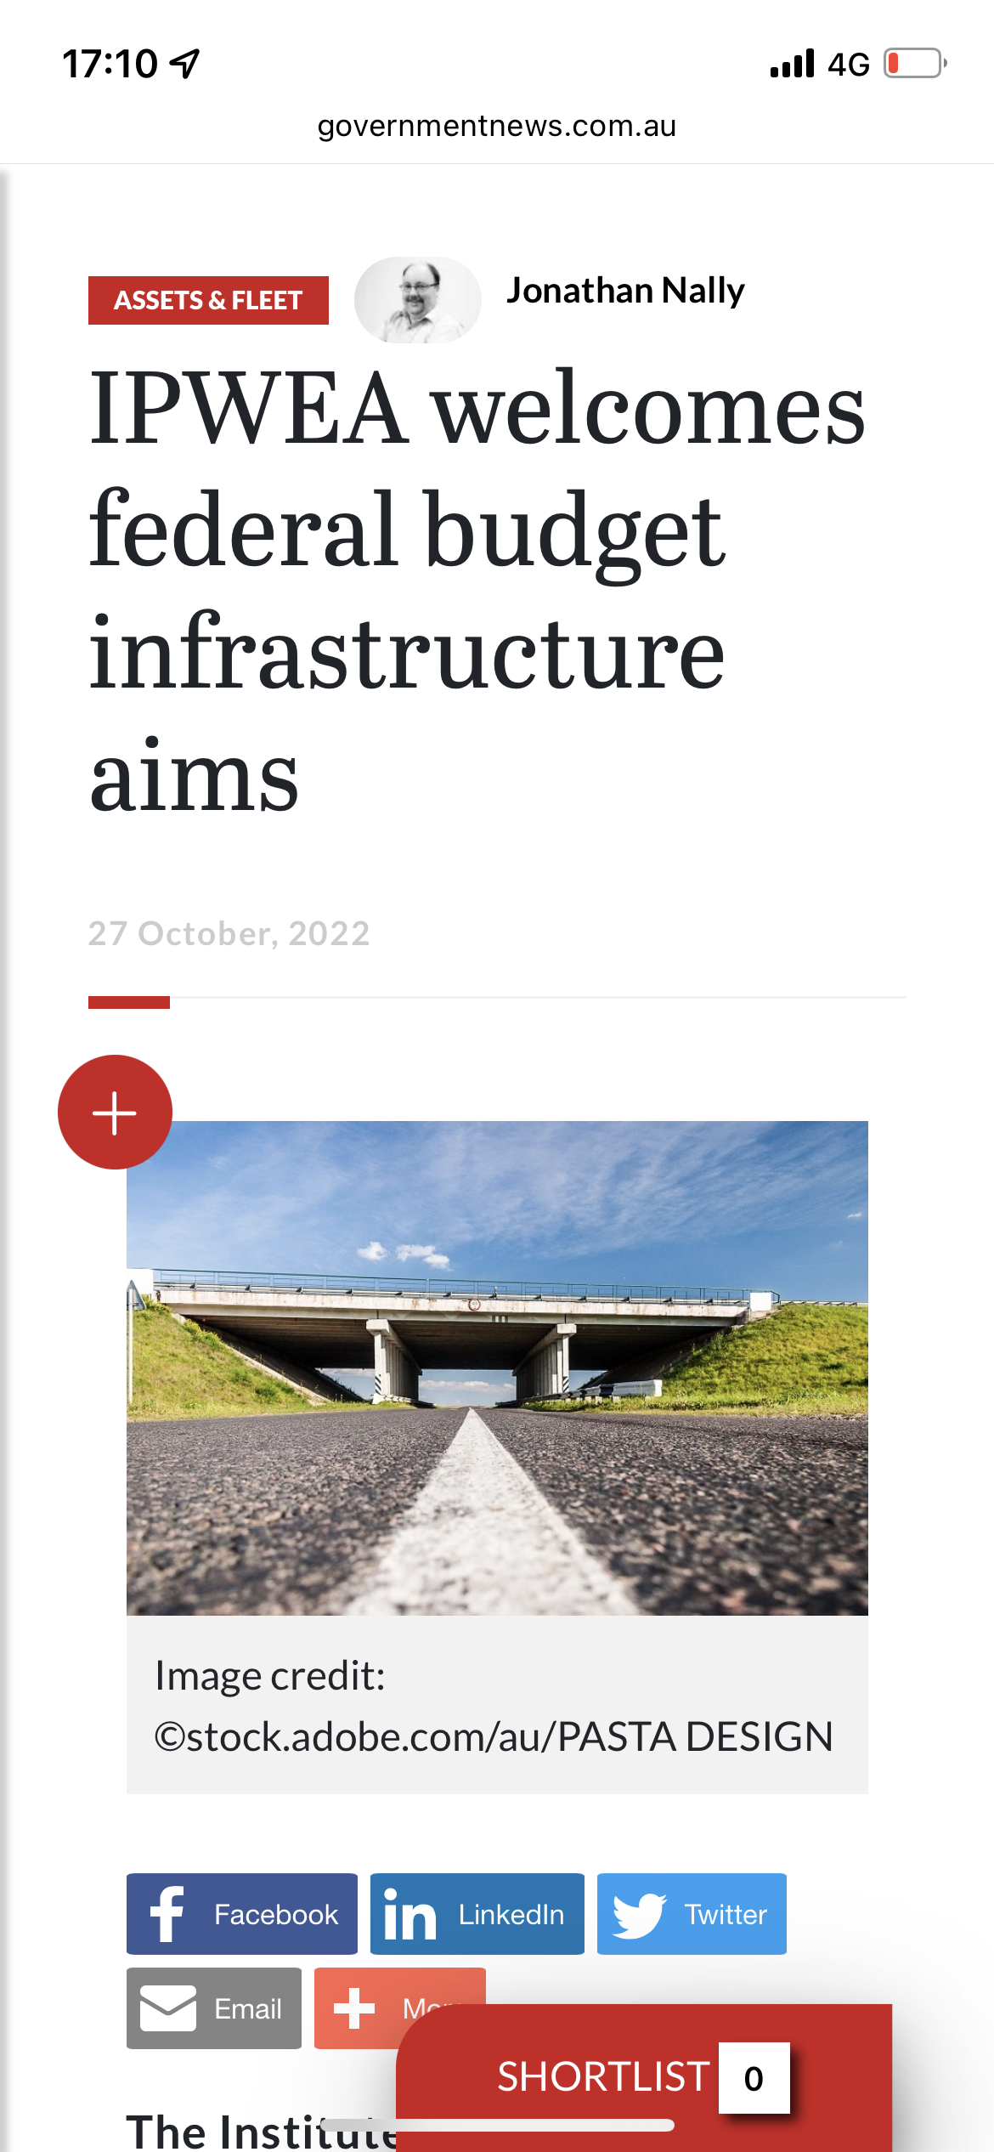
Notes:
International
Advocacy at the Federal level
Intergenerational inequity
My team

Slide 3
Macro Issues
Government stimulus money into infrastructure – US 1.2 Trillion Infrastructure Bill
Building new and re-prioritisation – asset management
Lack of immigration – Australia
Competing war for talent
Has the profession sold itself?
1
Keynesian Economics
2
New Vs Old
3
Immigration
4
War for talent
Notes:
The impacts of climate change can have a significant impact on the assets we manage and the services they provide. In the context of the Asset Management Planning process climate change can be considered as both a future demand and a risk.
How climate change impacts on assets will vary depending on the location and the type of services provided, as will the way in which we respond and manage those impacts.
As a minimum we need to consider how to manage our existing assets given potential climate change impacts for our communities.
The way in which we construct new assets should recognise that there is opportunity to build in resilience to climate change impacts. Building resilience can have the following benefits:
■ Assets will withstand the impacts of climate change;
■ Services can be sustained; and
■ Assets that can endure may potentially lower the lifecycle cost and reduce their carbon footprint
In short, good asset management planning is needed on an ongoing basis.

Slide 4
The Challenges
The race to build the infrastructure of the net-zero economy requires construction and energy companies to get faster, slicker, and more effective in the delivery of complex capital
Repeated shocks and disruptions are encouraging companies in all sectors to rethink the design of their supply chains and operating models
New focus on resilience and agility.
1
Net Zero
2
Efficiency
3
Disruption
4
Resilience and Agility
Notes:
The impacts of climate change can have a significant impact on the assets we manage and the services they provide. In the context of the Asset Management Planning process climate change can be considered as both a future demand and a risk.
How climate change impacts on assets will vary depending on the location and the type of services provided, as will the way in which we respond and manage those impacts.
As a minimum we need to consider how to manage our existing assets given potential climate change impacts for our communities.
The way in which we construct new assets should recognise that there is opportunity to build in resilience to climate change impacts. Building resilience can have the following benefits:
■ Assets will withstand the impacts of climate change;
■ Services can be sustained; and
■ Assets that can endure may potentially lower the lifecycle cost and reduce their carbon footprint
In short, good asset management planning is needed on an ongoing basis.

Slide 5
Capacity and Capability problems: Is this new?

Slide 7
The Solution
Multi-faceted

Slide 8
Short term actions
Short, practical, asynchronous – micro-credentials
National skills strategy – quick implementation
Re-prioritisation of infrastructure projects
Overseas trained immigrants
4
Notes:
Can a task be automated, or designed to be as intuitive and error-proof as possible? There is a good reason why the simple checklist is a standard tool used to support complex tasks in surgery and aviation.

Slide 9
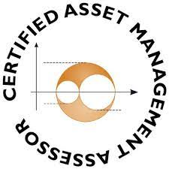
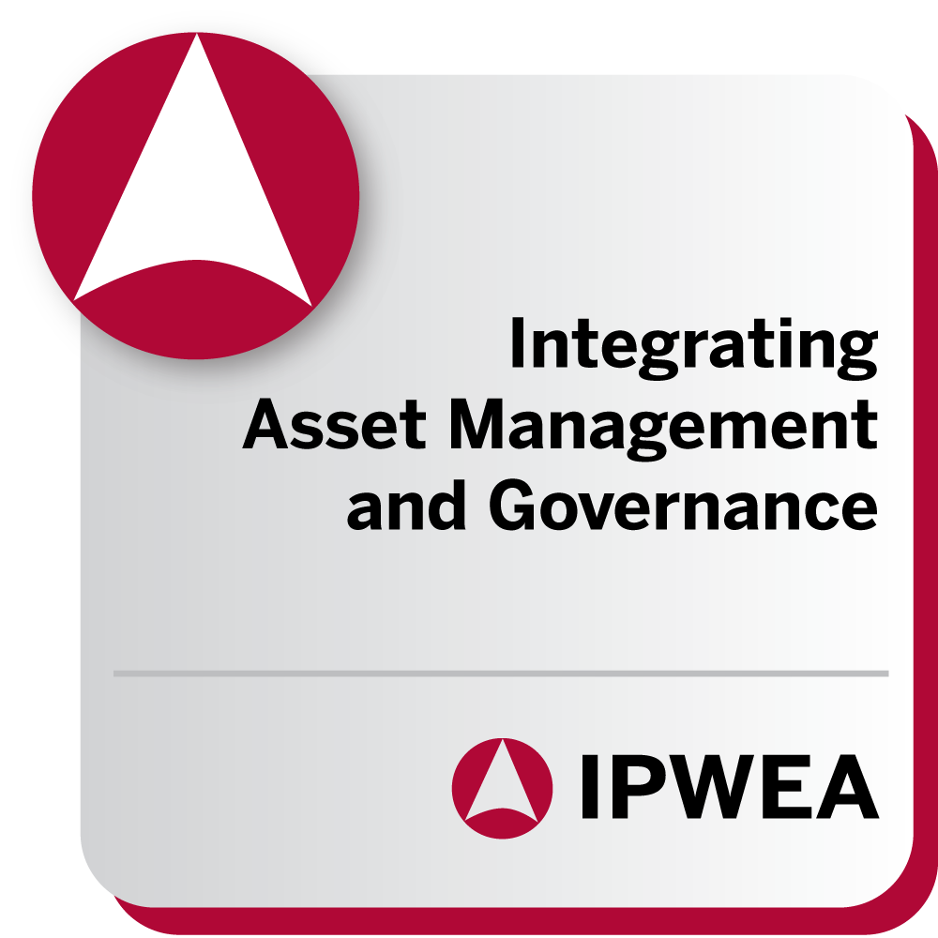
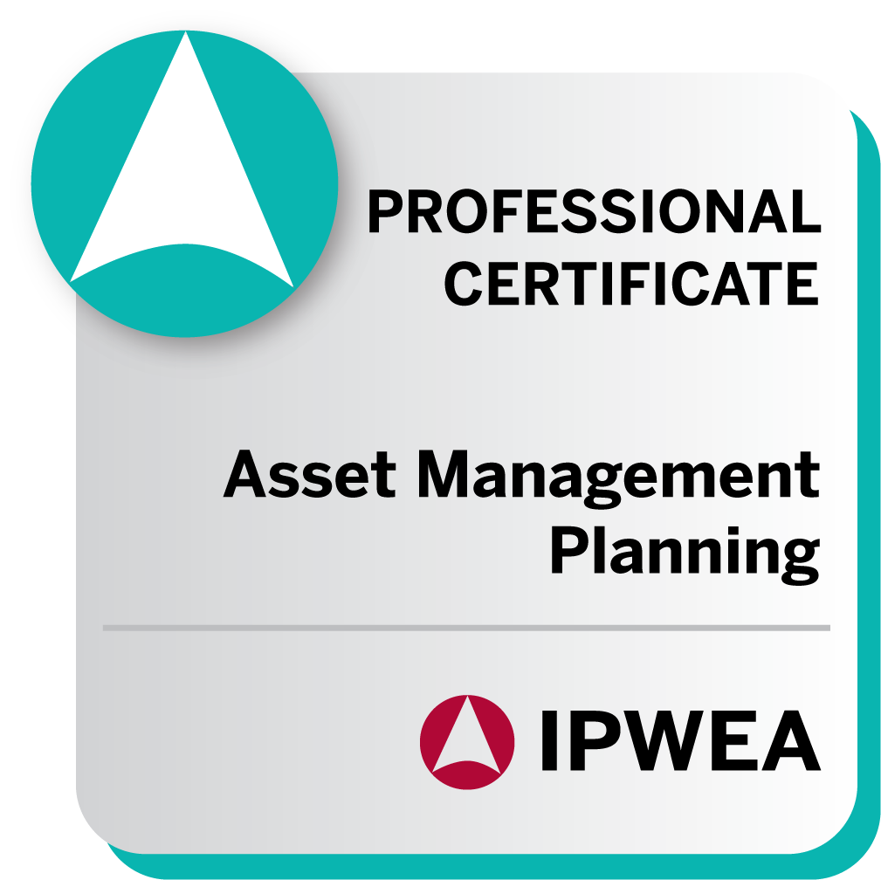
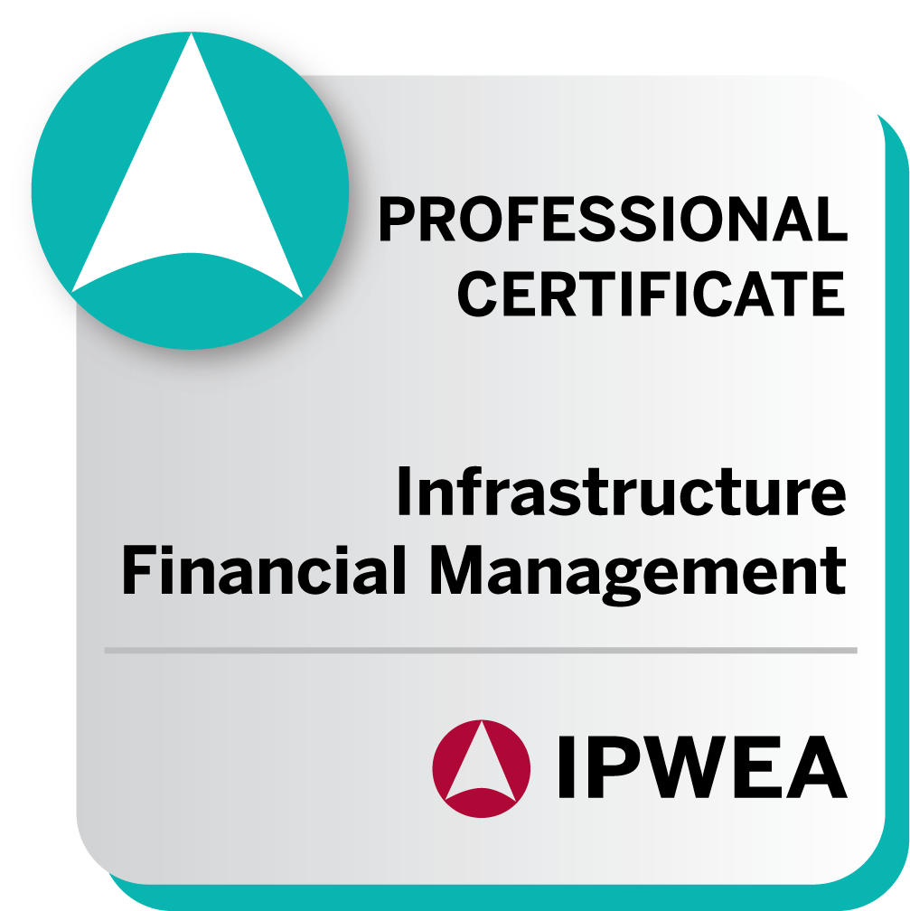
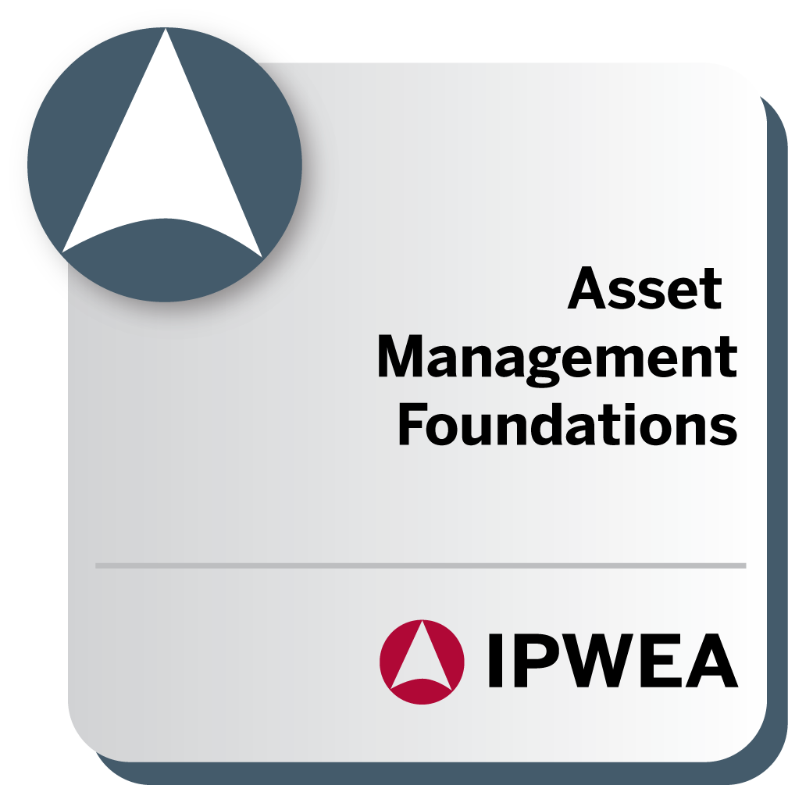
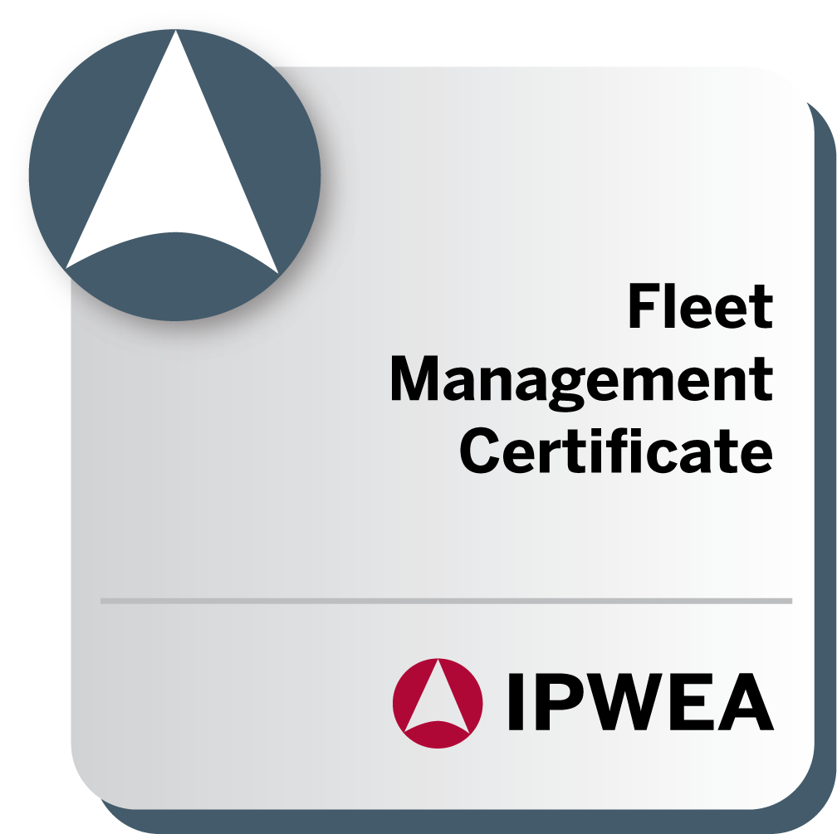
AM PATHWAY WITH LIFELONG LEARNING OPPORTUNITIES
EXTENSION: LEADERSHIP
EXTENSION: TECHNICAL
RECOGNISE
Continue your leadership and strategic development with the CEMD program by the AGSM @UNSW.
BUILD
Consolidate your learning and enhance your skills with strategic thinking and decision making, leading to an internationally recognised designation
Extend your career with an international designation with the World Partners in Asset Management
FOUNDATIONS
Apply your knowledge and develop deep capability in asset management
Understanding the key concepts and theories of asset management
NEED TO KNOW
NEED TO DO
NEED TO LEAD
BE RECOGNISED
EXTEND MY LEARNING
www.ipwea.org/ampathway

Slide 10
National Skills Strategy

Slide 11
Shifting the Learning
Notes:
We see three main levers to pull here: adopting new technologies to work more efficiently, reducing process waste, and sequencing works more effectively. • The sector can capitalise on automation opportunities in construction to simplify processes and automate predictable work. This could potentially affect 44 percent of activities within the sector.35 • The sector can manage labour demands by streamlining processes and eliminating work that doesn’t add value.

Slide 12
Long term thinking
Alignment – Education, Employers, Prof. Bodies
“Tell the story”
Genuine attempts to increase female participation
Notes:
Can a task be automated, or designed to be as intuitive and error-proof as possible? There is a good reason why the simple checklist is a standard tool used to support complex tasks in surgery and aviation.

Slide 13
Female Participation
“Women’s participation in construction is actually falling, decreasing from 17 per cent in 2006 to 12 per cent in 2018.”
Australia
A diverse workforce is known to increase well-being and talent retention, but it can also lead to tangible economic benefits.
Notes:
Can a task be automated, or designed to be as intuitive and error-proof as possible? There is a good reason why the simple checklist is a standard tool used to support complex tasks in surgery and aviation.

Slide 14
What can we do?
Adopt flexible working patterns
major UK contractor Sir Robert McAlpine took a pioneering corporate stance on gender parity when it comes to family leave. “Irrespective of gender and sexual orientation, every parent is entitled to 26 weeks paid leave, no matter how their family grows (birth, adoption or surrogacy)”.
2. Eliminating 'unconscious bias’
3. Role models
The industry needs diverse role models and champions to communicate the potential and diversity of roles within a construction career
Construction needs to reposition itself as a career for both women and men.
Improve talent retention by reframing the culture of the industry.
Notes:
Can a task be automated, or designed to be as intuitive and error-proof as possible? There is a good reason why the simple checklist is a standard tool used to support complex tasks in surgery and aviation.

Slide 15
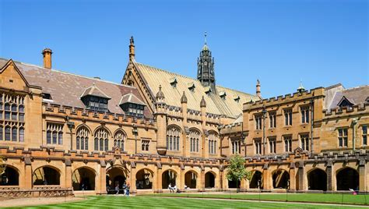
A holistic approach
Schools – Importance of STEM subjects
Universities – opportunities for careers in Civil Engineering; the opportunities available
Employers – apprenticeships, graduate opportunities; the opportunities available
Professional Bodies: lifelong learners, advocating for the profession, networks and career advancement. Role models and mentoring

Slide 16
Technology to drive efficiency
Source: McKinsey

Slide 17
https://www.ipwea.org/ipweacommunities/assetmanagement/amwhitepaper
IPWEA Whitepaper
Notes:
NSOA
Replacing poor quality infrastructure is estimated to cost $51bn– and replacing infrastructure in fair condition will range from $106bn to $138bn.
Specifically, nearly 1 in 10 of all local government assets need significant attention, and 3 in every 100 assets may need to be replaced.
Collecting just 3.5 percent of Australia’s taxation revenue, local governments need and welcome the support of other levels of government.
The NSoA Report is based on survey data provided by professional officers responsible for engineering and asset management from 454 councils (85% of all councils) across seven asset categories.

Slide 18
National State of the Assets Report 2021
Notes:
NSOA
Replacing poor quality infrastructure is estimated to cost $51bn– and replacing infrastructure in fair condition will range from $106bn to $138bn.
Specifically, nearly 1 in 10 of all local government assets need significant attention, and 3 in every 100 assets may need to be replaced.
Collecting just 3.5 percent of Australia’s taxation revenue, local governments need and welcome the support of other levels of government.
The NSoA Report is based on survey data provided by professional officers responsible for engineering and asset management from 454 councils (85% of all councils) across seven asset categories.

Slide 19
Thank You E: david.jenkins@ipwea.org
Notes:
Skills shortage – education for engineers
Changes in mobility
Areas of notice
Build long term in a short term world
Now overlay some of the big macro trends that are changing the world around us. Demand for action on the climate agenda, growing pressure from economic and climate migration, intensifying trade issues, persistent supply chain challenges, political gamesmanship, and new strains of COVID-19 are all having massive short and longterm impacts on the world in which we operate.
Maintaining control while encouraging agility
In the future, expect governments, regulators and infrastructure players to embrace governance — not simply as a way to control costs and manage risks — but rather as an opportunity to ensure projects and programs are properly scoped, delivered and managed to address society’s need. And, when that need changes or objectives are not being met, that the regulation is agile and flexible enough to allow the correct changes to be made.
Towards a new livable
Over the coming year, expect to see city planners and policy makers start to place bigger bets on how their populations will want to live, work and play
Use of Natural Assets
Canada announced CAD 1.8 million in funding to restore 75 hectares of salt marshes to combat rising sea levels in Eastern Canada's Bay of Fundy.
Paying for it all
This year, expect to hear governments having more articulate and persuasive conversations about how they will fund their infrastructure plans over the long-term. Taxation will likely rise and expand. And serious conversations about user fees will come to the front page

