Slide 1
Case study – Avesta distric heating with hot water storage in rock caverns
Eric Båve

Slide 2
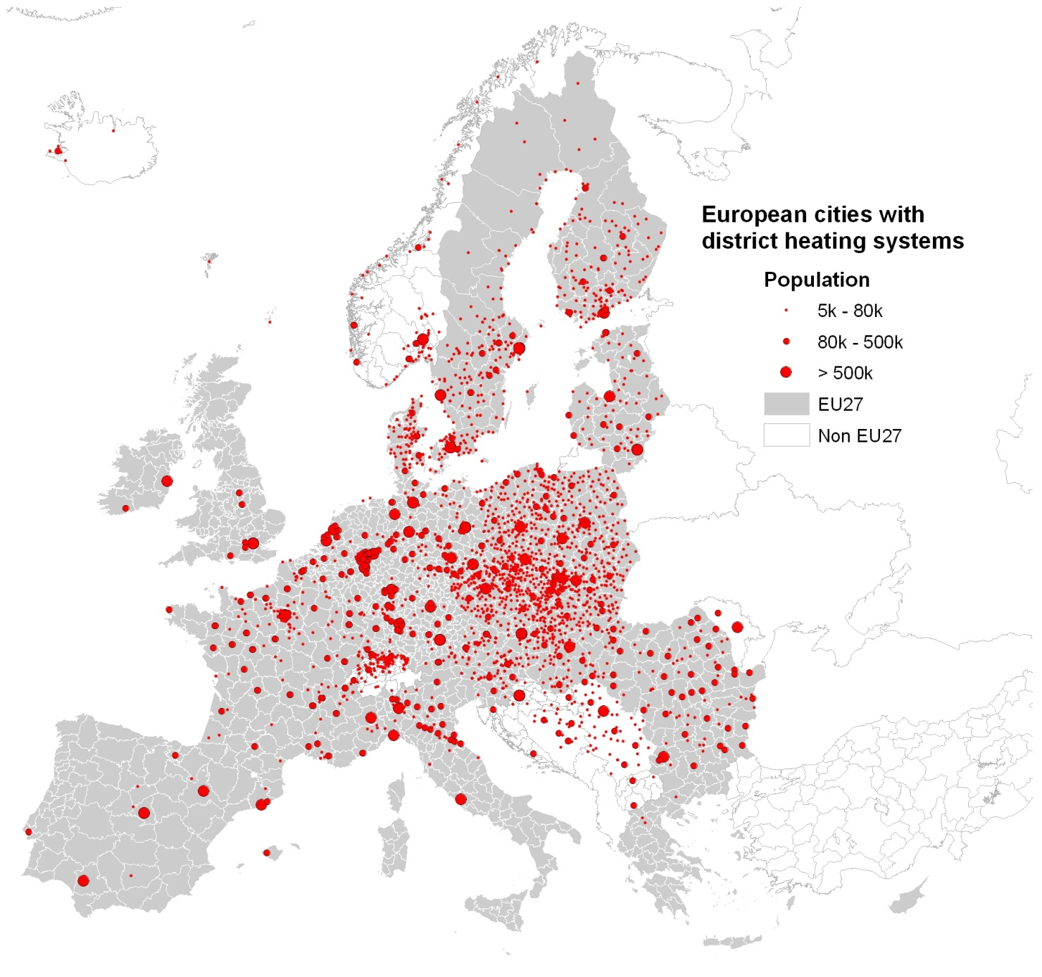

Slide 3
Avesta, Källhagsverket
Produced 185000MWh of district heating by waste incineration from a waste-fired grate boiler. A hot water storage was constructed 1982
Owner2020 is Capstone Infrastructor Corporation 50% and Macquarie Infrastructor and Real Asset 50%

Slide 4
1 Rock cavern 15000 m3 2 Machine hall 3 Research tunnel 5 Lift and hoist shaft 6 Entrance building

Slide 5
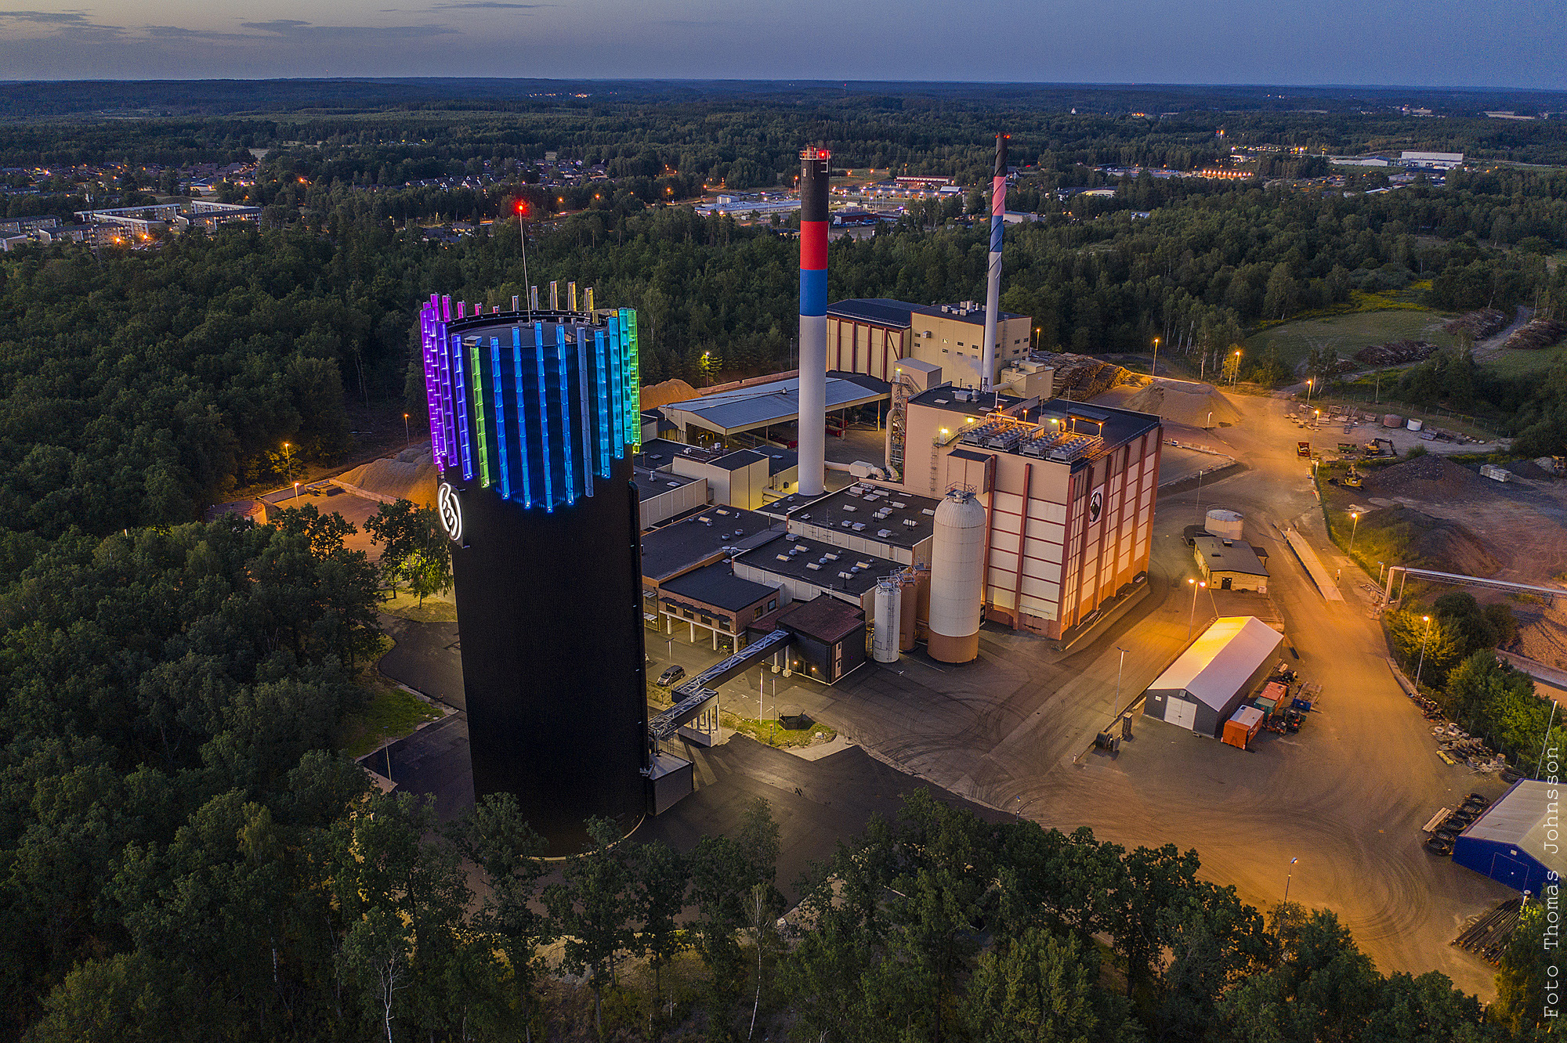
Clay Hässleholm SE, 15 000 m³ vatten

Slide 6
Temperaturskillnader före och efter inspektion

Slide 7
Cavern roof Joints & rockfalls Inspection 1984

Slide 8
Two rock caverns in municipal of Hudiksvall Constructed 1977 for oil storage and 2018 used för hot water

Slide 9
smoother production for district heating
Without storage
With hot water storage

Slide 10
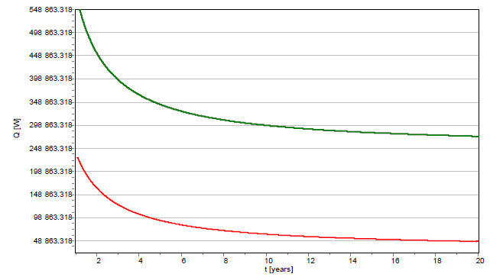
Energy losses

Slide 11
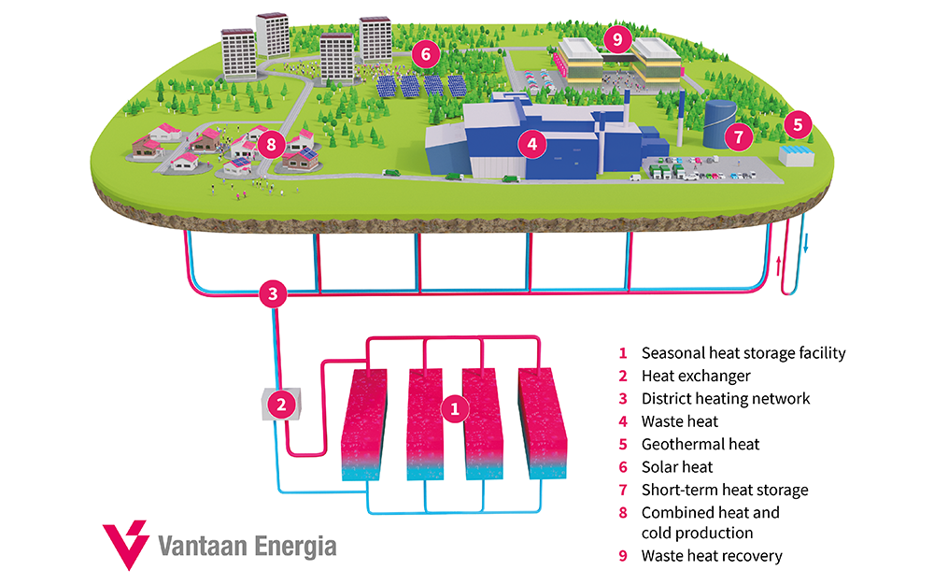
Seasonal heat storage 1 000 000 m³ Vantaa, FI 2026

Slide 12
Conclusions
1 heat exchanger must bee cleanded every month and full reset every 10 year
2 Rising temperatur increase the risk of ”water chemistry problems” after 30 years max temperature is upp to 121 C
3 Numeric models for forecasting have been developed to high precision!
4 Energy storage in a distric heating system increase the energy efficincy and reduse the risk of transporting fuels and other energy equalensis.

Slide 13
Investment cost and Water volume in storage

Slide 14
Thank you for listening
Eric Båve
Mail bave@kth.se
Mobile +46 708520725

