Slide 1
How can we strengthen our capacity to develop climate-neutral and smart cities?
Lessons learned from Swedish cities with a focus on leading innovation and transformative change

Slide 2
Viable Cities
A Swedish strategic innovation programme for climate neutral and sustainable cities, until 2030
Based on mission oriented research and innovation
Funded by three government agencies (Vinnova, Swedish Energy Agency, Formas)
An investment budget of €100+ million
Climate neutral cities 2030
Klimatkontrakt 2030 – a Swedish climate city contract

Slide 3
“Our planet is fast approaching tipping points that will make climate chaos irreversible. We are on a highway to climate hell with our foot still on the accelerator.”
“It is the defining issue of our age. It is the central challenge of our century. It is unacceptable, outrageous and self-defeating to put it on the back burner.”
António Guterres, UN Sectretary General at COP27, nov 2022

Slide 4
We need to sacrifice our lifestyle in order to save the planet
Technology solves everything. There is no need to change our lifestyle
Notes:
We need to change the metaphor.
Two false narratives shaping the discourse.

Slide 5
The mission
Visionary, yet clear and concrete objective
A broad perspective where ecological, economical and social sustainability are equally important
We need to engage and gather many forces, across sectors, actors and disciplines
Our Mission: Climate neutral cities 2030 – with a good life for all within the planetary boundaries
The climate transition will provide greener, safer cities with better air quality, better mental and physical health, where children and adults can live, play and enjoy life
Olga Kordas, Viable Cities

Slide 6
Why cities?
Cities cover about 3% of the land on Earth, and produce about 72% of all global greenhouse gas emissions
Cities are growing fast – by 2050 almost 85% of Europeans will be living in cities

Slide 7
System innovation – as an iceberg
Radical changes in society on many levels
Visible levels: Innovative solutions, partners and networks
Invisible levels: behaviour, governance, policies
Governance innovation Climate City Contract

Slide 8
A portfolio of initiatives aiming at the mission
We gather strength by moving from fragmented projects to an ecosystem of efforts aiming at a common goal
Beyond
projectification!
Accelerated learning!

Slide 9
Climate Neutral Cities 2030
Together with cities – municipalities and their partners – and government agencies we strive towards the mission: Climate neutral cities 2030
We try new solutions and new ways of working, and learn from each other
Klimatkontrakt 2030 – a Swedish Climate City Contract – is an instrument to speed up the climate transition

Slide 10
2019
2021
Skellefteå
Umeå
Umeå
Östersund
Borlänge
Gävle
Uppsala
Uppsala
Järfälla
Järfälla
Karlstad
Nacka
Stockholm
Örebro
Stockholm
Mariestad
Enköping
Enköping
Eskilstuna
Göteborg
Göteborg
Borås
Linköping
Helsingborg
Kalmar
= Wave 1
Malmö
Malmö
Växjö
Växjö
= Wave 2
Lund
Lund
Kristianstad
Notes:
Borlänge
Borås
Enköping
Eskilstuna
Gävle
Göteborg
Helsingborg
Järfälla
Kalmar
Karlstad
Kristianstad
Linköping
Lund
Malmö
Mariestad
Nacka
Skellefteå
Stockholm
Umeå
Uppsala
Växjö
Örebro
Östersund

Slide 11
Wave 1, 9 cities
Wave 2, 14 städer
23 municipalities
of the population of Sweden
Population
Rest of Sweden
Malmö
Örebro
Umeå
Lund
Borås
Nacka
Gävle
Växjö
Karlstad
Borlänge
Göteborg
Linköping
Järfälla
Kalmar
Enköping
Stockholm
Uppsala
Helsingborg
Eskilstuna
Kristianstad
Skellefteå
Östersund
Mariestad

Slide 12
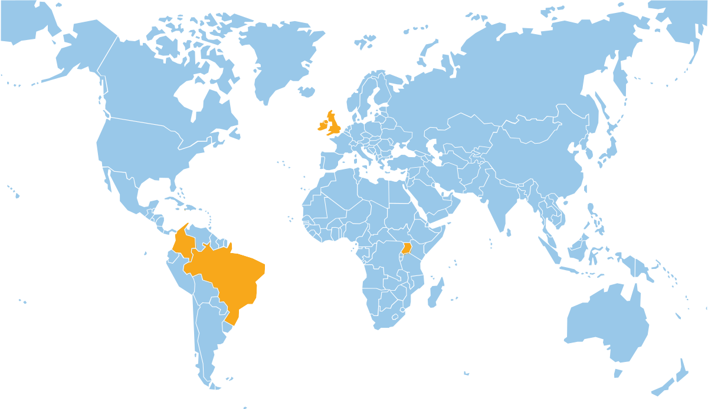
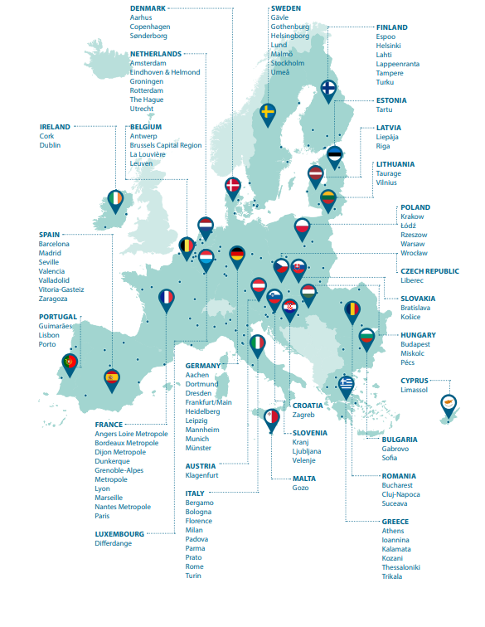
Climate Neutral Cities 2030
Mission: Climate neutral cities 2030 with a good life for all within planetary boundaries
Bristol
Sweden
Europe
Globally
Bogotá
Makindye
Ssabagabo
23 cities 40 % of the Swedish population
Curitiba
112 cities (of which 7 Swedish cities)

Slide 13
Lessons learned

Slide 14
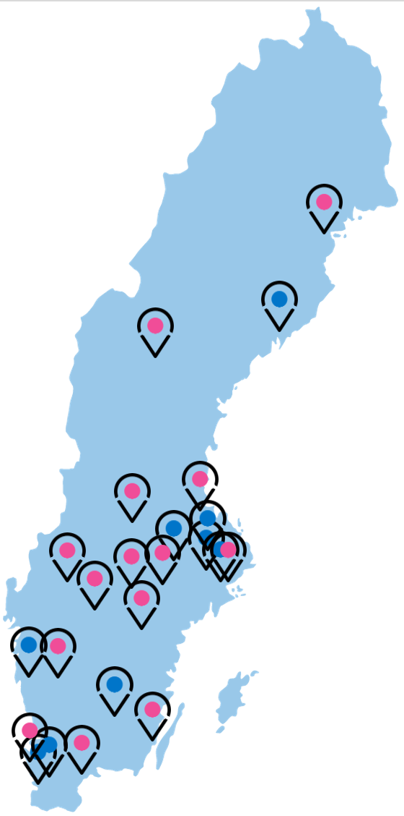
Climate Neutral Cities 2030
Expected results in each of the 23 cities:
A yearly revised and signed Climate City Contract 2030
An established innovation team or transition function.
A portfolio of measures, anchored in the Climate City Contract 2030, that strengthen the capacities to accelerate climate transition.
En Climate Investment Plan as a part of the Climate City Contract 2030. (including investments within the municipal organisaton as well as investments from external stakeholders)
Participate in mutual and peer-to-peer learning between the cities. (Viable Cities Transition Lab)

Slide 15
Climate Neutral Cities
Commitments by Mayors: goals, strategies, governance, citziens engagement, climate investment plans and funding
Signed by the Mayors, the Director Generals of government agencies and Viable Cities
National support to cities
Policy/ better regulations
More innovation
Coordinated funding/financing

Slide 16
The journey to climate neutrality 2030
Climate goals 2030 Which are the climate ambitions / commitments of the city in line with the mission?
Climate action plan 2030 What actions are required to realise climate neutrality by 2030?
Climate investment plan 2030 How do we invest to realise climate neutrality by 2030?

Slide 17
What does the Climate City Contract 2030 say?
The cities commit to – based on local conditions – collaborate with many in society and work in new ways to reduce climate emissions and work for a sustainable society
The government agencies commit to facilitate the urban transition by coordinating the national level, for example regarding financing and the review of laws and regulations
Viable Cities commits to long-term support and coordinate development, revision and analysis of the work with the Climate City Contract 2030

Slide 18
Borlänge
Borås
Enköping
Eskilstuna
Gävle
Göteborg
Helsingborg
Järfälla
Kalmar
Karlstad
Kristianstad
Linköping
Lund
Malmö
Mariestad
Nacka
Skellefteå
Stockholm
Umeå
Uppsala
Växjö
Örebro
Östersund
viablecities.se/klimatkontrakt-2030
Notes:
Borlänge, Borås, Enköping, Eskilstuna, Gävle, Göteborg, Helsingborg, Järfälla, Kalmar, Karlstad, Kristianstad, Linköping, Lund, Malmö, Mariestad, Nacka, Skellefteå, Stockholm, Umeå, Uppsala, Växjö, Örebro, Östersund
Creates space for trusted intermidiaries and boundry spanners
Supports Silo breaking

Slide 19
Iteration of the Swedish Climate City Contract 2030
Key areas where we need more knowledge to speed up the climate transition
How can digitalisation and digital tools contribute to the transition to climate neutral cities?
We need everyone to be involved to succeed, how can we empower citizens to be co-creators of the future of cities?
How do we mobilise and redirect financial flows to make climate transition happen faster?

Slide 20
TRANSITION MANAGEMENT
Municipality
Policy making
Implementation
Business
Policy making
Implementation
Public org.
Academia
Transition
Citizens
Traditional governance
Network governance
Notes:
UPPSALA: The way the climate ambitions in Uppsala the last 10 years have been raised in steps is an example of network governance. There has been like a dance between the political leadership and the climateprotocoll leadership. Now they need to work with a similar mechanism for implementation,

Slide 21
Viable Cities - Climate Neutral Cities 2030
MISSION
Business
TRANSITION ARENA
Mayor, politicians
Municipality
Public org.
Academia
Municipality
Transition
Team
Citizens
Experiments,
System
demonstrators
Climate City
Contract

Slide 22
Transition arena
Purpose: Create a platform and framework for local stakeholders to collaborate and develop joint plans
Goal:
Mission – climate neutrality by 2030
Output
Roadmap/Climate City Contract
Implementation

Slide 23
Municipal government
Governing the city; emissions generated from service provision; heating and cooling public buildings, schools, etc.
Citizens
Travelling to school, work; recreation; shopping; heating and cooling houses; etc.
Industry
Industrial processes including burning of fossil fuels, agricultural activities, logistics activities; marketing; etc.
Civil society
Emissions generated from investments; activities organized by the civil society organisations
Superordinate government
Governing the region and nation; emissions generated from service provision
Utility companies
Service provision, e.g., transport, waste and wastewater management, energy production
Financial institutions
Emissions from banking activities, including emissions from investments

Slide 24
0. Current emissions in the city
1. Forecasted emissions (2030)
2. Defining climate actions – goal is net zero
3. Assessing consequences
4. Climate Investment Planning
Territorial or consumption-based
Asset structure in the city
Territorial or consumption-based
Asset structure in the city
Behavioural change measures
Technological improvements and shifts to renewable energy
Negative emission solutions
1) Risk management
2) Economic case
Focuses on the capital planning
Considers financial rating of the “asset owner”
Considers financial instruments each owner has access to
Includes terms and conditions, such as interest rate, payback term
Requires monitoring of the impact of the investment, and alignment with rules and regulations such as the EU Taxonomy
$$f\left(x\right)={−I}_{at}+\sum_{t=0}^{n}{\frac{R_{at} − C_{at}}{{(1+i_{a})}^{t}}}$$
With: Capital investment (I); Revenue (R); Costs (C); over time (t); per actor (a) with i the interest rate per type of actor
3) Policies and policy instruments analysis (city, region, national and supranational mapping)
Negative emission solutions
Negative emission solutions
Negative emission solutions

Slide 25
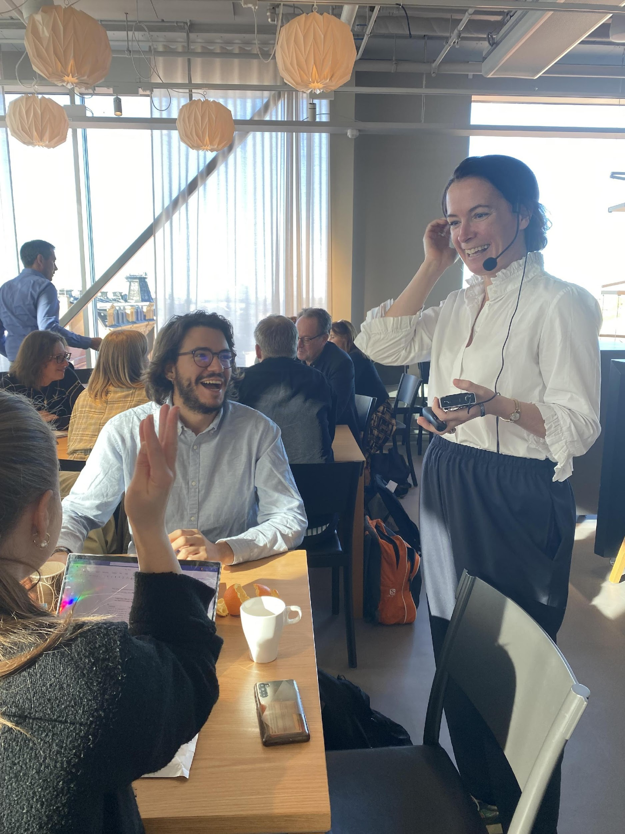
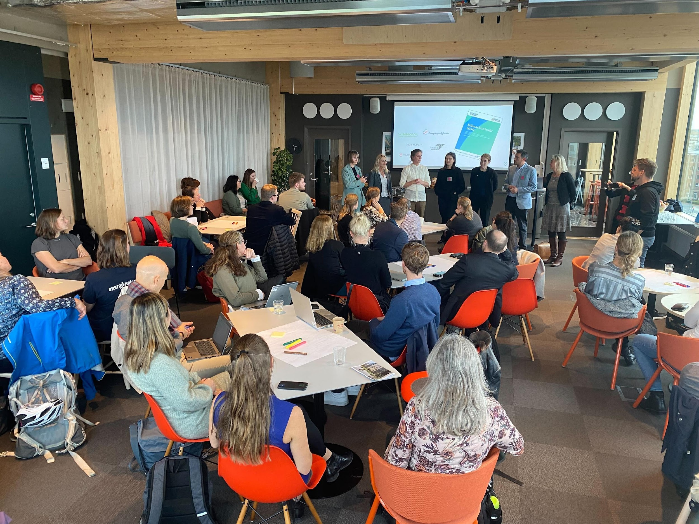
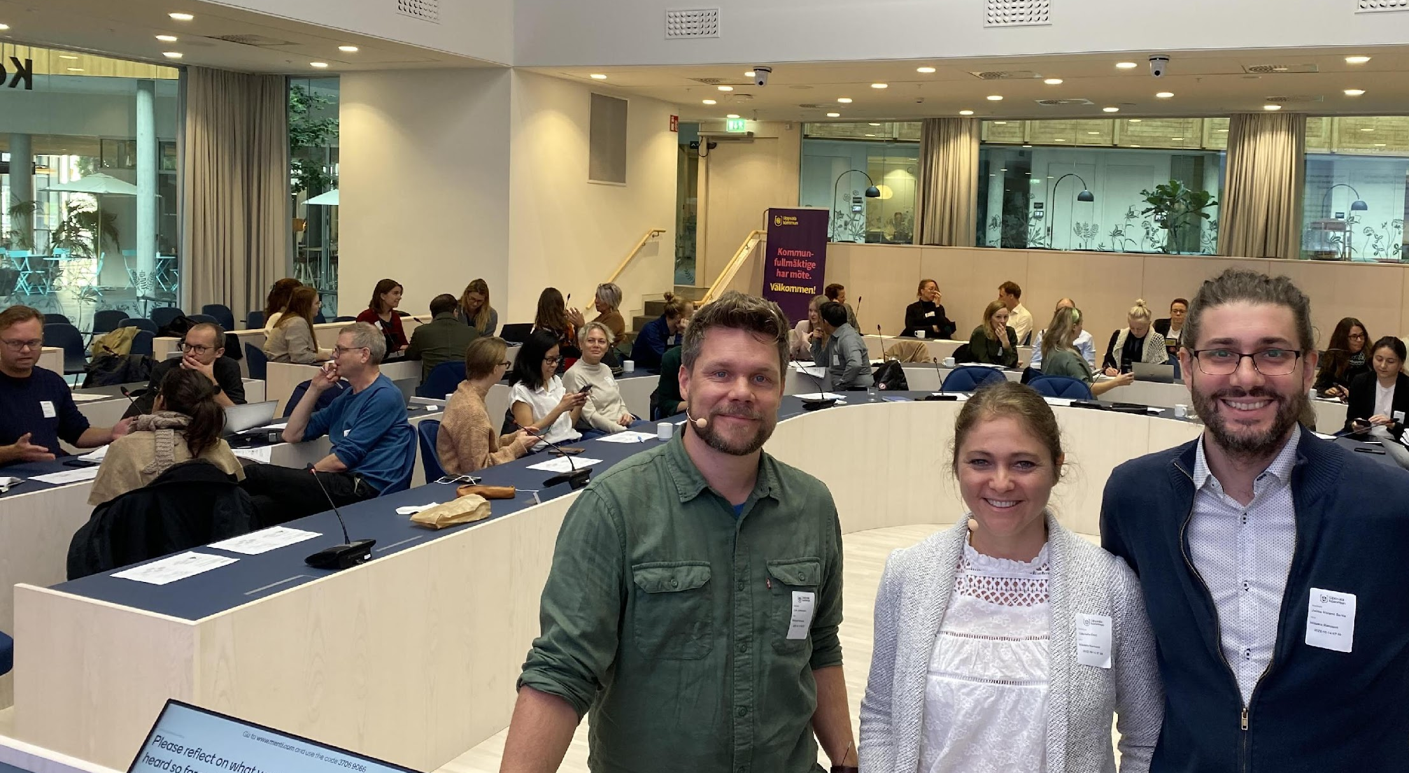
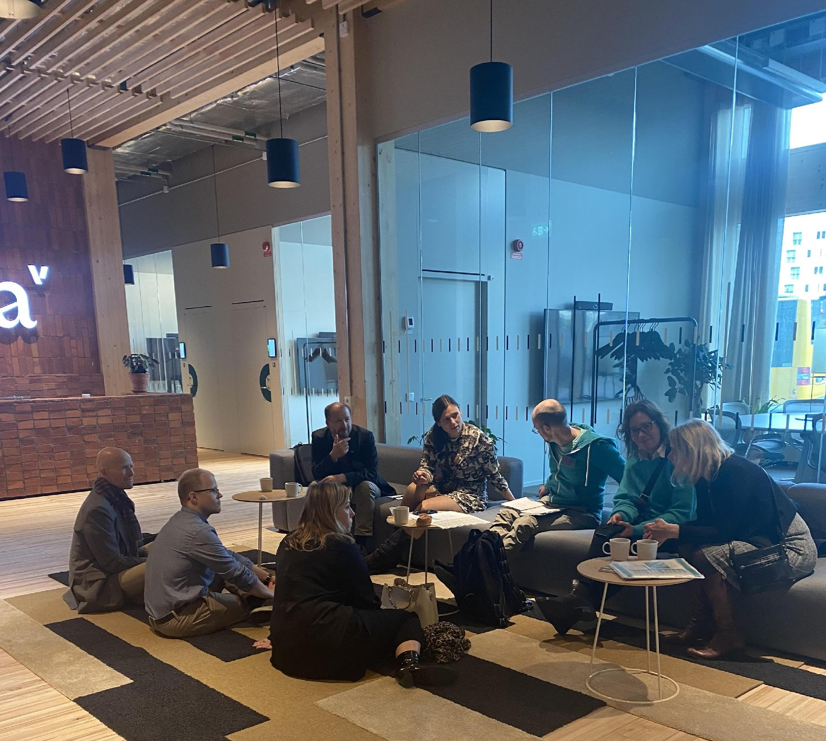
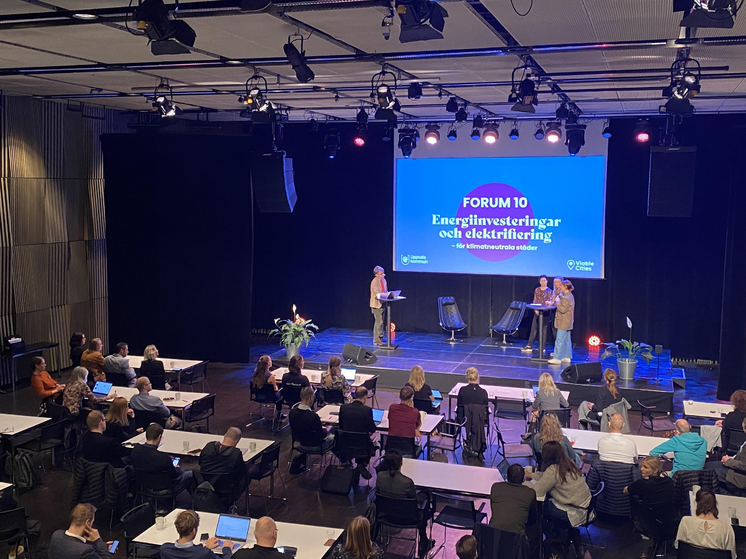
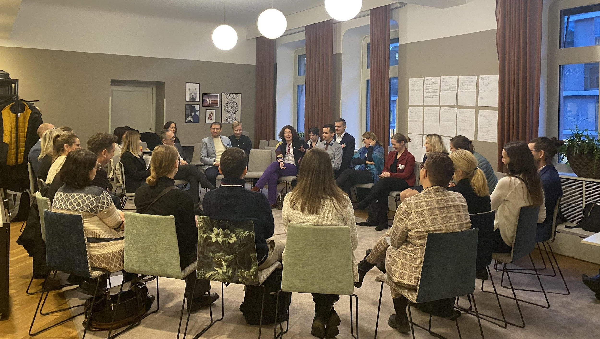
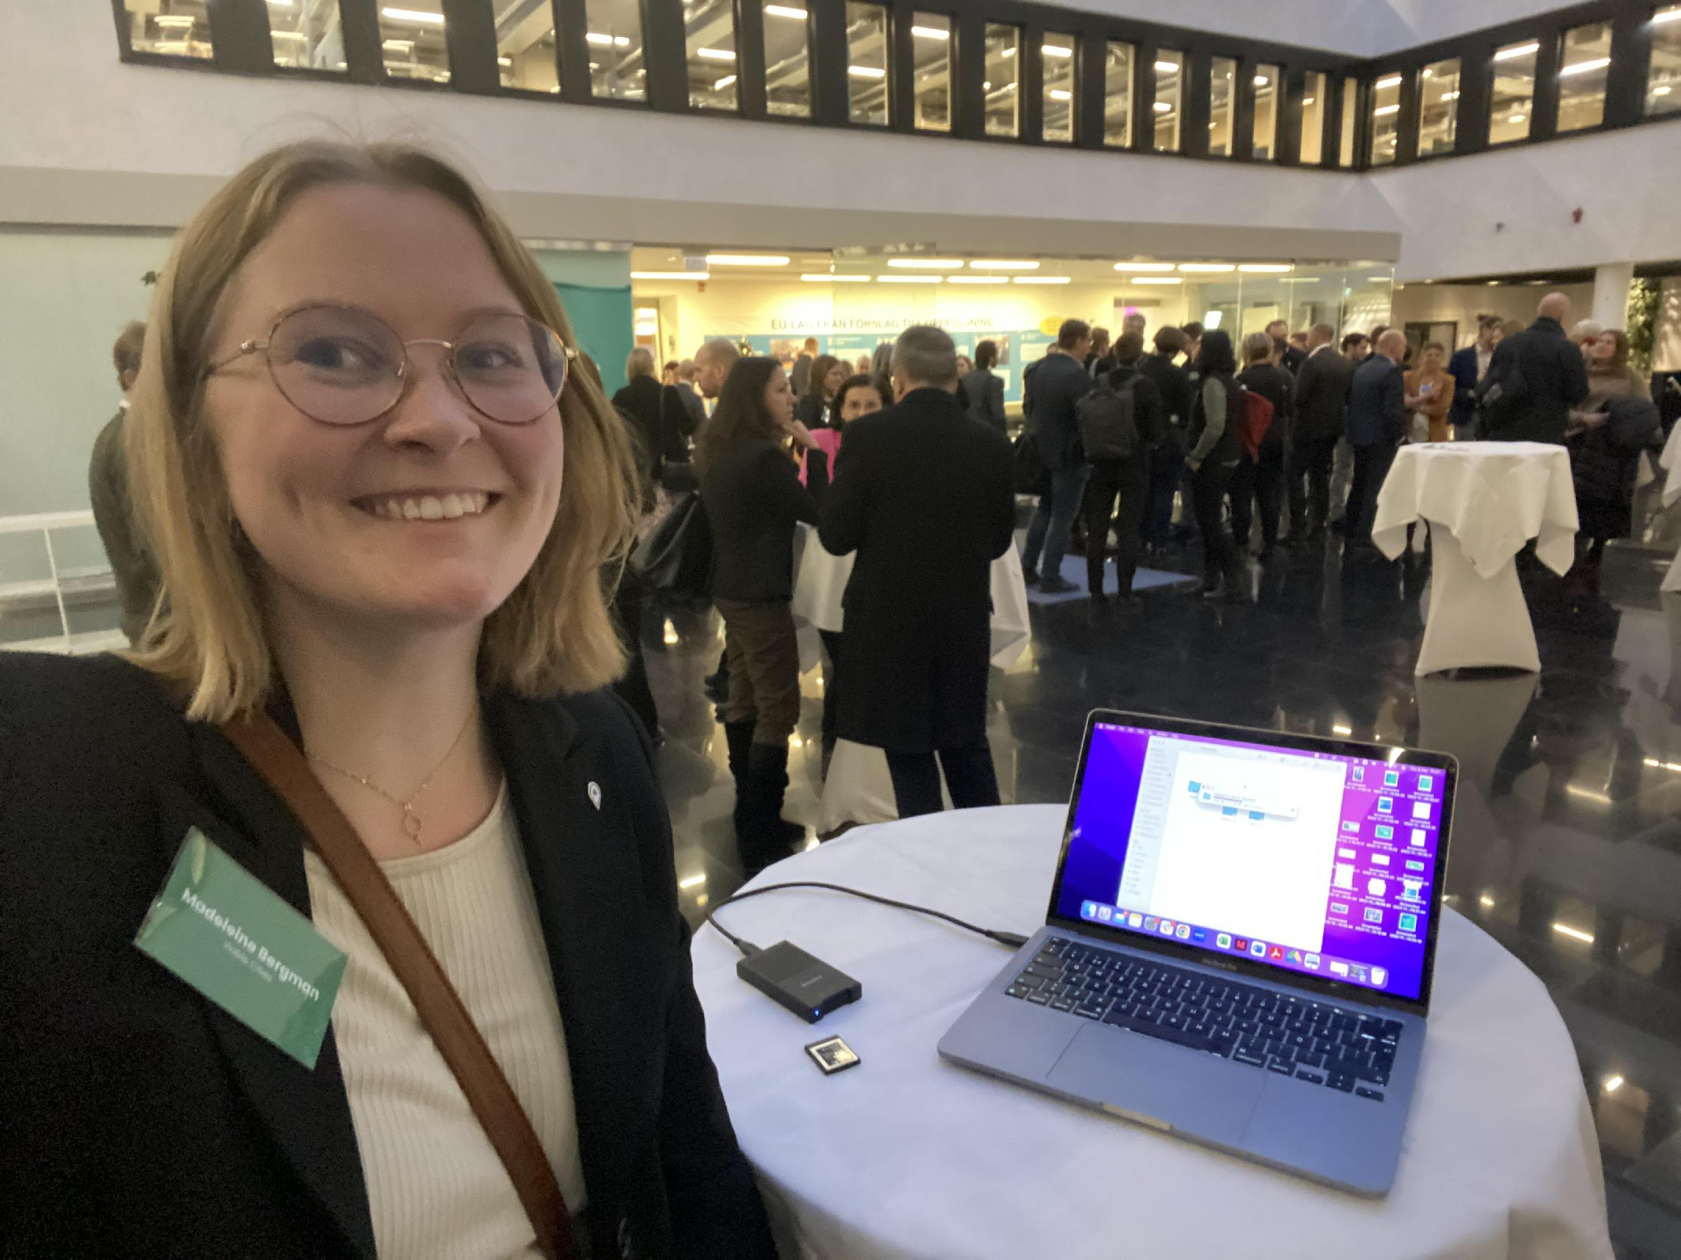
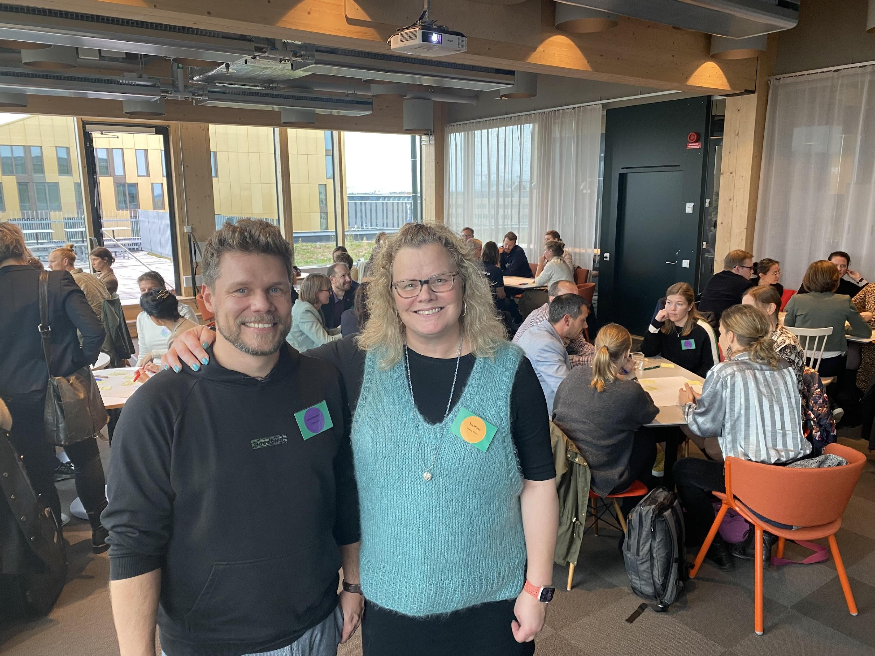
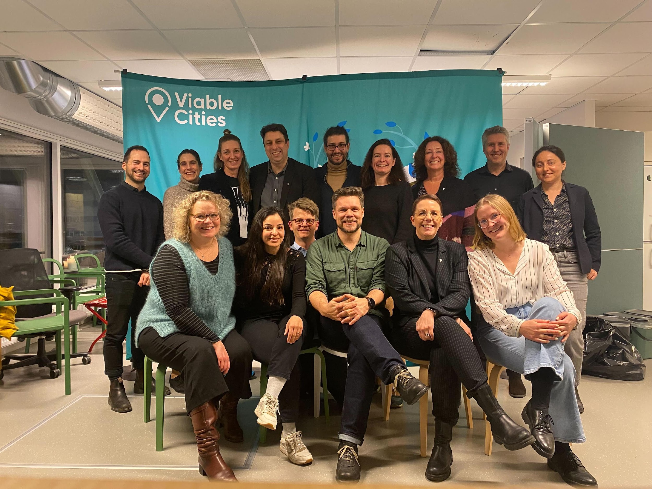
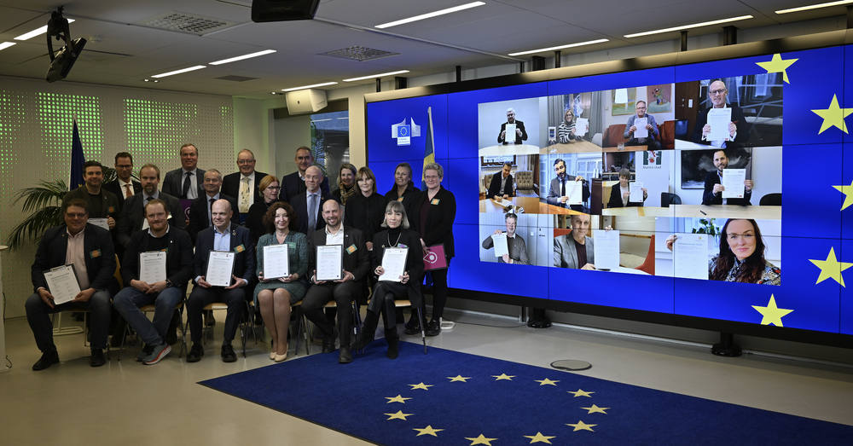
Transition Lab
Creating a movement, engaging people and accelerates learning. Building trust, relationships and supportstructures to empower innovation leaders and change makers.

Slide 26
Lars Johansson
Climate Neutral Cities 2030 Viable Cities
lars.johansson@viable cities.se

