Slide 1
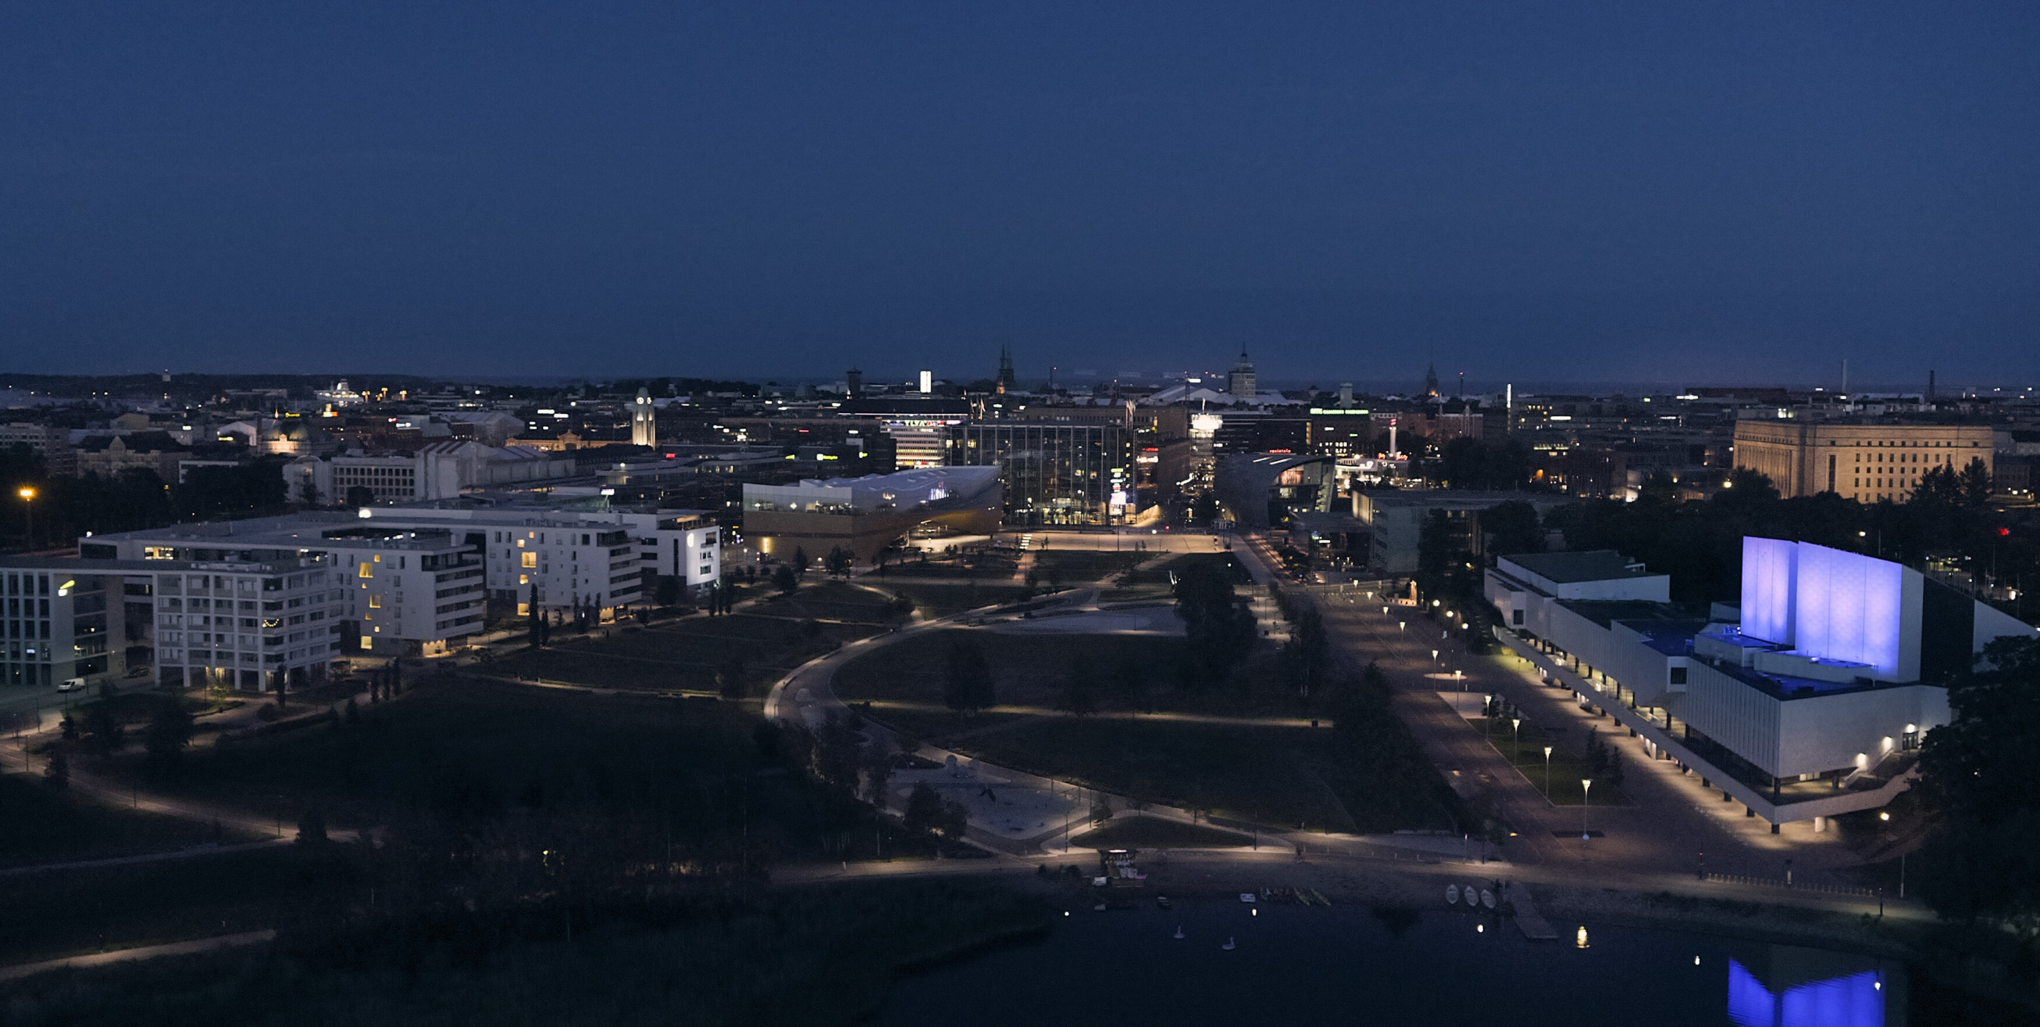
How to reduce obtrusive light in Helsinki? Marjut Kauppinen Head of Public Lighting City of Helsinki, Finland

Slide 2
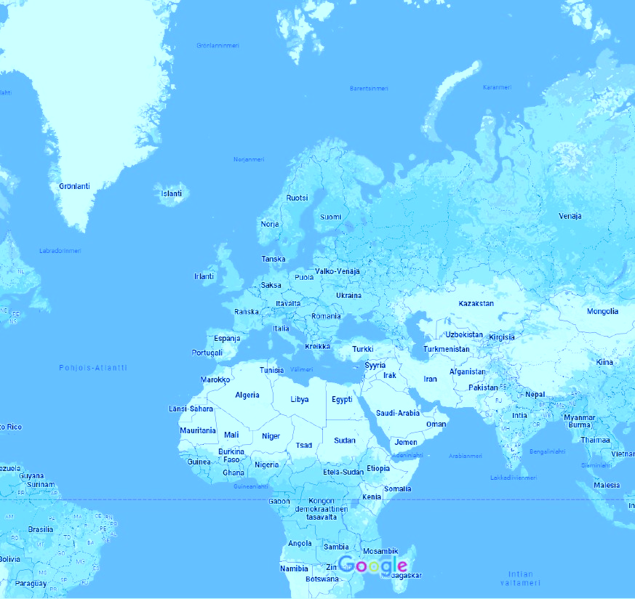
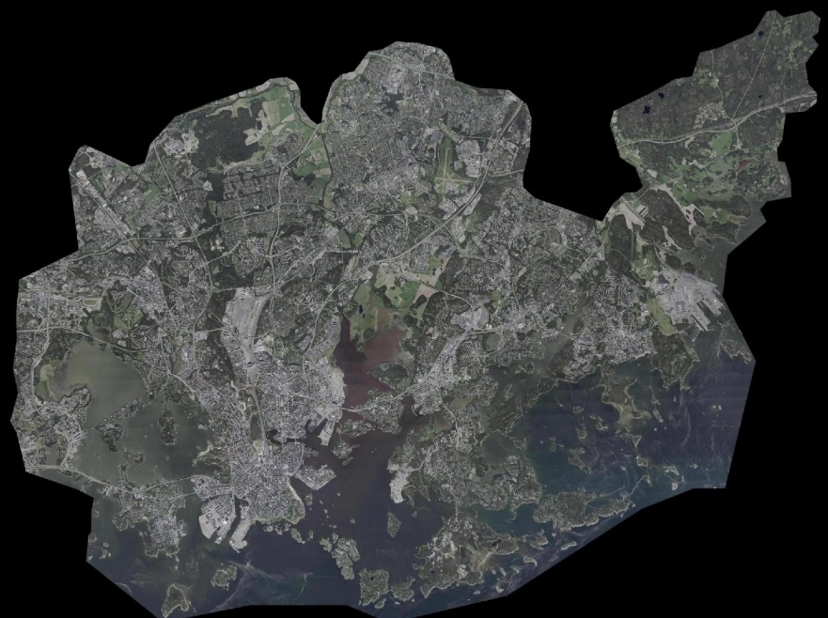
The context of lighting planning in Helsinki
Approximately 660,000 inhabitants
60 boroughs
More than 7000 new homes annually (2021)
3,073 inhabitants per km²m²
Approximately 92,000 points of light
Approximately 130 km of coastline
Approximately 1200 km of bike trails
1,898 hectares of park
4,734 hectares of forest, approximately 22% of the area

Slide 3
Obtrusive light or light pollution?
Obtrusive light is light directed above the horizontal and to directions not needed. It causes irritation, it is unpleasant, and makes it difficult to see essential information when directed outside the area to be illuminated. (International Commission on Illumination CIE definition)
According to the CIE, light pollution is the sum of the harmful effects of artificial light. It is a term commonly used by the environmental industry for light that is unnecessary for comfort or safety, possibly also to the sky, and which has an impact on nature.
Light pollution causes some environmental damage to plants, insects and animals. Environmental damage manifests itself in plants as changes in the growing season and in insects and animals as a reduction in habitat, which can lead to decline of population.
Excessive light also has health effects on humans (melatonin secretion, cancer risk).

Slide 4
The International Dark Sky Association (IDA) has identified different types of light pollution: sky glow, glare and light trespass. The association has been operating since 1988 with the aim of protecting the sky from light pollution by instructing, informing and organizing various events. There are already 180 special dark sky protected areas (cities, parks) in the world.
https://www.darksky.org/

Slide 5
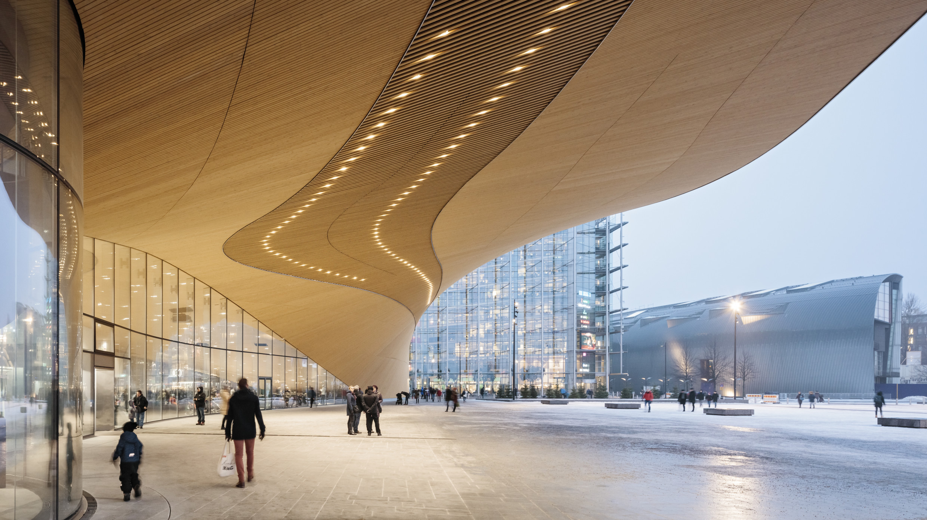
Does Helsinki feel safe and comfortable even in the dark?

Slide 6
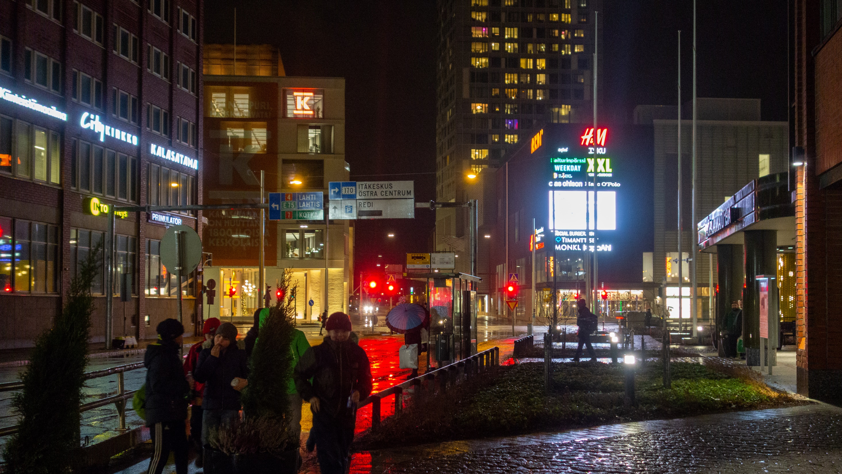
Does Helsinki feel safe and comfortable even in the dark?

Slide 7
Report on obtrusive light study in Helsinki
Categories for obtrusive light
Planning instructions
Next steps

Slide 8
There were 3,965 map markings from the participant of the survey and a large number of open comments.
Survey about light pollution

Slide 9
Survey results
It can be concluded that there is sources of obtrusive light in everyday environment.
Inhabitants find too bright advertising screens as the biggest problem.
Street lighting is usually well implemented. Exception is the traditional suspended Y-luminaire with new and too bright light sources.
Light sensitive areas (to be left dark): certain parks and coastal areas
Several pleasantly lit places that feel safe

Slide 10
With the help of the survey, Helsinki found out the prevalence of light pollution and glare in the city. The survey also identified places that could be left dark.
The results have been strong drivers of the study.
The online survey was conducted between 14 November and 15 December 2019. A total of 1523 responses were received.
The majority of respondents, 76%, live in Helsinki, 17% work in Helsinki and 7% of respondents were visitors.

Slide 11
Sources of obtrusive light are usually area lighting, larger advertising displays and certain luminaire types. Obtrusive light project included several areal night surveys, measurements of the brightness of the night sky and display luminance measurements. Photos: Annukka Larsen

Slide 12
1 Classification 2 Evaluation 3 Action
Obtrusive light categories
Advertising lights and led screens
Street and road lighting and parks
Facade and accent lights
Area lighting, public
Area lighting, private
Yard lights, public
Yard lights, private
Construction site lights and other temporary area lighting
Other (such as traffic lights and immobilizers)

Slide 13
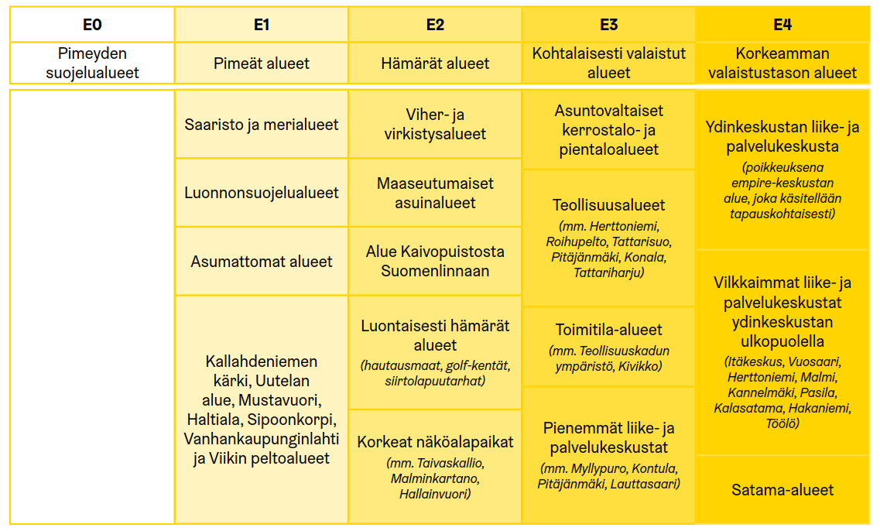
Planning instructions – area classes
Helsinki area is divided into different classes according to their current or target light climate.
Classes E0-E4 are in accordance with the CIE 150: 2017 report. E4 is the brightest and E0 is the darkest.
In the future the aim is to present classification on a map. The maximum amount of light allowed at the walls and the sky is defined.
Areas with no light
Dark areas
Light sensitive areas Dim areas
Moderately lit
Higher lighting level areas

Slide 14
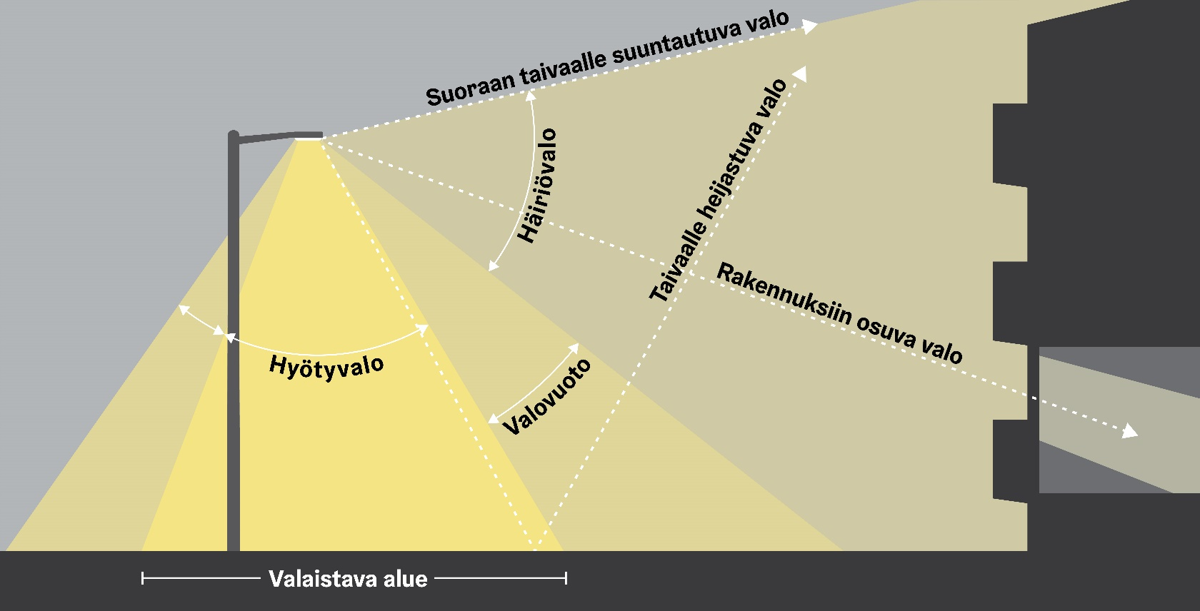
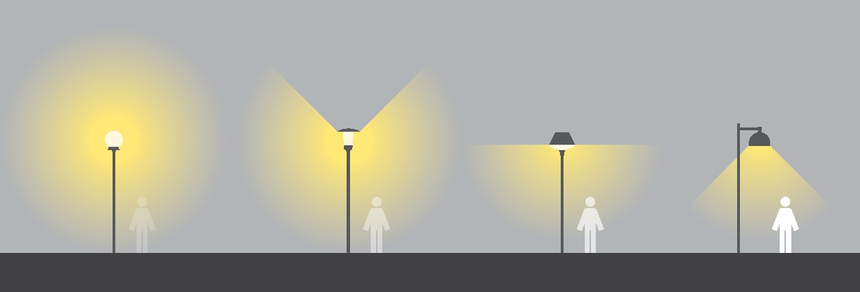
Planning instructions – luminaires
Light directed to the sky
Obtrusive light
Light reflected in the sky
Light on buildings
Useful light
Leaking light
OK
OK
Illuminated area
Direct the street light fixture correctly and avoid light on the sky or unnecessarily on the walls of the property.
The design must comply with lighting standards and the limit values set by the obtrusive light area classes (E-classes). d
Choose a luminaire model that does not produce light beyond the luminaire's own horizontal plane.

Slide 15
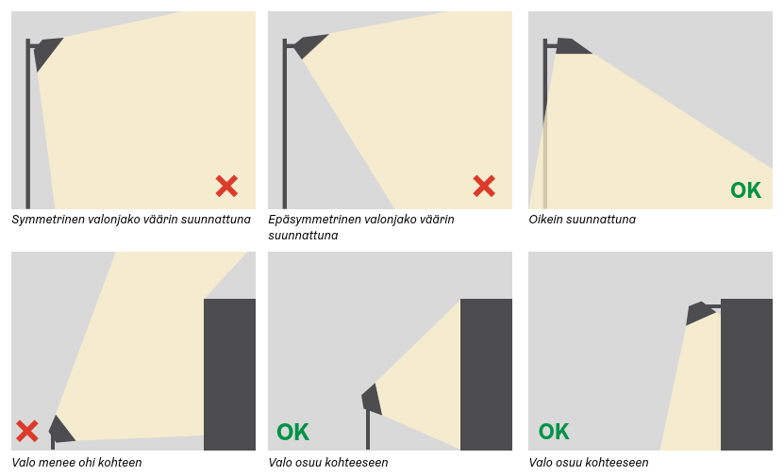
Planning instructions – light distribution
Symmetrical light distribution aimed wrong
Asymmetrical light distribution aimed wrong
Asymmetrical light distribution aimed correctly
The light is not limited at the boundary of the area but may unplanned disturb light sensitive on dark areas. Illuminations should therefore always be evaluated in relation to the environment
Light passes the target
Light hits the target
Light hits the target

Slide 16
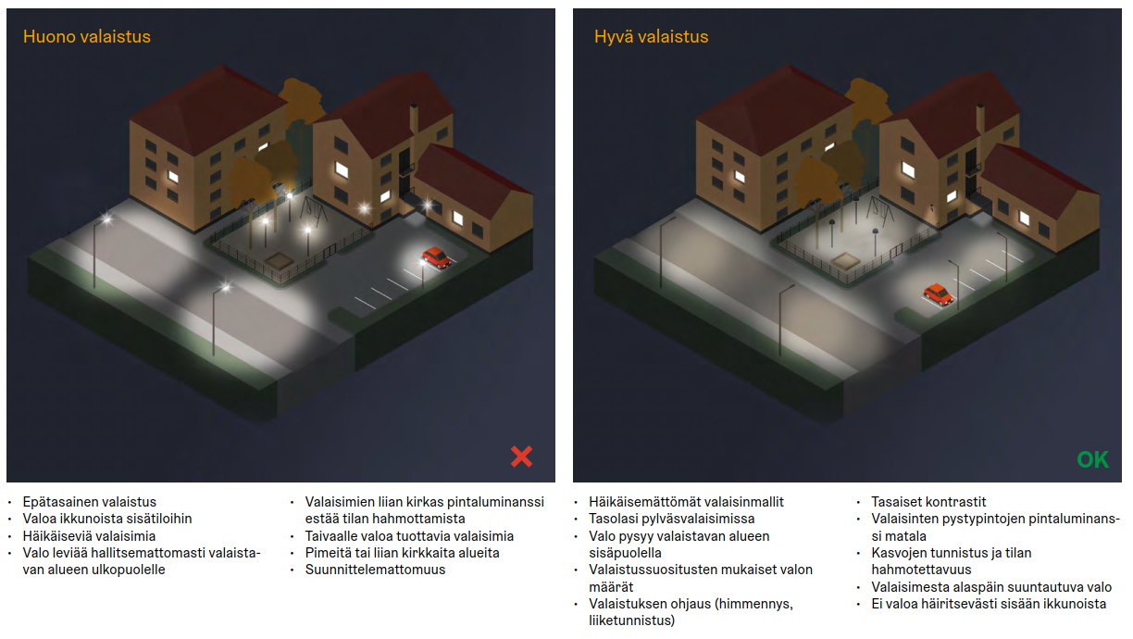
Planning instructions – yard lighting
Poor lighting
Good lighting
• Uneven lighting • Light spill to indoors • Dazzling luminaire types
• Light spreads uncontrollably outside the illuminated area • Too bright surface luminance of the luminaires prevents the space from being perceived • Lights that produce light to the sky • Dark or too bright areas • Unplanned
• Non-glary luminaire types • Flat glass in pole lights • The light stays inside the area to be illuminated • Amounts of light according to lighting recommendations • Lighting control (dimming, motion detection) • Even contrasts • The surface luminance of the vertical surfaces of the luminaires is low • Face recognition and space perceptibility • Light directed downwards from the luminaire • No distracting light towards the windows

Slide 17
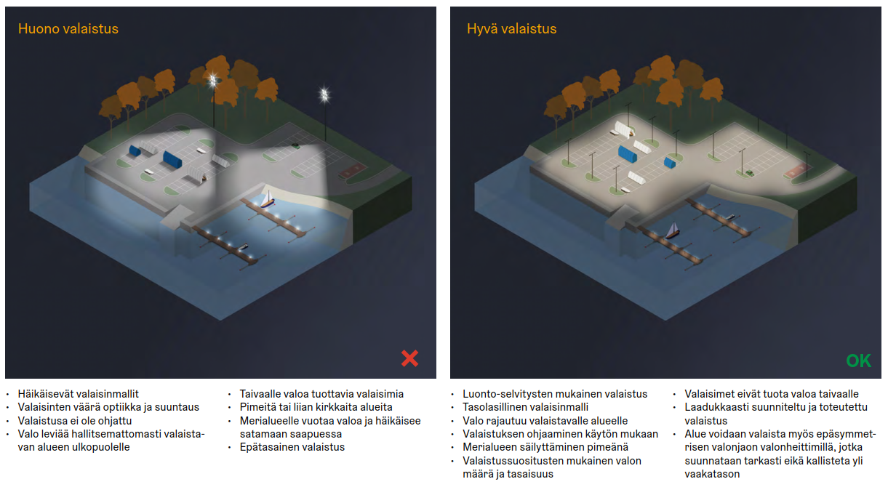
Planning instructions – harbour area lighting
Poor lighting
Good lighting
• Dazzling luminaire models • Incorrect optics and orientation of luminaires • The lighting is not controlled • Light spreads uncontrollably outside the illuminated area • Lights that produce light to the sky • Dark or too bright areas • Light leaks into the sea area and dazzles when entering the port • Uneven lighting
• Lighting according to nature reserve surveys • Flat glass luminaire model • The light is limited to the area to be illuminated • Control of lighting according to use • Keeping the sea area dark • Amount and uniformity of light according to lighting recommendations • Lamps do not produce light in the sky • High quality designed and implemented lighting • The area can also be illuminated with floodlights with asymmetrical light distribution, which are precisely oriented and not tilted over the horizontal

Slide 18
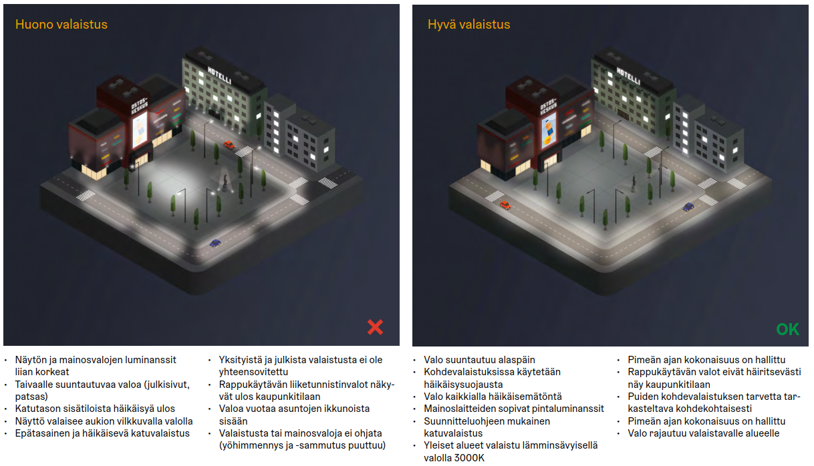
Planning instructions – urban area lighting
Poor lighting
Good lighting
• The luminances of the screen and advertising lights are too high
• Lights towards the sky (facades, statue) • Glare from street-level facilities • The screen illuminates the square with a flashing light
• Uneven and dazzling street lighting • Private and public lighting are not coordinated • The motion sensor lights in the stairwell are visible to urban areas • Light leaks in from the windows of the apartments
• Lighting or advertising lights are not controlled (no night dimming and shutdown)
• The light is directed downwards • Glare shielding is used in accent lighting • Glare-free light everywhere • Suitable surface luminances for advertising equipment • Street lighting according to the design guide • Public areas illuminated with warm light 3000K • The nocturnal whole is controlled • The stairwell lights do not disturb the urban space • The need for accent lighting of trees must be considered carefully • The light is limited to the area to be illuminated

Slide 19
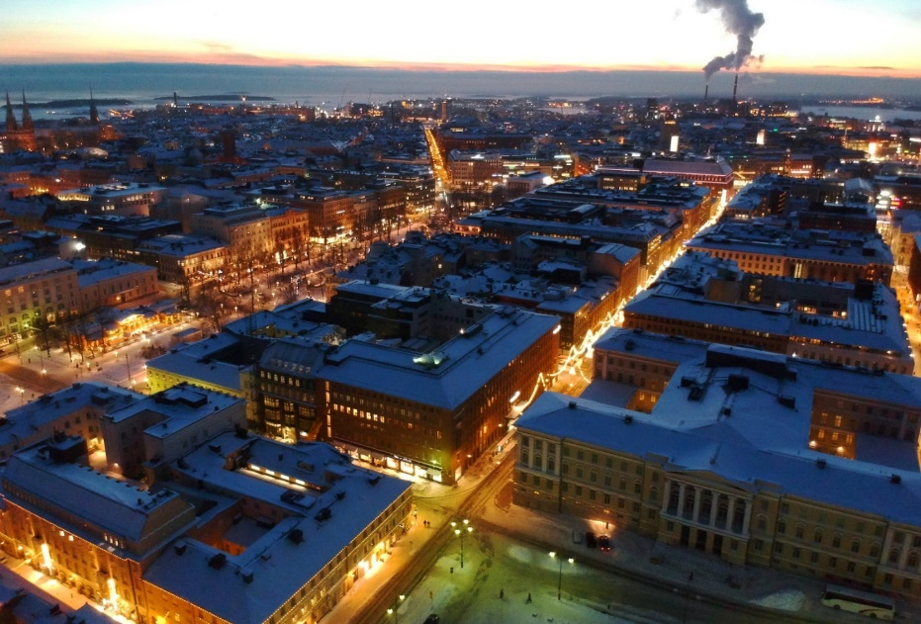
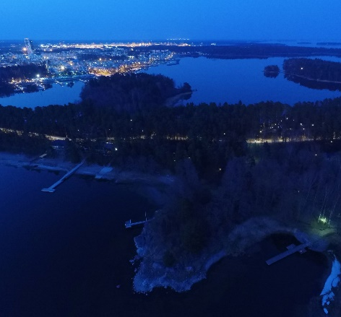
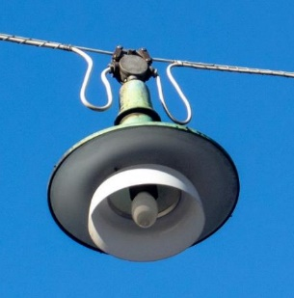
Action: Obtrusive light is wasted energy, bad for people and nature, therefore we
Update all lighting design guidelines and add clearer visual information!
Present good lighting principles!
Follow the areal categories of stray light limit values (light spreading to the sky and vertical surfaces, glare)!
Update the lamp technology of the traditional Helsinki luminaire (Y- pendant)!
Update the zones of historically valuable and dark areas!
Update guidelines for outdoor advertising equipment!

Slide 20
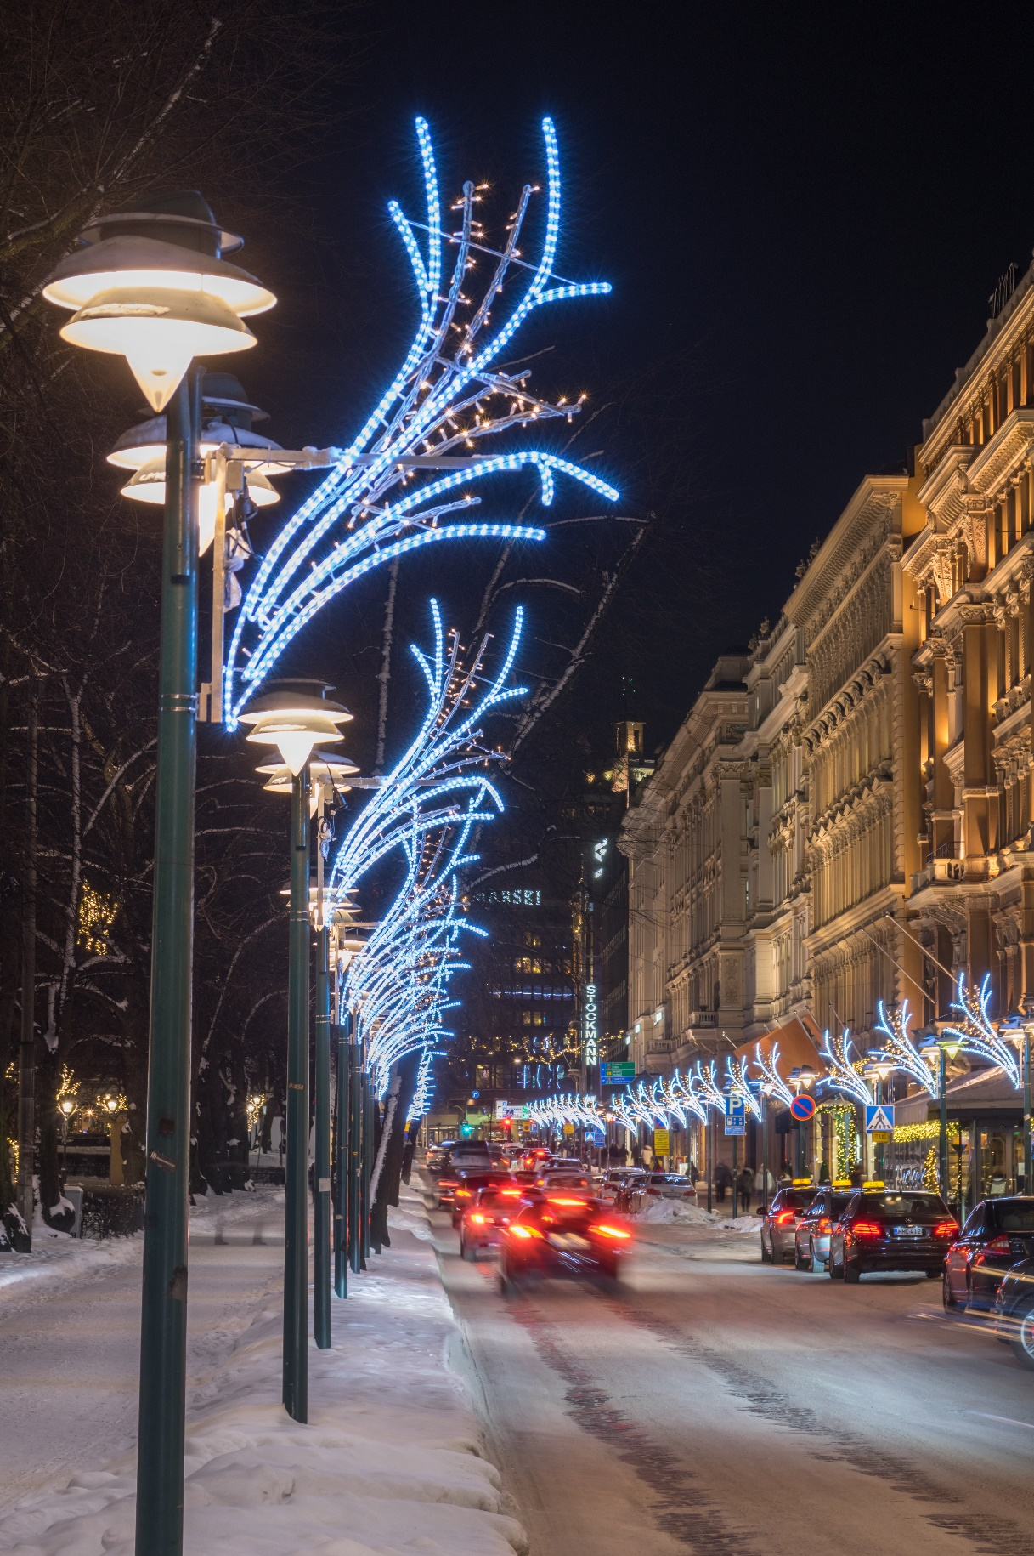

Slide 21
Lighting culture of Helsinki
Implements the City Strategy
Cultivating safe neighborhoods with distinctive identities
Helsinki’s goal is to be a city where polarization between districts does not increase, and every resident can live a safe and pleasant life in a neighborhood with its own distinct identity. We will seriously address the threat of segregation, listening carefully to what the city’s residents have to say on the matter and learning from research.

Slide 22
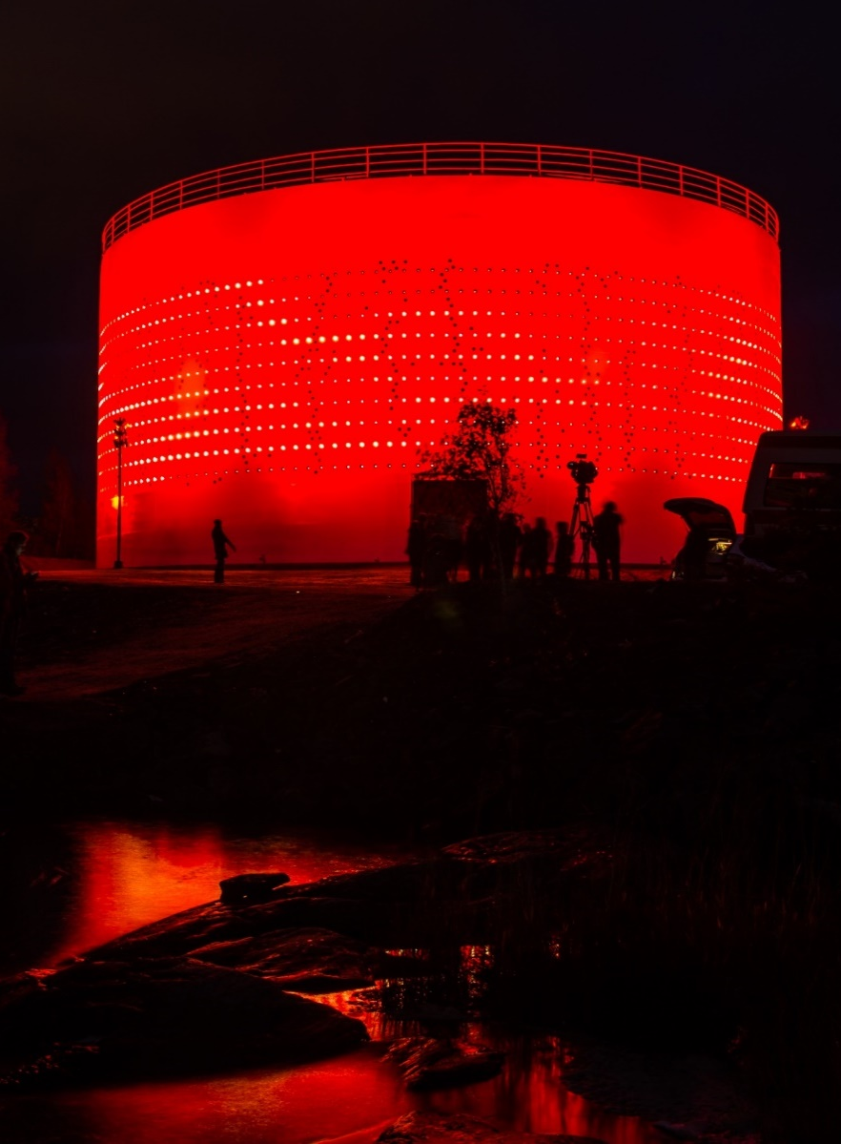
Kruunuvuorenranta, a new neighborhood of light and light art

Slide 23
A smoothly functioning and beautiful city
Sustainable growth is based on long-term zoning and city planning. Balanced development of the city makes it possible for resident satisfaction to improve alongside population growth, as a growing populace is a prerequisite for the success of many economic activities. This enhanced activity leads to joint investments that can increase both general satisfaction and urban beauty.

Slide 24
Thank you!
Helsinki Senate Square in new light 2023
Lighting design: Valoa Oy; Light pole design Futudesign Oy, Structural and electrical wiring design Sitowise Oy

