Slide 1
Utrecht: Growing fast but still remaining green
City of Utrecht
IFME Congres Birmingham,
Jeroen Schenkels
18 april 2023
Notes:
image of Utrecht in 2040: growing fast but still remaining green
Utrecht wants to give space to this growth, while retaining its identity. With affordable homes, a green, attractive, and healthy living environment with good accessibility. Our vision is: "Natural living in a green Utrecht". Utrecht is a compact city of healthy urban life for everyone. This implies an environment with lots of high-quality greenspace, nearby citizens and a high biodiversity. We choose as much as possible for solutions that match the natural system. In the coming decades we want to work on this to achieve this for and together with the residents of Utrecht, as part of healthy urban living for everyone.
In the next slides I want to explain you how we want to reach this ambition.

Slide 2
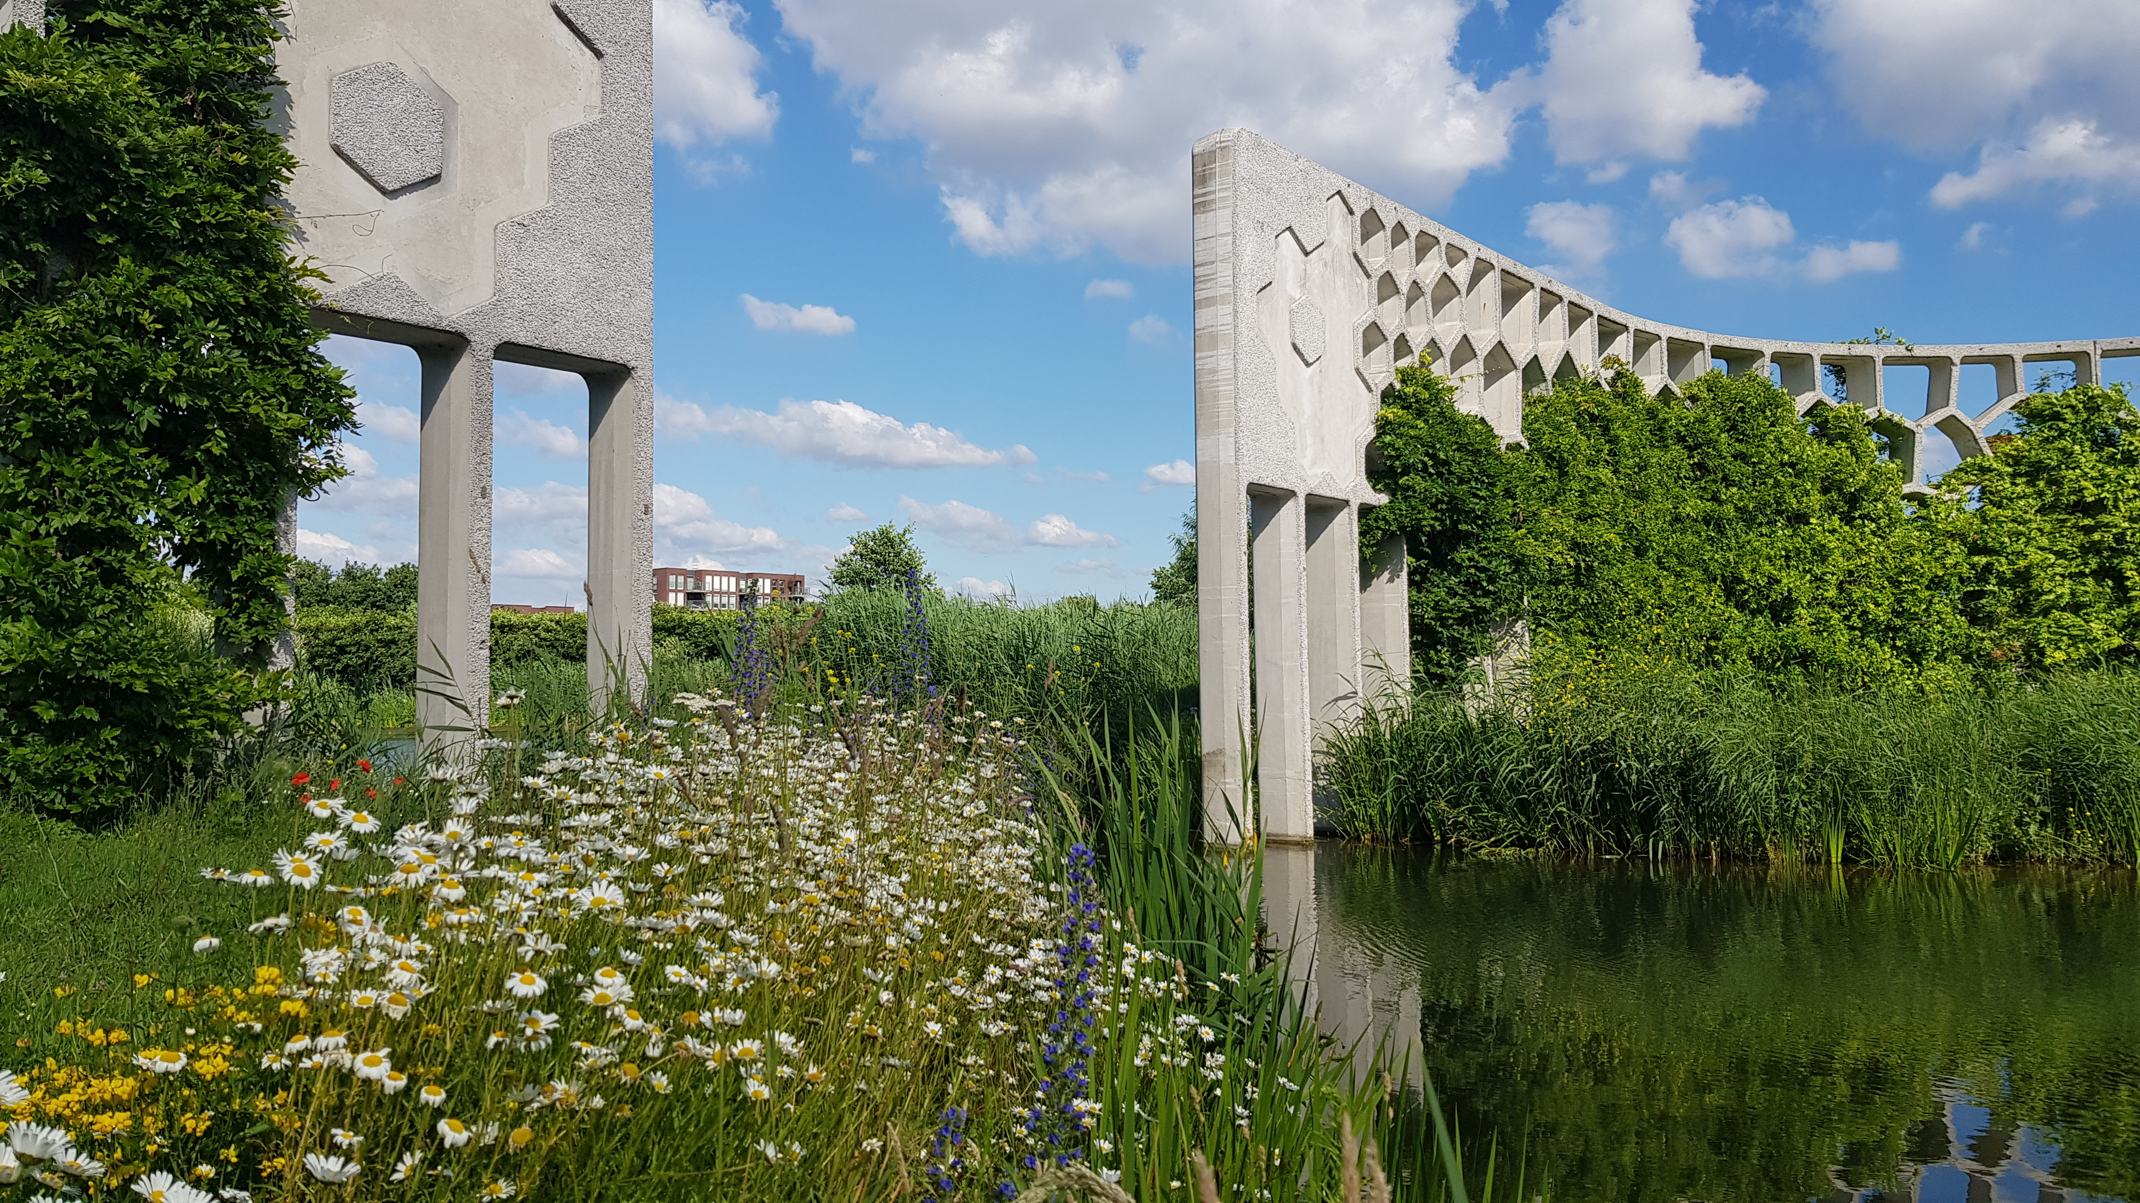
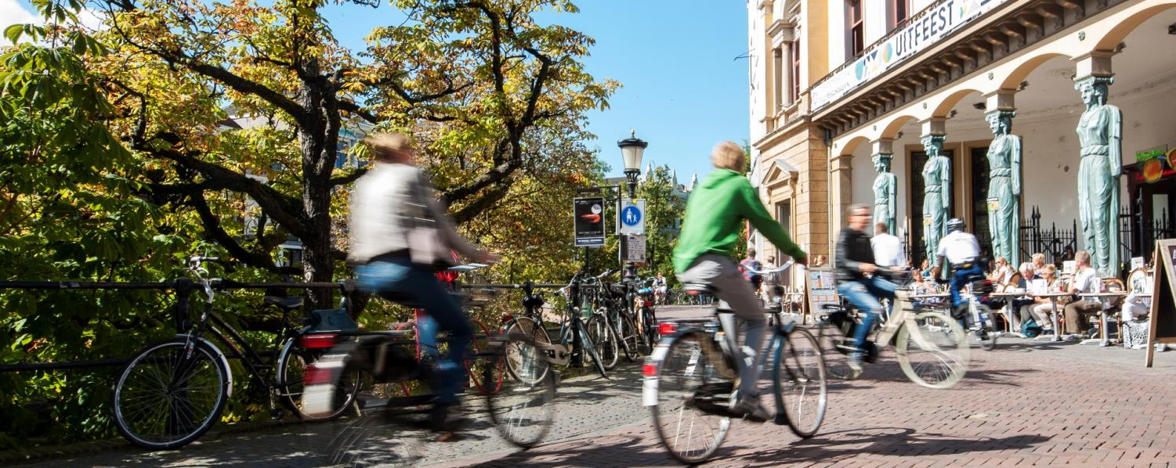
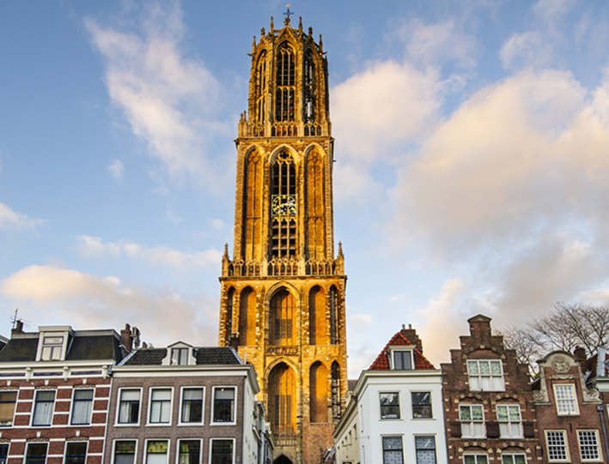
Introduction to the city of Utrecht
Notes:
But first of all, I give you a short introduction of Utrecht.
Utrecht is situated right in the heart of The Netherlands, with a historic medieval city center with unique wharves and because of the green surroundings at our doorstep it is a nice town to live.
Utrecht counts more than 360.000 inhabitants and bustles with life. 70.000 students.
Utrecht is known as a pleasant city to live, to work and to enjoy. Utrecht Central Station : 88 million passengers per year growing to 100 million in 2030.
Utrecht is also known as number one cycling city according to World Economic Forum where 49,3 % of all trips in the city up to 7,5 kilometer is done by bike.
This is something we’re very proud off. And I can tell you this has been a lot of work to get that done.
We know a quite common development as many cities from the medieval city to a car-oriented city in the 1960
The province of Utrecht, with over a million inhabitants, is considered to be the most competitive region of Europe, with several hundreds of thousands of jobs. Because of all of these unique characteristics, Utrecht is very appealing to a lot of people. Hence our city is the fastest growing city in the Netherlands and it is expected that in 2040 Utrecht will have more than 450.000 inhabitants.

Slide 3
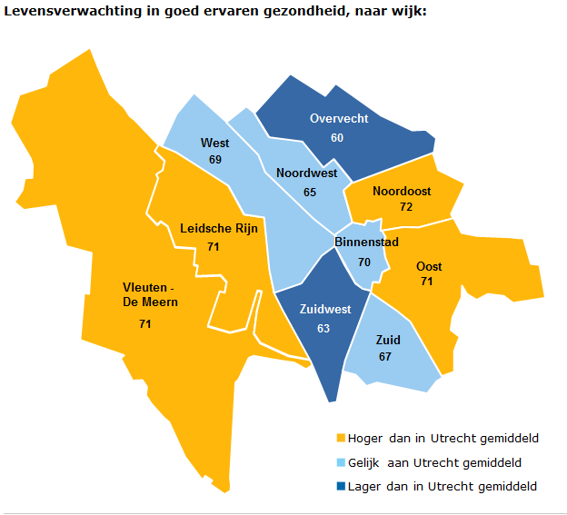
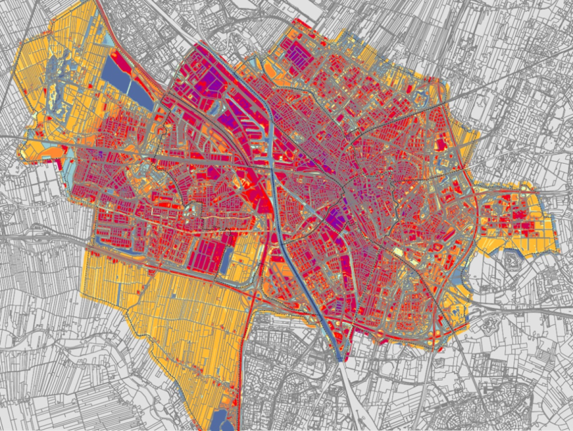
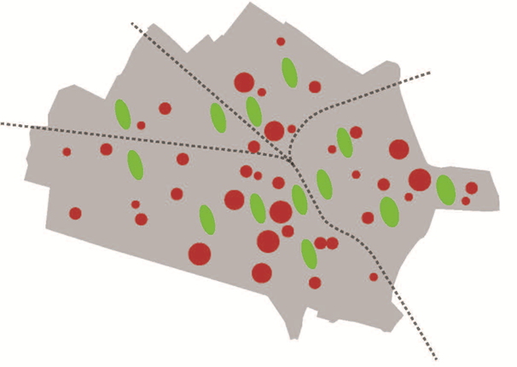
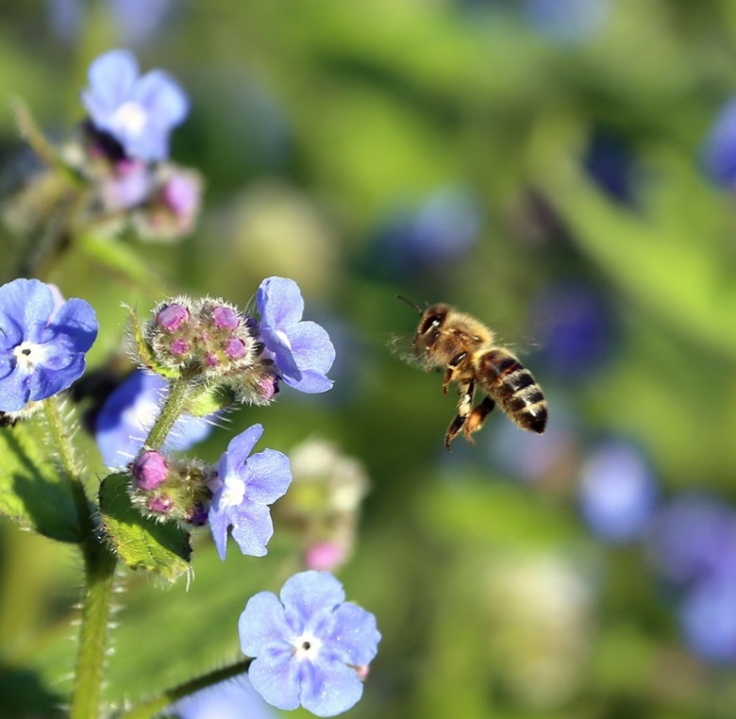
Healthy urban living for all
Notes:
Healthy Urban Living for all Three important tasks in Utrecht and increasing biodiversity plays an important role in this
Most important policy question or challenge for the city Growing city through densification Explanation of the image left: shows how we want to grow healthily; by densifying inner cities and preserving the landscapes around the city. Utrecht (99 km2) is the fastest growing city in the Netherlands. It is a transport hub with highways, rivers and railways passing or intersecting the city and poses one of the greatest spatial challenges. In addition, In the next 20 years (till 2040) we want to welcome 100.000 new inhabitants. Therefore, we will have to build 60.000 new homes.
Health equality: our new city council wants to invest unequally in the next four years for equal opportunities in terms of climate, health and amount of greenery.
Expectation: life expectancy is increasing, especially in neighborhoods where it is lagging.
Explanation image at the top center: health differences per neighbourhood: orange, light blue and dark blue respectively, life expectancy higher, equal and lower than average) Our goal is to achieve a healthy city where the role of public green space is important.
Explanation of the image right: pavement map relevant to climate change = climate adaptation and mitigation Climate change is another challenge that the city must pose. how climate adaptation measures (combating prolonged drought, heat stress, flooding and water pollution) can keep pace with climate change. The risk of flooding and heat stress increases in combination with the increasing fortification in the city.
Explanation bottom center: Nature, natural processes and biodiversity are declining worldwide, but at the same time they are of great importance for solving challenges in cities
Green cities are healthy, liveable and resilient to climate and water risks. Investing in nature in the city (nature-based solutions) helps cities to tackle flooding, heat stress, drought, poor air quality, inclusion, unemployment, and helps biodiversity to flourish.

Slide 4
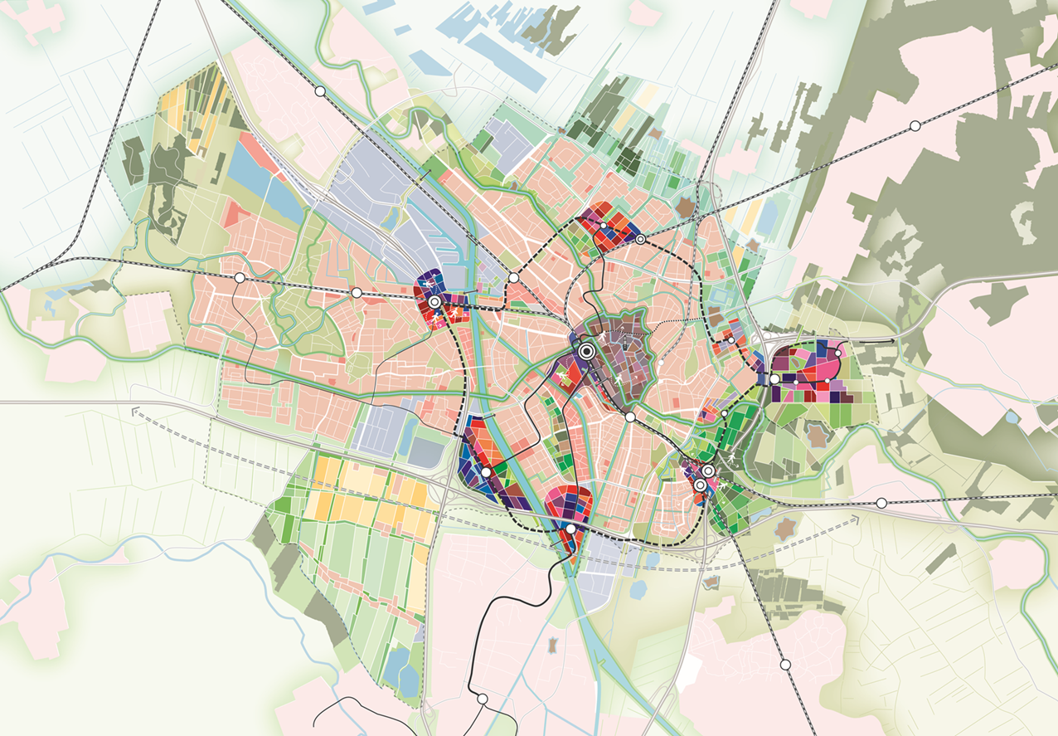
Utrecht 2040 New Spatial strategy
Notes:
We want to make sure that our city is a healthy and enjoyable place for people to live and work. We also want to make sure that they can travel across, in and out of the city quickly and easily, and can enjoy their city in their spare time.
With the growth of inhabitants and jobs in Utrecht in the next 20 years we updates our mobility strategy. Otherwise, traffic collapses, the city is not accessible and attractive anymore.
We are aware that spatial planning and mobility go hand in hand. Integrated planning of city growth and (green)infrastructure are a no brainer for us. We also combine our city and neighborhood improvements with goals as social cohesion end climate adaptation.
Organization of mobility and greenstructure makes the healthy growth of Utrecht possible

Slide 5
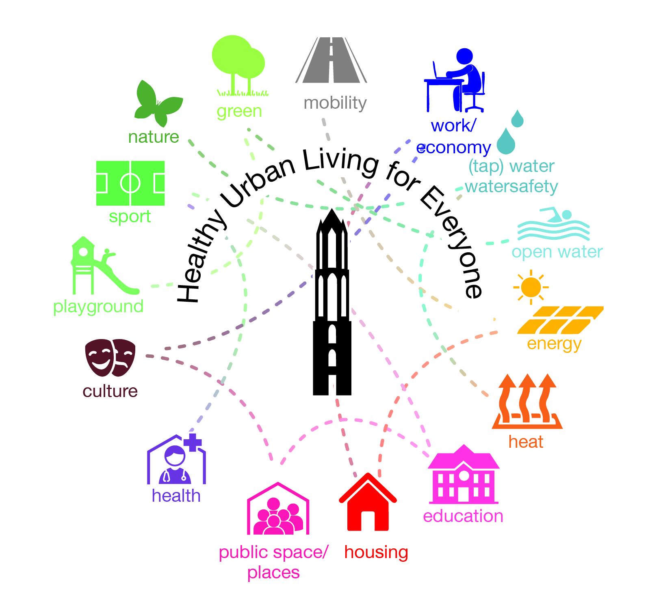
Connecting ambitions
The 10-minute city
City residents can find everything they require within a 10-minute walk or by bike
Crucial factors
proximity
diversity
density
Notes:
In the process of the development of the spatial strategy and the mobility and we decided to use the frame: “What if every resident is able to find everything he/she needs for daily use is accessible within 10 minutes”
grocery shopping, leisure, culture, school, green space, sporting facilities, station, mobility hub, work…
We are convinced that if we are able to design Utrecht like that: the need for transportation is minimized and people are able to use our preferred modes of transport: walking, cycling, public transport and MaaS options.
Crucial factors to succeed are: proximity, diversity and density. Combined with other city measures as climate, health, inclusivity. We worked out 6 city profiles which will be used as guideline for future projects.

Slide 6
Utrecht barcode
Systemic and integral approach:
Add 40.000 residents => Add 440 hectare of green
Notes:
Barcode
Systemic and integral approach / together with others
- Energy: space in the subsoil for mature trees
- Mobility. create space on ground level (265 hectares, see climate adaptation) by moving from traffic to accommodation. Making joint connections
- Climate. choosing nature-based solutions over technology;
- Subsurface: Space (600 hectares) in the subsurface for mature trees and city sponge;
- Management: set up developmental management, increase biodiversity
- Living and working: Contributing to four green variants;
- Partners: greening and opening up private greenery (120 hectares)

Slide 7
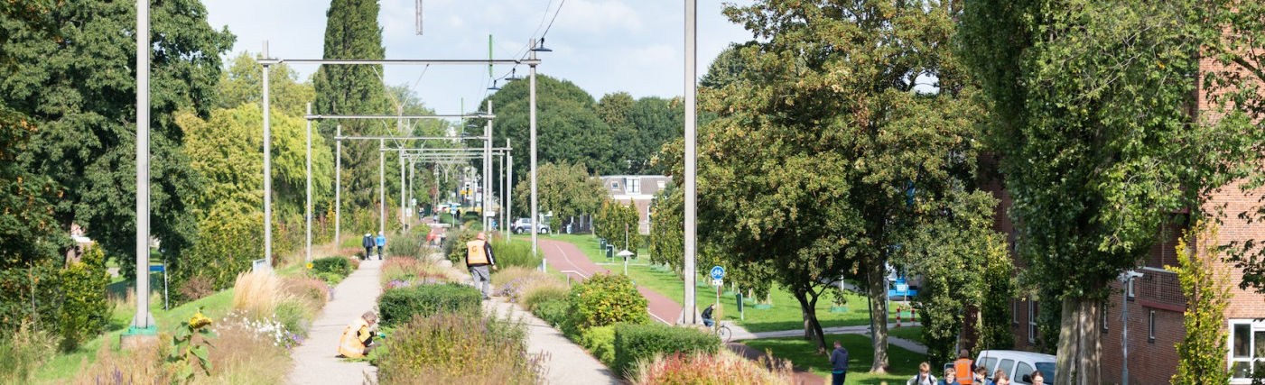
Green in Utrechts’ Urban Development Strategy 2040
Systematic leap for our urban nature strategy
30 % increase of citizens in 20 years.
Condensation within infill, never done before on this scale
Neighbourhoods with fewer nature and green, health problems, climate vulnerability, big challenges for the energy transition
Balance between more nature and infill means 440 ha extra for nature in the city: where??
Notes:
Solution is in the holistic and integral approach: find space in ànd with the other assignments and divisions
leading principle: green unless..
Systematic leap: higher level, innovative solutions, out of the box

Slide 8
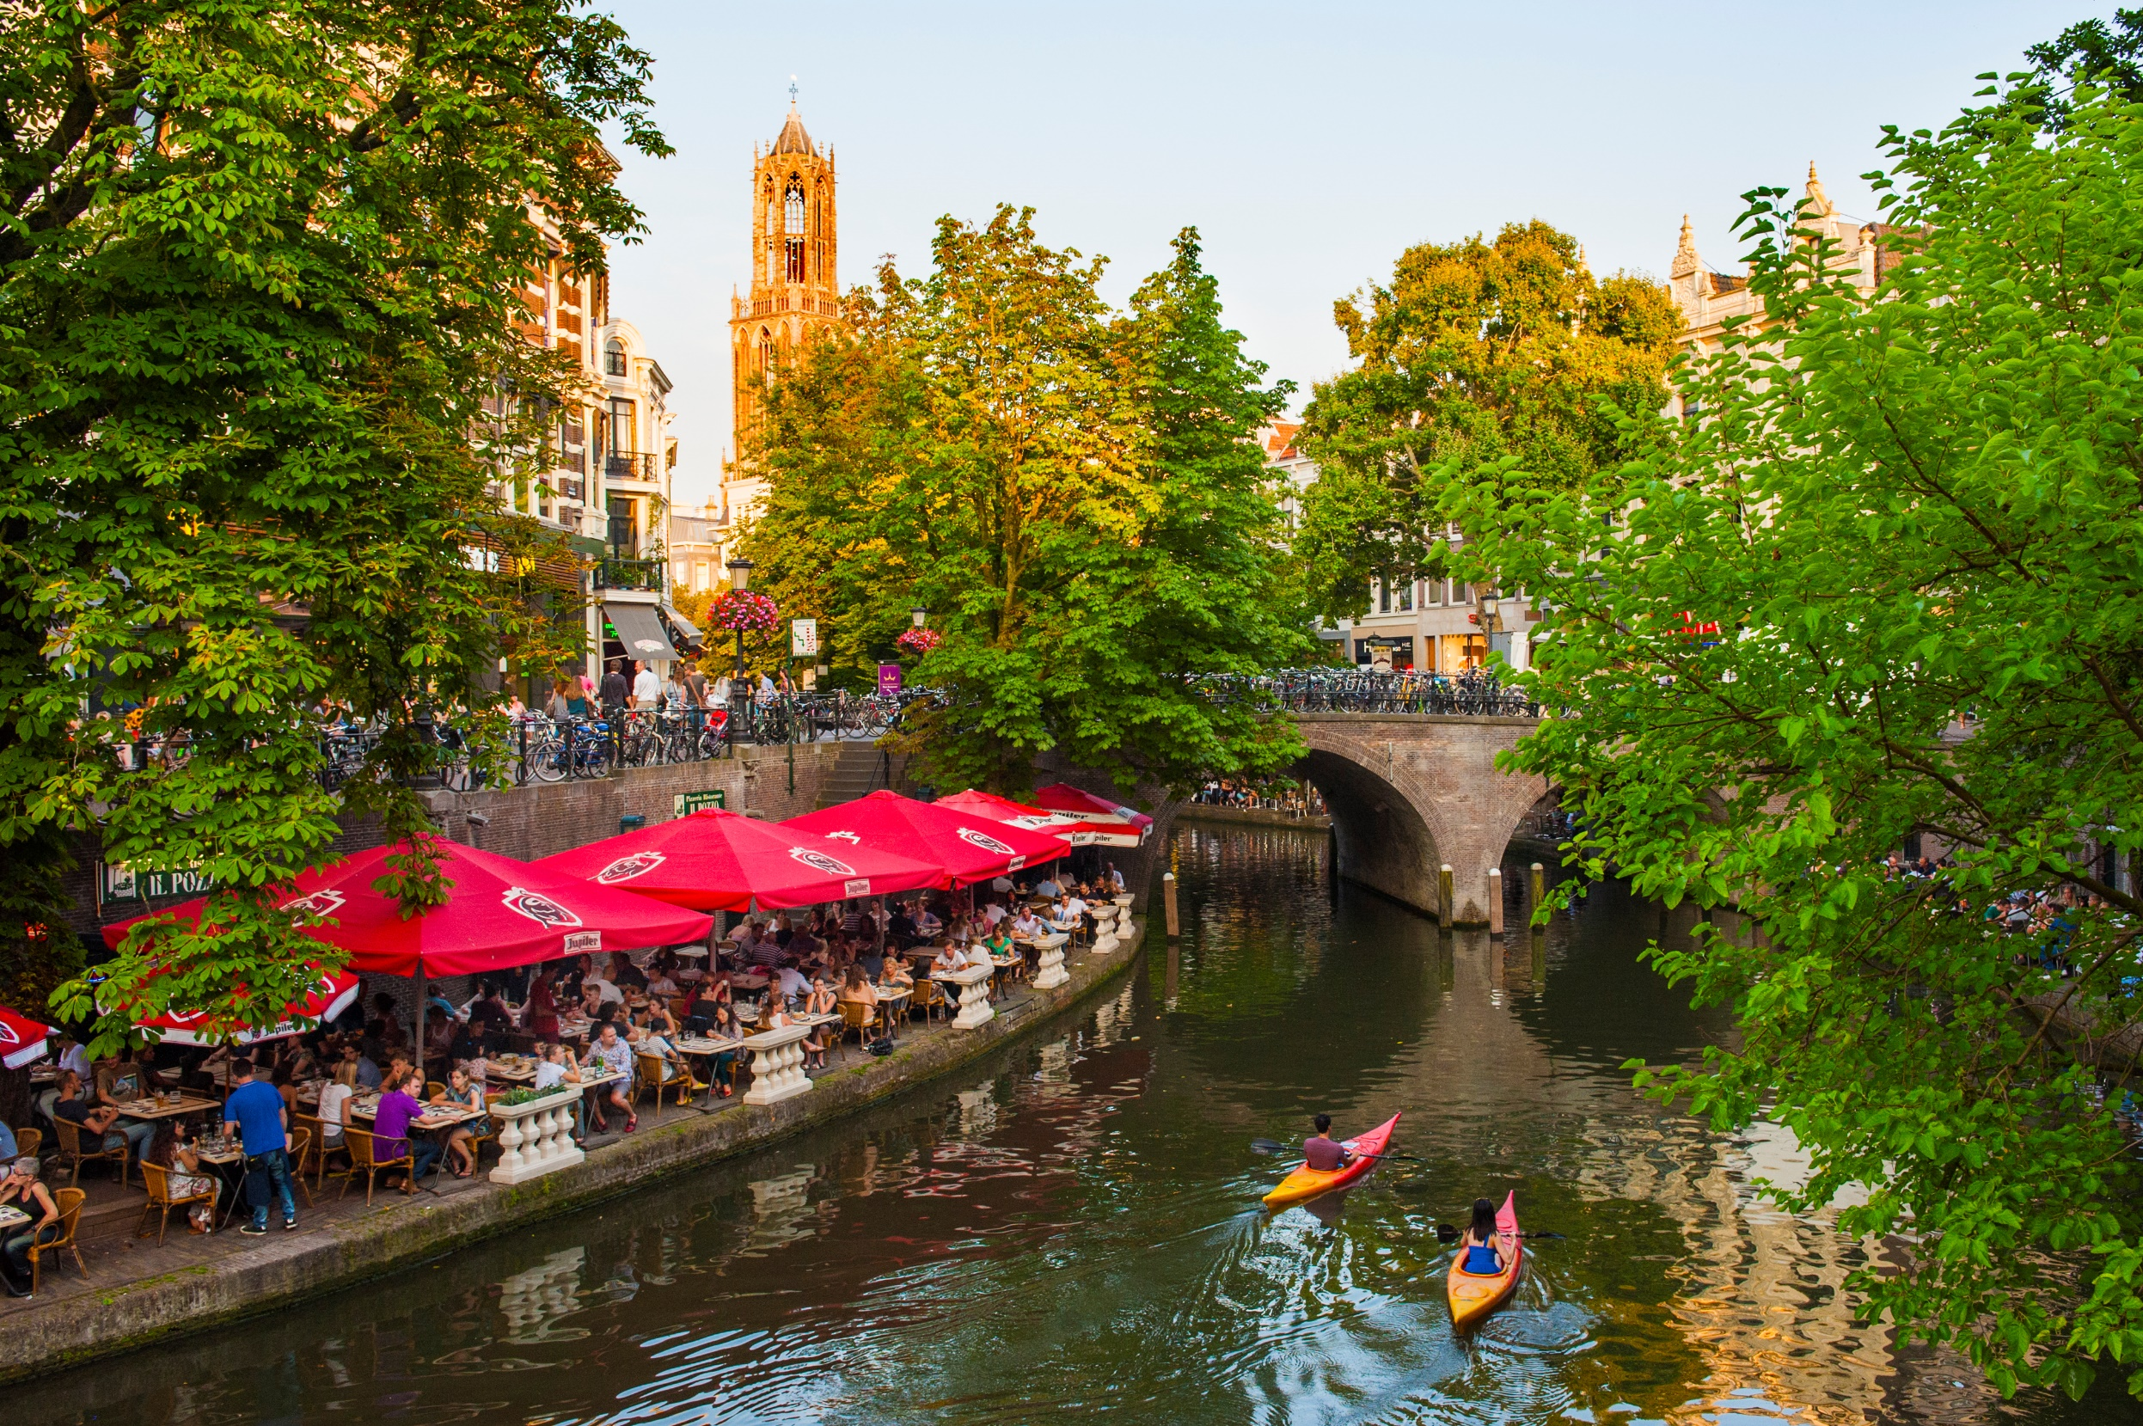
The green unless priciple
75 m2 meter per household (urban Barcode)
Green unless, 440 ha green added
At least 40% green in the neighborhood
Maximum distances to green areas for use (health)
More biodiversity, Big 30
World green city award -> nomination living green for health and wellbeing
World green capital
European green week
100 climate neutral cities
Vakbeurs openbare ruimte
Most Inspiring Global Goals City 2017
Notes:
The growth in the number of inhabitants (and the number of homes) presents the municipality with major challenges in the areas of greenery, housing,
work, social facilities, mobility and energy. For all these themes, the most important ambitions in this RSU 2040 are direction
elaborated in 2040. A guiding framework is being developed for choices in the spatial development of Utrecht in the next 20 years,
including the principle “Green Unless” RSU. The Green Unless principle comprises nine principles

Slide 9
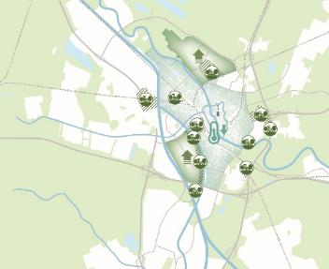
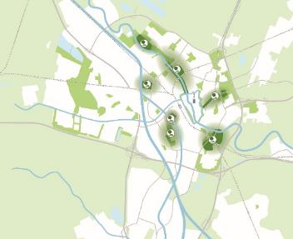
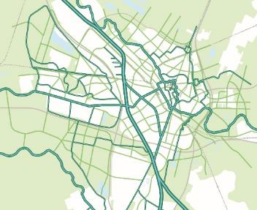
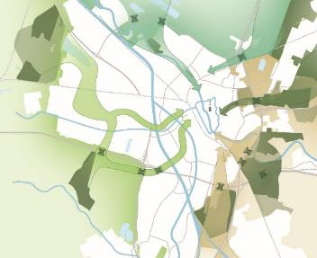
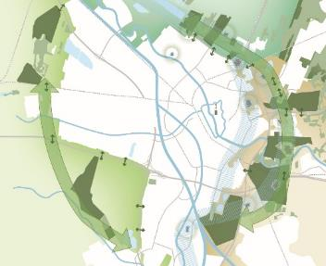
Greening our city at different levels
Notes:
To keep the balance with urbanization, 440 hectares of green space will be needed for these new residents in 2040. Every year, 20 ha of greenery must be added. That is an enormous task! To achieve this leap in scale and we have mapped out 5 scenarios (green variants) to indicate how this can be achieved at the different scale levels.
That I explain in following sheets with examples.

Slide 10
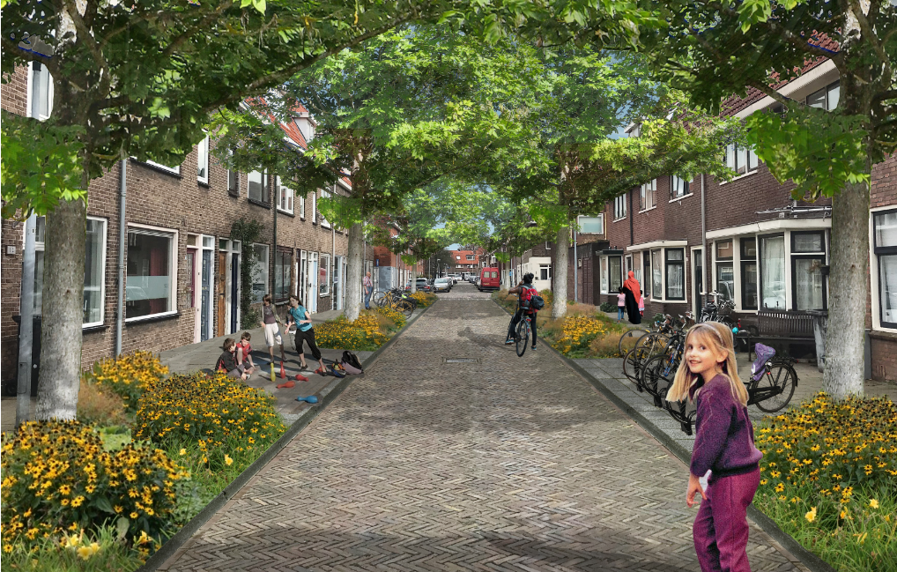
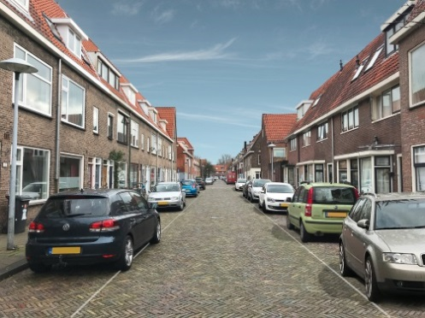
❶
Greening streets
Notes:
Greening streets: we looked at which neighborhoods are green. It involved 800 streets and we think we can make 200 hectares green there. We do this by narrowing streets through one-way traffic, removing parking spaces, narrower sidewalks, etc.
robust greening of the green-poor neighborhoods
The transition to green mobility will help us to make more room for green public space in our city. Parking spaces which can be turned into greening streets.
Why are we doing this?
Greener living conditions for plants and animals in the bare center
Provides green living space for new residents and current residents
Green view from homes
Public garden and park, close by with a 5- or 10-minute walk

Slide 11
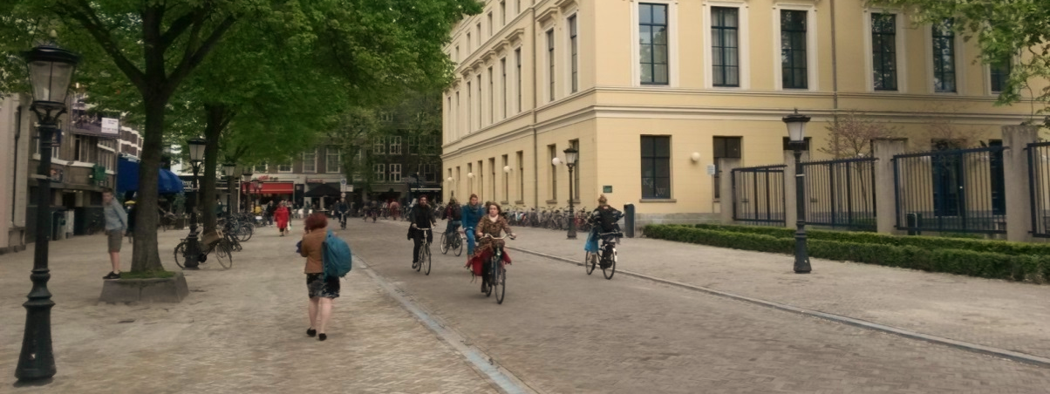
Complete redesign, more allure in the city
Notes:
Downtown Utrecht. In this picture you can see a downtown street that has been re-designed to fit people instead of cars. At first the city proposed to get rid of half the number of parking space. The shop and restaurant owners asked us to remove all of them. They discovered that they didn’t profit much from the people parking their cars over there. After the redesign sales went up, the same as in other downtown-streets we re-designed. Now there are many more pedestrians and cyclists who spend on average a little bit less but since there are many more it is still very profitable for the entrepreneurs.

Slide 12
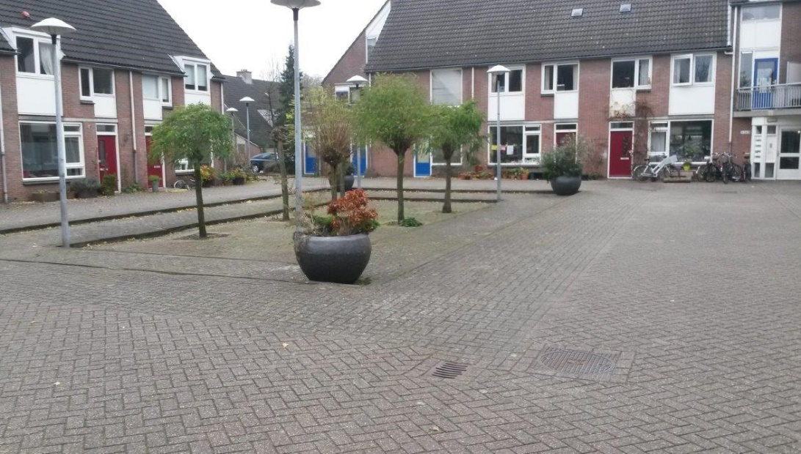
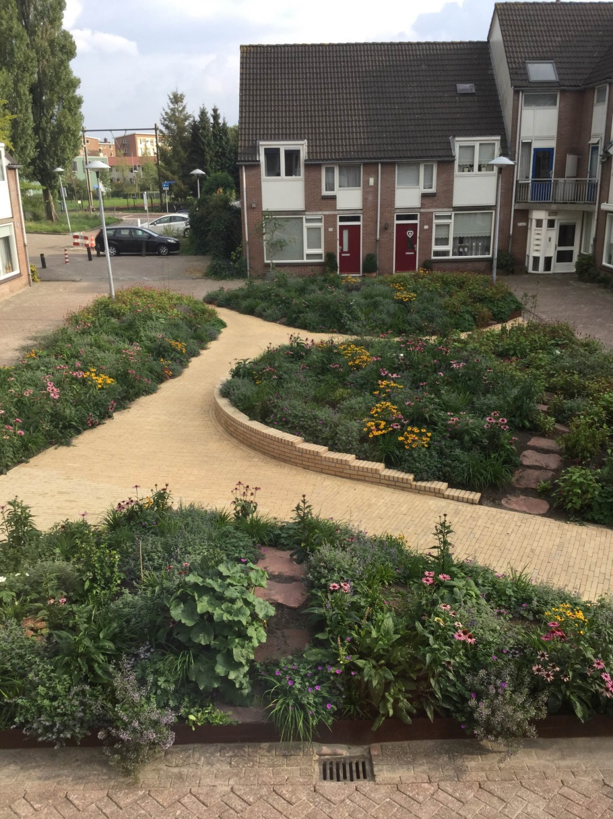
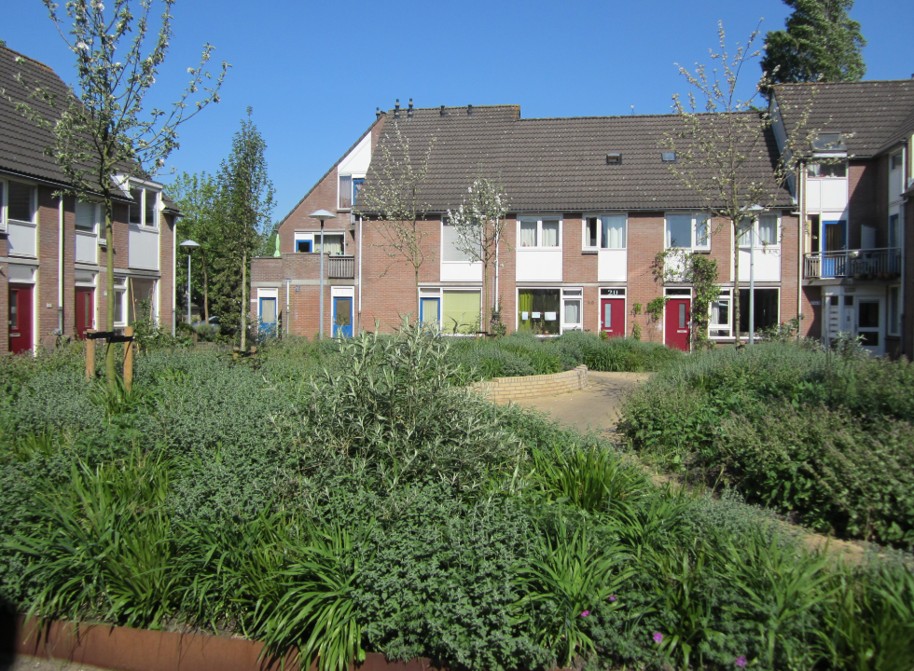
Abstederhof
Absterderhof

Slide 13
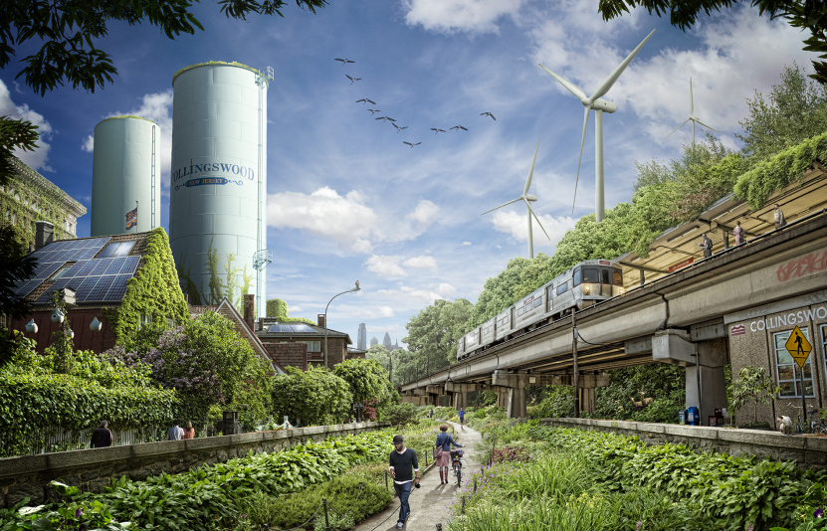
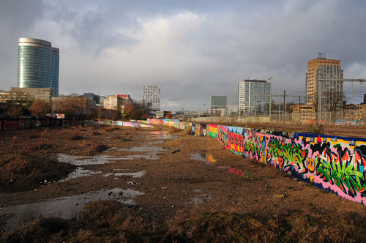
❷
New Park Areas
Notes:
New park areas. Here we think we can realize 120 ha. This can be the expansion of an existing park by removing paving in the vicinity of the park, but it can also be done by creating new parks on, for example, parking garages or by eliminating parking spaces or choosing not to build homes somewhere.
adds large city parks with a size that is new to Utrecht.
What do we want to achieve?
New green areas close to residents?
Requires the greening of areas with urban functions and land tunnels above railway lines and national roads
City park close to recent developments – people can enjoy green space in the neighbourhood
Policy is add more green space and playgrounds on street level. Therefore, we introduced the policy to reduce parking space with 0,5-1% each year.

Slide 14
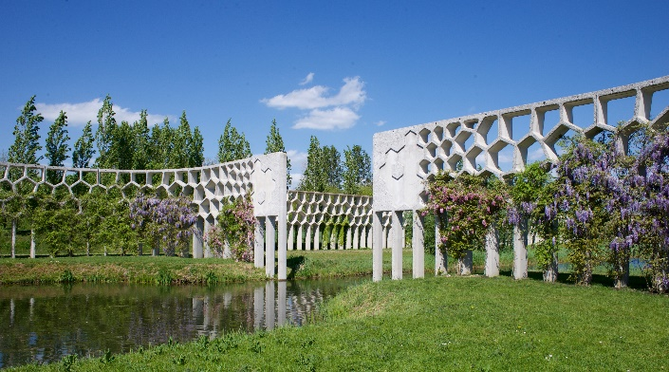
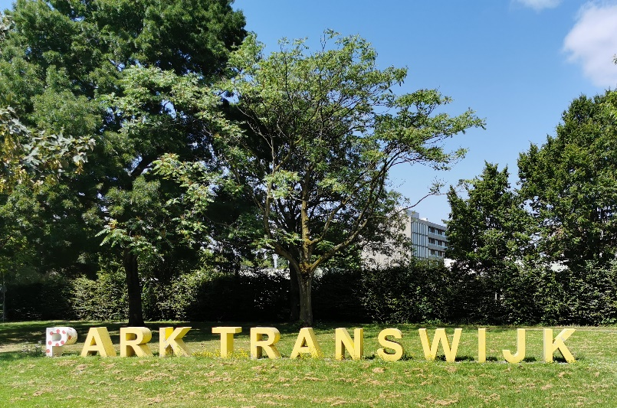
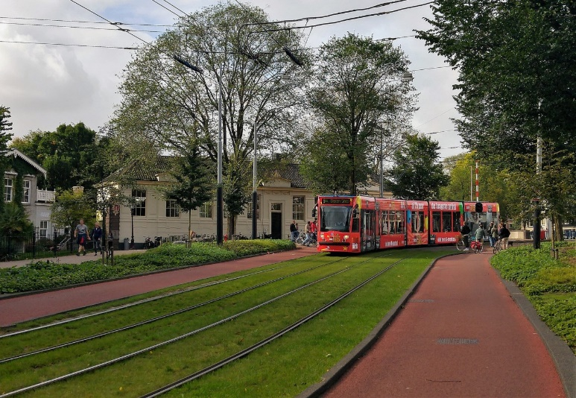
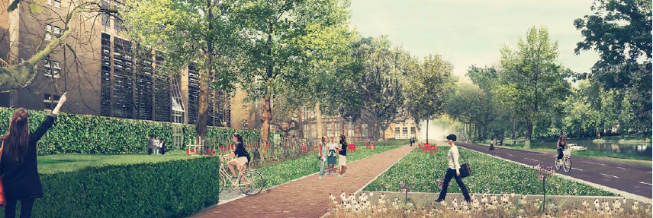
Icoonproject: Singelpark incl Moreelse parken
De Tuinen van Moreelse + Malieblad + Wolvenplein + Daalsepark + Smakkelaarsveld
Notes:
Recent examples of started projects for new park areas

Slide 15
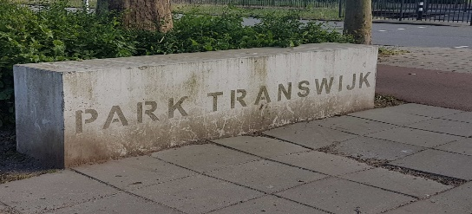
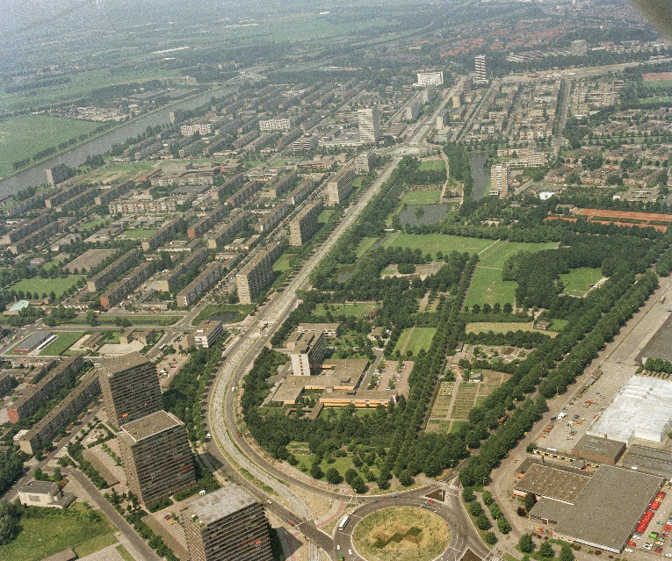
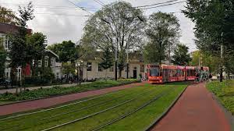
Icoonproject Park Groot Transwijk
Metro of Lightrail Europalaan deepened
Beneluxlaan and Europaweg as parkway
Lift barriers
Together with mobility task and
Housingassignment

Slide 16
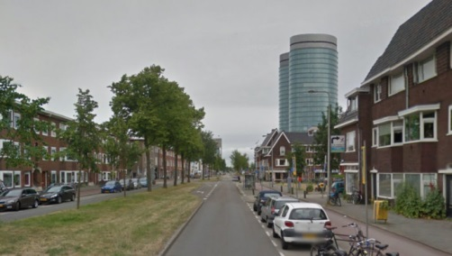
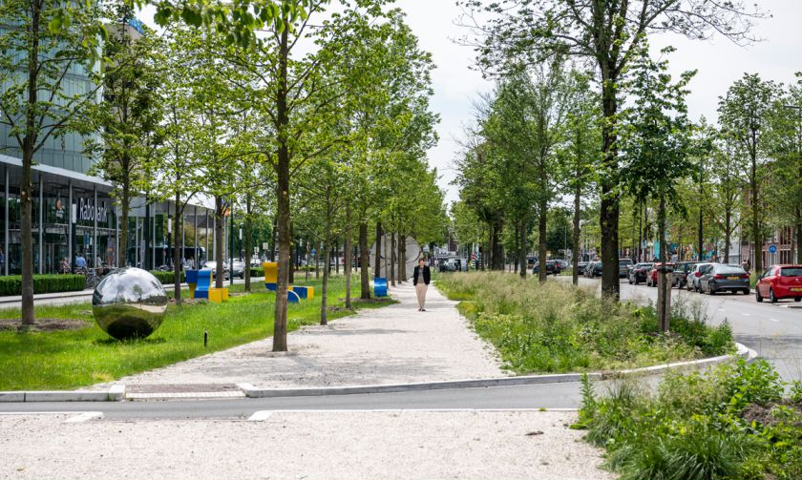
❸
Green-blue connections
Notes:
Green-blue connections. Our main green structure map shows which connections we want. It is estimated that we can make 120 hectares here. We do this by, for example, narrowing roads, by handling our mobility differently. What is also important here is that we also solve the bottlenecks that cause the connections to be interrupted.
construction of green connections between parks, neighborhoods and outdoors
What do we want to achieve?
Strengthens the urban ecosystem through better migration of plants and animals;
Offers "green nearby" for residents and users and nice routes to the parks

Slide 17
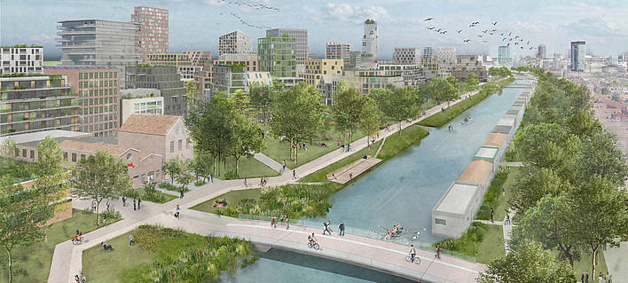
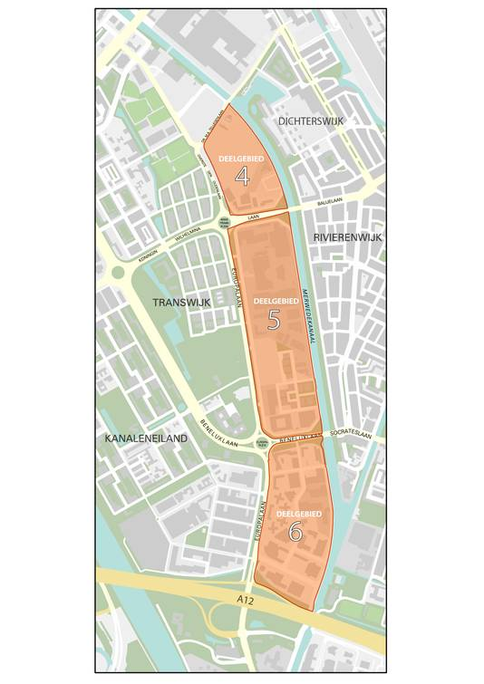
Merwedekanaalzone: Green, compact and connected
Voorbeelden en fotos
Notes:
Planning new developments – Merwedekanaalzone
10.000 houses
Mostly car free
Very good bicycle and pedestrian infrastructure, 5 new walking and cycling bridges
Good access to improved public transport tramline
Bike sharing, cargo bike sharing available nearby
Parking space only at underground parking facilities
Hundreds of cars available in car-sharing scheme

Slide 18
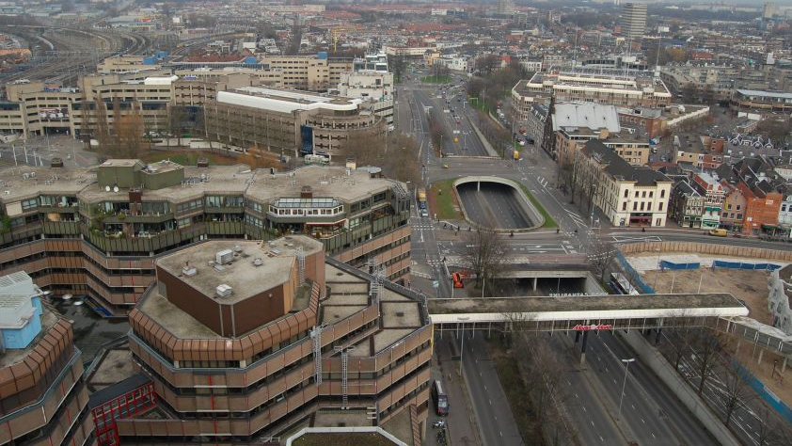
Singel
from 8 lane highway to restored waterway
Notes:
from 8 lane highway to restored water
Catharijnesingel, 8 lane highway in downtown Utrecht. Constructed in the beginning of the sixties. Considered to be the biggest mistake the city ever made. Plans were to construct a modern ring road all the way around the historic town and at the same time get rid of the historic mauld (canal ) Luckily it stopped because there was to much opposition from the inhabitants.
This is how it look now. Plenty of space for walking and cycling and a nice city park and some road infrastructure for the cars. In the far end of the picture we are going to make it impossible for cars to continue. No more through traffic from North to South using the downtown area.

Slide 19
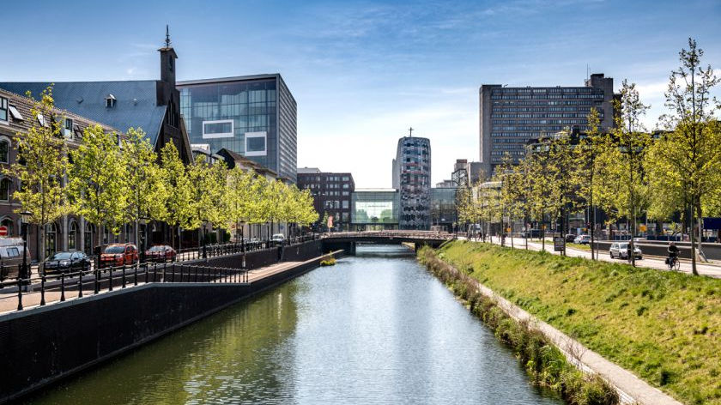
Notes:
The decade
From car orientation to quality

Slide 20
Dafne Schippers bridge
Notes:
The Dafne Schippers bridge. In order to connect the new suburb of Leidsche Rijn with 30.000 new houses we build a dedicated cycling bridge over the 100 meter wide Amsterdam-Rhine channel.
Due to the lack of space we integrated the ramp in a school and park.
By doing this, we are improving our city every day. This cycling bridge was a difficult process as well, until someone said: could we built the bridge ON the roof of the adjacent school and make a curve in the route. Now it’s on of our most photogenic examples.
We are aware that there still many challenges to face.
But never forget every now and then to sit back, relax and enjoy also as an encouragement for the next improvement.

Slide 21
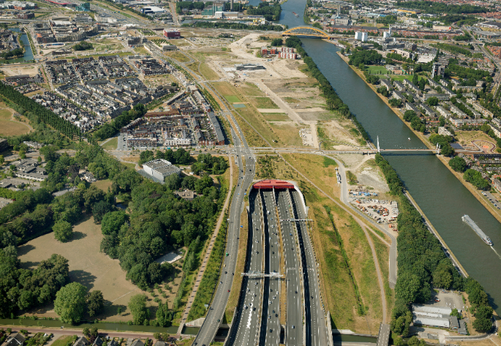
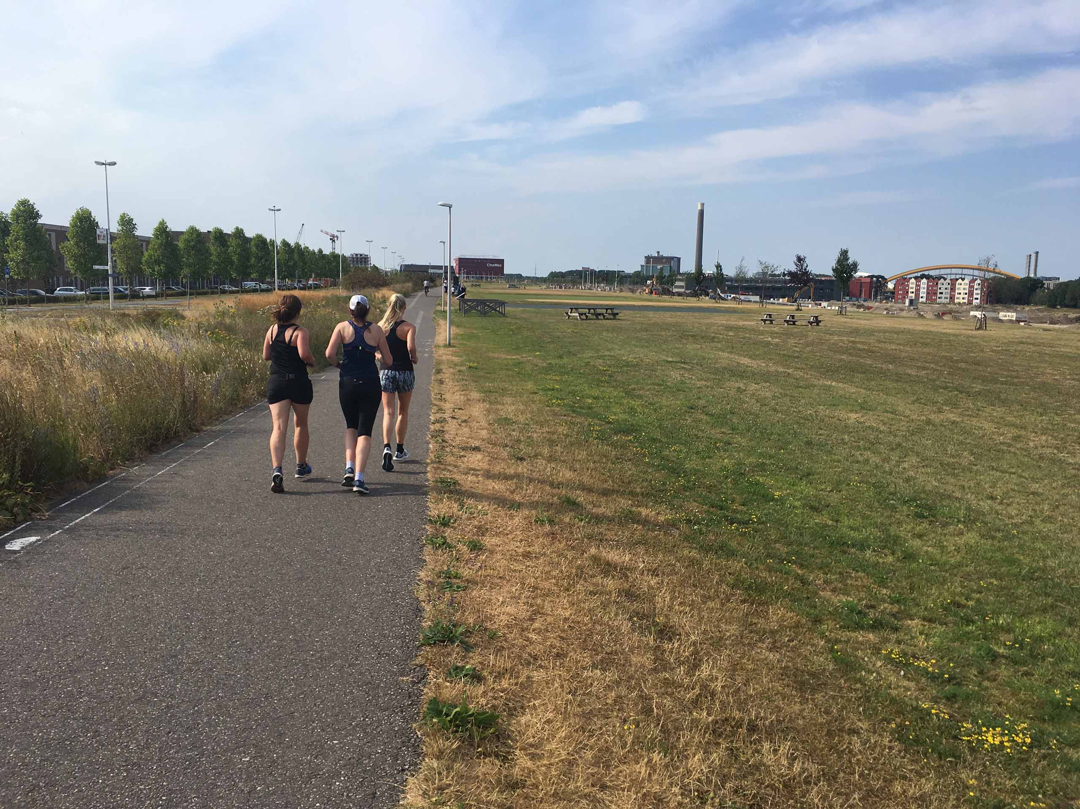
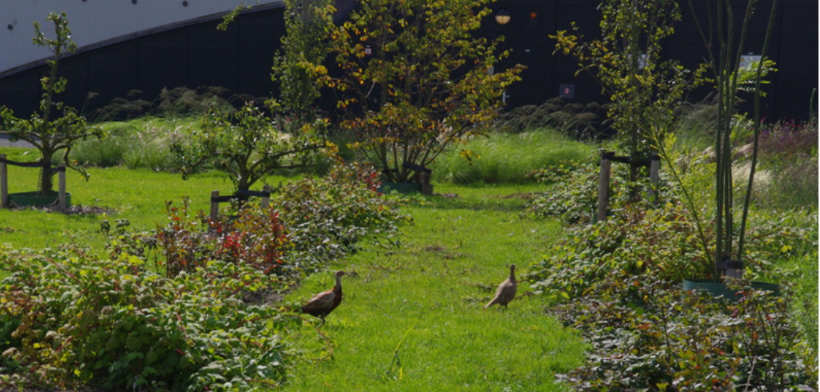
❹
Green corridor
Notes:
4. Green corridor. The transition from the city to the countryside. Here we think we can realize 30 hectares through purchase and leasehold. Here also the barriers of roads and railways must be solved.
What do we want to achieve?
More undisturbed space for plants and animals and better exchange possible
"Outdoors" is closer to residents and users, faster access to landscapes
Widening of “green fingers" plus green redevelopment of a green belt in the city fringes Existing green fingers: protect against built urban development and make it more robust. Strategically identify new green fingers and develop them step by step (green reservation) Also green fingers at regional level between city and surrounding centers

Slide 22
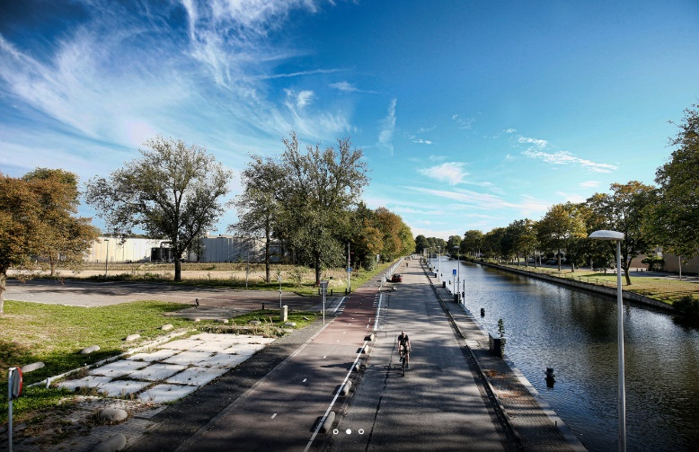
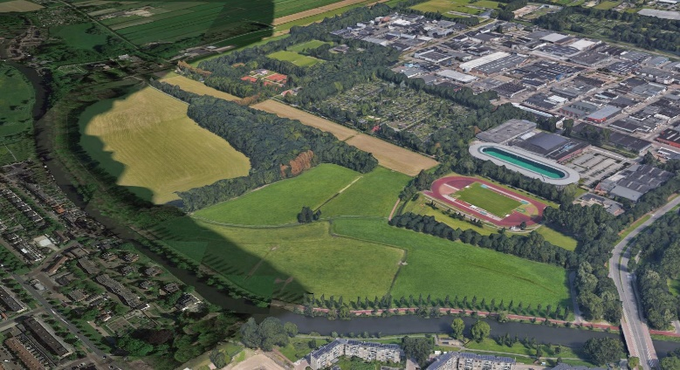
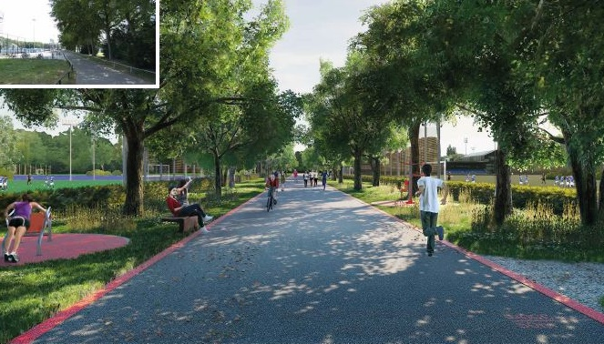
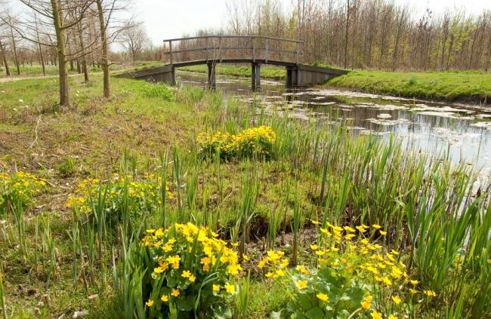
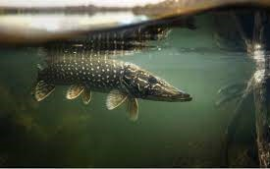
Vecht-scheg/Oud Zuilen
Bringing nature into the city
Notes:
Example of a green corridor; Park Oud-Zuilen along the Vecht river
Vechtdijk, regional route (max 30 km/h, cycling street) into the neighbouring village of Maarssen, no cars allowed except from the inhabitants who live along the river Vecht.
For the development of walking and cycling routes and the development of green networks we are cooperating with the regional government

Slide 23
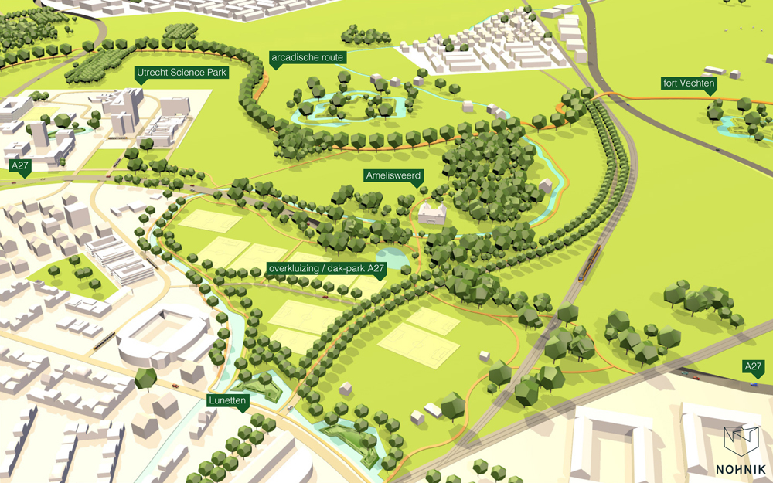
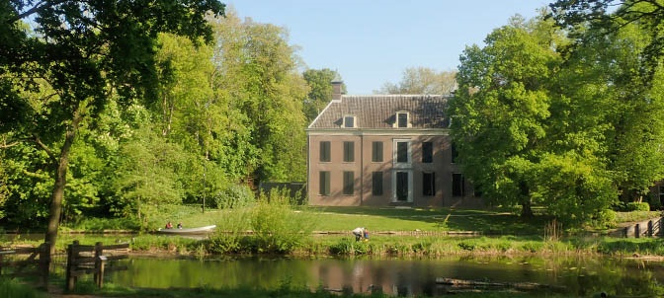
Scenario 5: Green around the city, Icoonproject Groot Amelisweerd
Brilliant growth with Unesco status, together with future
development Koningsweg Lunetten
Notes:
Green around the city as a counter-mold to the compact city. Here we think we can realize 250 hectares by purchasing land and creating connections between recreational and green areas.

Slide 24
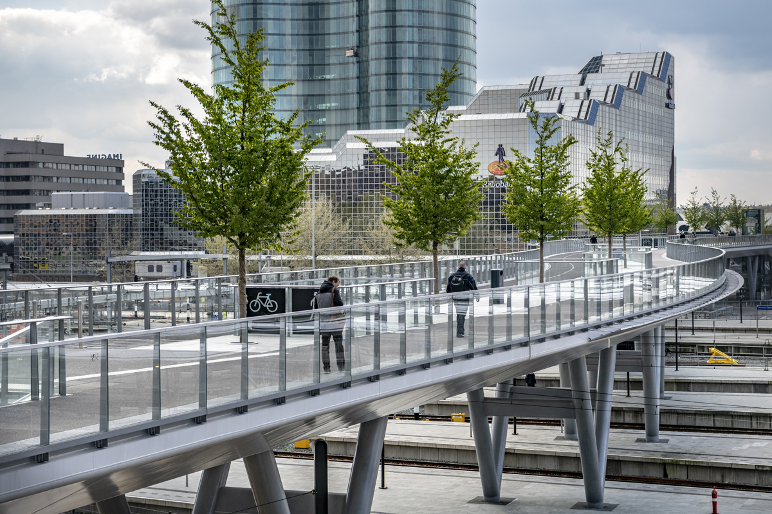
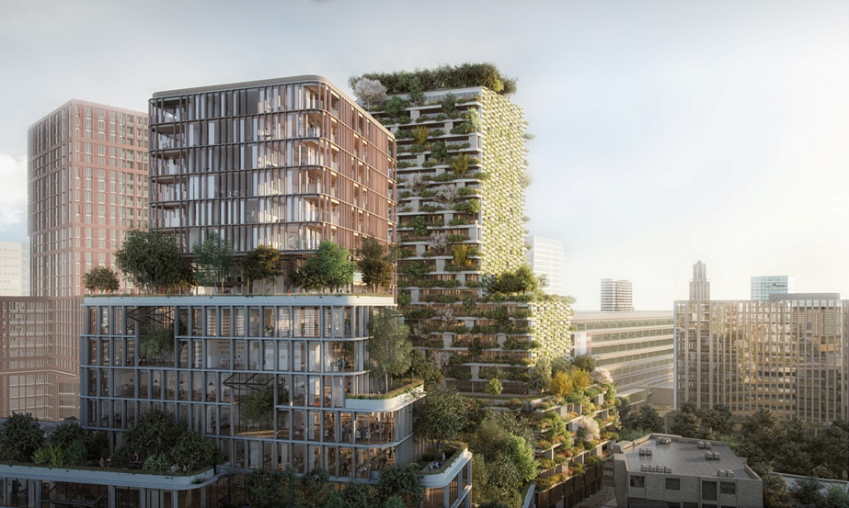
Other multifunctional inner city green
Moreelsebrug
https://nl.wikipedia.org/wiki/Moreelsebrug
Now building: Wonderwoods
https://wonderwoods.com
Notes:
Wonderwoods and Rabo bridge
in the station area is a challenging project (next step greenstructure planning in and on a building):
- Wonderwoods will probably consume more water than it will be raining in Utrecht, because of its exuberant green (360 trees).
The challenge is to make rainwater available from the surrounding environment / buildings
- maintenance of the green by 'flying gardeners' or abseiling alpinists with green fingers. A profession that does not exist yet.
- ignorance of permit issuer, supervisory authorities and emergency services (fire brigade) how to deal with such a building with a lot of greenery.
- many developers and especially investors still have to make mindshift to HUL

Slide 25
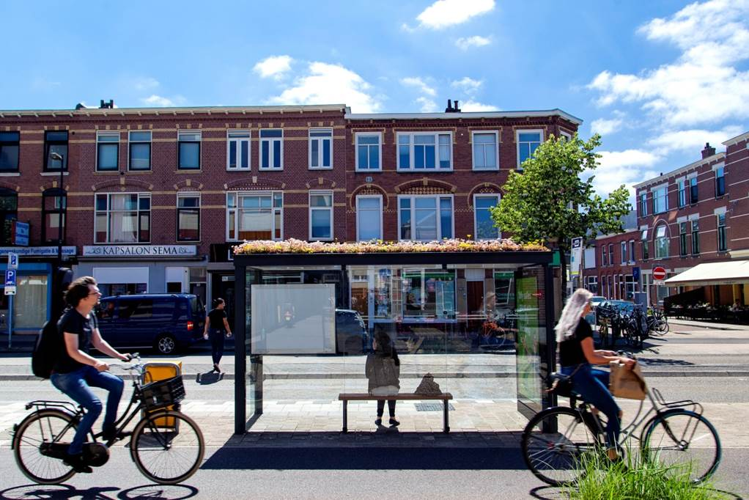
Making the city a healthy ecosystem with happy citizens
In collaboration with the city and other partners
Notes:
Collaborating from idea to implementation, multidisciplinary approach and celebrating results together with everyone
We share this strategy with the important partners in the city. We take them with us and we keep them engaged. They know what they can expect from us, namely the question 'how do you contribute to healthy urban life?) and think along about possible solutions
Start with the question, not the solution
In that collaboration, we start by asking questions. And especially the question 'how can we....'. We therefore do not prescribe solutions in advance.
And enjoy together the results?
For example:
Take our famous bee-friendly bus shelters. In the past we would have organized a tender in which we would have described and specified the bus shelters in detail. And then chose the cheapest entry.
Not this time. In the tender, we now asked for bus shelters that match our goal of healthy urban living and that provide an answer to our energy transition and climate adaptation challenges. This was the winning entry.
We couldn't have come up with it ourselves.

